Slide 1
LO: To apply key map skills.
18/6/2020
The future is in your hands class of 2020
The zombie apocalypse has arrived. It is thought they have been attracted to earth by Donald Trump’s orange glow.
You have just 12 DAYS to manage the invasion, find survivors, gather resources and seek safety. Each mistake results in 1 DAY lost. Will you endure?
Starter: Are you qualified for the job?
Do you know your places around the world? Can you:
Key: Name each of the 7 continents.
Boost: Name a country in each continent
Aspire: Name a city in each continent?

Slide 2
There has been a zombie invasion that is spreading across the globe.
They are spreading rapidly, but governments cannot find the patterns or warn people quickly enough.
It is YOUR mission to find out more about the zombie invasion – to map their spread, to warn those in danger and to support the survivors.

Slide 3
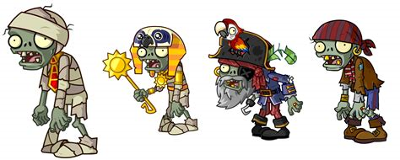
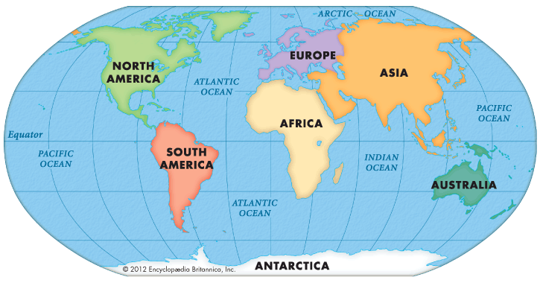
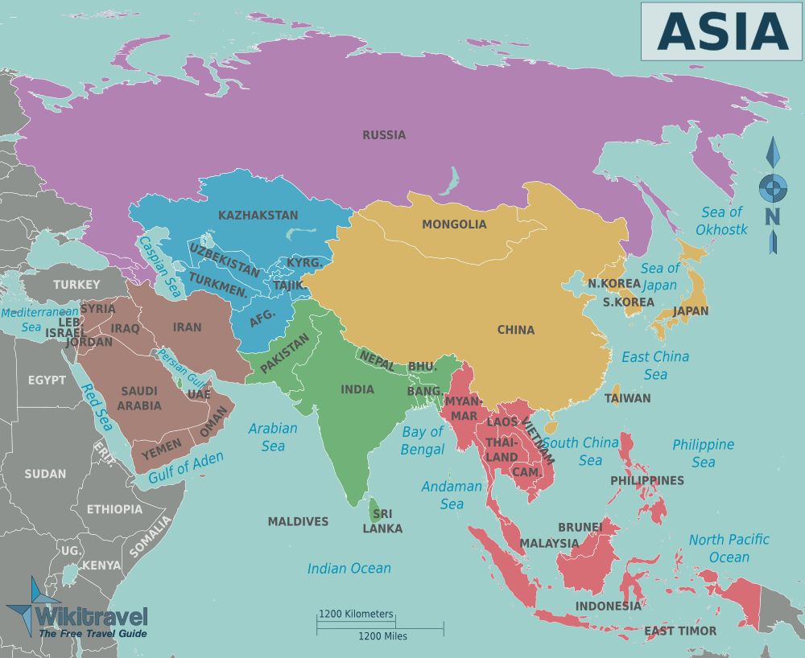
What do we know about the 7 continents of the world?
You must know them to be able to complete your mission!
The continent that has had the biggest hit of zombie attacks is Asia – so let’s find out more about Asia!
https://www.youtube.com/watch?v=K6DSMZ8b3LE
The countries that you will be focusing on are highlighted on the map opposite – these countries desperately need your help!

Slide 4
Mission 1:You must watch the following news bulletin to find out more.
Some of the locations invaded are located on your map –
Key: Can you complete the map to achieve mission 1?
Boost: Can you describe the spread of the invasion so far?
Think about: Countries affected so far, continents affected so far, what the hemisphere have the zombies invaded
Aspire: Can you predict where you think the zombies will head next? Use your compass directions to help.

Slide 5
EMERGENCY BROADCAST
:: UPDATE ::
ZOMBIE’S CONFIRMED IN THE FOLLOWING CITIES ACROSS ASIA AND THE MIDDLE EAST
BEIJING
HONG KONG
BANKGKOK
DHAKA
NEW DELHI
MUMBAI
KATHMANDU
ISLAMABAD
Karachi
KABUL
BAGHDAD
TEHRAN
EMERGENCY BROADCAST
INFECTION CONFIRMED IN THE FOLLOWING CITIES ACROSS ASIA
BEIJING
HONG KONG
BANKGKOK
DHAKA
DELHI
MUMBAI
KATHMANDU
ISLAMABAD
EMERGENCY BROADCAST
INFECTION CONFIRMED IN THE FOLLOWING CITIES ACROSS ASIA
BEIJING
HONG KONG
BANKGKOK
DHAKA
DELHI
MUMBAI
KATHMANDU
ISLAMABAD
EMERGENCY BROADCAST
INFECTION CONFIRMED IN THE FOLLOWING CITIES ACROSS ASIA
BEIJING
HONG KONG
BANKGKOK
DHAKA
DELHI
MUMBAI
KATHMANDU
ISLAMABAD
EMERGENCY BROADCAST
INFECTION CONFIRMED IN THE FOLLOWING CITIES ACROSS ASIA
BEIJING
HONG KONG
BANKGKOK
DHAKA
DELHI
MUMBAI
KATHMANDU
ISLAMABAD
EMERGENCY BROADCAST
INFECTION CONFIRMED IN THE FOLLOWING CITIES ACROSS ASIA
BEIJING
HONG KONG
BANKGKOK
DHAKA
DELHI
MUMBAI
KATHMANDU
ISLAMABAD
EMERGENCY BROADCAST
:: UPDATE ::
INFECTION CONFIRMED IN THE FOLLOWING CITIES ACROSS ASIA AND THE MIDDLE EAST
BEIJING
HONG KONG
BANKGKOK
DHAKA
DELHI
MUMBAI
KATHMANDU
ISLAMABAD
Karachi
KABUL
BAGHDAD
TEHRAN
EMERGENCY BROADCAST
:: UPDATE ::
INFECTION CONFIRMED IN THE FOLLOWING CITIES ACROSS ASIA AND THE MIDDLE EAST
BEIJING
HONG KONG
BANKGKOK
DHAKA
NEW DELHI
MUMBAI
KATHMANDU
ISLAMABAD
Karachi
KABUL
BAGHDAD
TEHRAN
EMERGENCY BROADCAST
:: UPDATE ::
INFECTION CONFIRMED IN THE FOLLOWING CITIES ACROSS ASIA AND THE MIDDLE EAST
BEIJING
HONG KONG
BANKGKOK
DHAKA
DELHI
MUMBAI
KATHMANDU
ISLAMABAD
Karachi
KABUL
BAGHDAD
TEHRAN
EMERGENCY BROADCAST
:: UPDATE ::
INFECTION CONFIRMED IN THE FOLLOWING CITIES ACROSS ASIA AND THE MIDDLE EAST
BEIJING
HONG KONG
BANKGKOK
DHAKA
DELHI
MUMBAI
KATHMANDU
ISLAMABAD
Karachi
KABUL
BAGHDAD
TEHRAN
EMERGENCY BROADCAST
:: UPDATE ::
INFECTION CONFIRMED IN THE FOLLOWING CITIES ACROSS ASIA AND THE MIDDLE EAST
BEIJING
HONG KONG
BANKGKOK
DHAKA
DELHI
MUMBAI
KATHMANDU
ISLAMABAD
Karachi
KABUL
BAGHDAD
TEHRAN
EMERGENCY BROADCAST
:: UPDATE ::
INFECTION CONFIRMED IN THE FOLLOWING CITIES ACROSS ASIA AND THE MIDDLE EAST
BEIJING
HONG KONG
BANKGKOK
DHAKA
DELHI
MUMBAI
KATHMANDU
ISLAMABAD
Karachi
KABUL
BAGHDAD
TEHRAN
EMERGENCY BROADCAST
:: UPDATE ::
INFECTION CONFIRMED IN THE FOLLOWING CITIES ACROSS ASIA AND THE MIDDLE EAST
BEIJING
HONG KONG
BANKGKOK
DHAKA
DELHI
MUMBAI
KATHMANDU
ISLAMABAD
Karachi
KABUL
BAGHDAD
TEHRAN
EMERGENCY BROADCAST
:: UPDATE ::
INFECTION CONFIRMED IN THE FOLLOWING CITIES ACROSS ASIA AND THE MIDDLE EAST
BEIJING
HONG KONG
BANKGKOK
DHAKA
DELHI
MUMBAI
KATHMANDU
ISLAMABAD
Karachi
KABUL
BAGHDAD
TEHRAN

Slide 6
12.
1.
11.
8.
10.
9.
5.
7.
2.
6.
4.
3.
Let’s check our answers to see if we have successfully completed Mission 1…

Slide 7
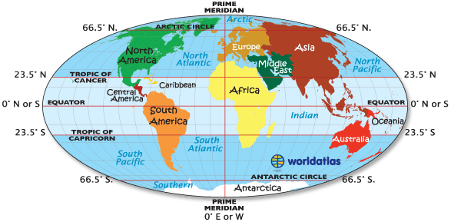
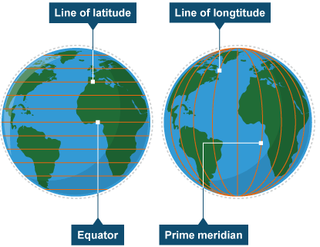
To complete Mission 2 we have to know about lines of latitude and longitude. These are invisible lines that split the world up for us. It makes it easier for us to know where places are.
Let’s find out more…
We can use numbers and letters to find places on a map. The map above shows us how these can be used.
N- North. S- South. E-East. W-West.
You live in England – this is 60°N (latitude) and 0° longitude. Australia would be 23.5°S (latitude) and 133°E (longitude).
Let’s practice…

Slide 8
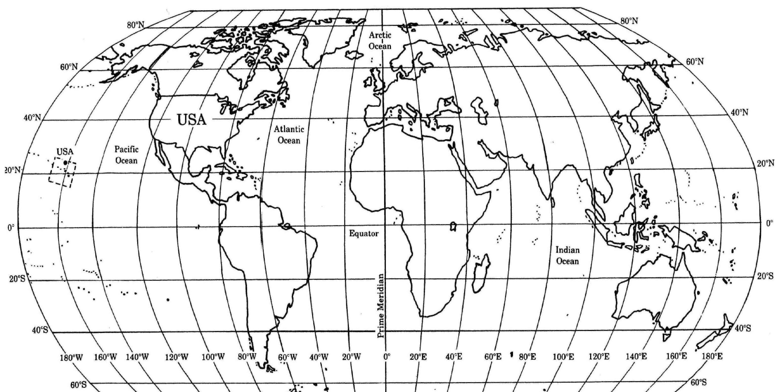
Can you give the latitude and longitude for these places?
1. USA 2. South Africa 3. Iceland 4. New Zealand
3
1
2
Answers:
1: 40°N; 100°W.
2:20°S; 20°E
3: 60°N; 20°W
4: 40°S; 180°E
4

Slide 9
Mission 2:
We must find out where is safe so that we can keep as many people out of danger as we can!
Using the clues opposite, you need to find the missing cities.
The first letter of each location helps to spell out the clue…
You need an atlas for this!

Slide 10
9. Athens
10. New York
11. Dublin
12. Washington DC
13. Ankara
14. Tokyo
15. E
16. Riyadh
17. Seoul
18. Astana
19. F
20. E
Answers:
Mission 2:
Hong Kong
Islamabad
Guatemala City
Helsinki
5. Lisbon
6. Amsterdam
7. New Delhi
8. Dhaka
CLUE | H | I | G | H |  | L | A | N | D |  | A | N | D |  | W | A | T | E | R |  | S | A | F | E
What does this mean…..?

Slide 11
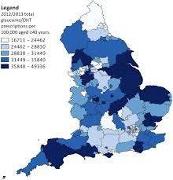
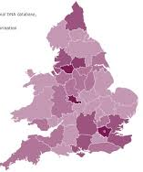
Mission 3: BREAKING NEWS: The zombies are heading to the UK. Look at your top secret email – firstly we have to find these cities in the UK.
Key: Use the list of cities to highlight where is at risk in the UK. The first one has been done for you!
Boost: Can you describe where these cities are?
Aspire: Can you use compass directions?
Mission 4: You must now colour your map to show where the zombies are spreading. Your email tells you how many zombies have invaded each area of the UK.
Key: Using the key opposite, you must choose a colour for each category – and colour that area of the map in that colour (see the examples above).
Boost: Once you have completed your choropleth map you should describe where in the UK is most at risk.
Aspire: Can you use data in your description? E.g. The South East of England has the highest number of zombies at 8.6 million.
0 to 1 million:
1 million + to 4 million:
4 million + to 6 million:
6 million + to 8 million:
8 million +:

Slide 12
Mission 5:
You need to warn everyone at risk of zombie invasion and tell them how to keep safe!
You must create a poster that you will put up in every town and village that warns them of the danger and tells them where has been invaded already.
It is your job to design an effective poster that really warns people of the danger.
You must include:
Key: Where the zombies have already invaded globally (around the world), and in the UK. Ideas of how to stay safe, and where to go!
Boost: Extend Key with a description of the spread of the zombies across the world and across the UK.
Aspire: Extend Key & Boost with an explanation of where people should head, clearly telling them why (they may need persuading to leave!).

Slide 13
Mission 6: Your map shows you where your supplies are located.
Key: Use the map provided to identify the 4 figure grid reference for the location of each of the supplies listed.
Boost: Try to work out the shortest route to collect all of the supplies (use the string and your ruler)
Number each item in the order you would collect them.
Aspire: Describe the route that should be taken to collect the supplies
Aim to include
Location of resources
Grid references
Directions
Distance between points
Any potential dangers
Your next mission involves using grid referencing. This is a key skill to learn in map reading- and could be the thing that saves our survivors!
E.g. A: 02, 51.
B: 02, 50. C: 01, 50. D: 01, 51.

Slide 14
Grid reference:
56, 35
55, 38
55, 37
54, 38
53, 38
52, 37
54, 36
55, 35

Slide 15
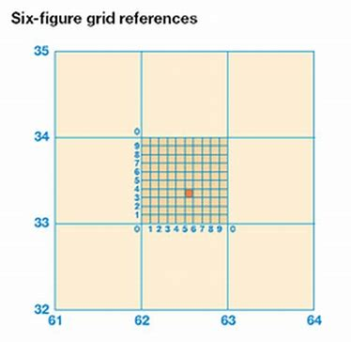
This mission requires 6 figure grid referencing – don’t worry- it’s easy! Use your 4 figure skills and then imagine each square is split into 9 along and up – estimate how far across each square you need.
See where the star is – this would be 637, 349.
The circle would be?
The triangle would be?
Mission 7:
Mission 7: Saving the survivors!
Key: Read the information received from the survivors left. Locate each location or 6 figure grid reference on your map.
Boost: Now you must write where we need to go, and the 6 figure grid reference of each location.
Aspire: Work out the route you will take to locate, and save, your survivors!

Slide 16
So, did you make it?
What skills have you learnt?
How many survivors are there?
How can we use these skills in other tasks?
Which mission was the hardest?

Slide 17
Congratulations on stopping the spread of the Zombie invaders
You are now officially armed with Geography skills, and ready to be a map reading legend.
Signed: _____________________
Date: ____________________

Slide 18
Notes to teachers:
This scheme of lessons aims to tackle many of the key, basic map skills that Geographers should be armed with when heading into KS3. Try and excite the students into completing the mission – we sometimes have to ‘jazz’ up map skills – but they are incredibly essential skills at both KS4 and 5.
Each mission should take a lesson – although mission 3&4 could be combined.
The task could be made more competitive by using mixed ability groups and setting timed challenges.
The tasks are differentiated to Key, Boost and Aspire – but I have also included a LAPs sheet to support students who may find it difficult to access the main worksheet or as an alternative to the normal sheet which could then be used as a HAPs sheet only.
Resources needed:
Print out of the worksheet (this might be best on A3)
Atlases/world map with latitude and longitude on - a scanned example is attached
Colouring pencils
Plain paper.
Answers are provided for most challenges to allow peer/self assessment and to check understanding of each skill.
NB: If students are unsure of the ‘zombie’ theme – this can quite easily be adapted.
I would love for all of the students’ work (posters & worksheets) to come back to us in September so that we can display this as part of our ‘Introducing Geography’ board in the department.
Any questions – please let me know!! CollinsR@Wollaston-school.net

