Slide 1
LIFE/work balance
We have started a #LIFEworkbalance campaign and we need your help to complete our LIFE/work balance survey.
We hope to publish the results soon, so please give 15 minutes of your time to help us get a true picture of school life.
Want to be a part of this campaign? Take the survey on our website and share it with your colleagues!
© Classroom Secrets Limited 2019

Slide 2
Year 6 – Place Value – Negative Numbers
About This Resource:
This PowerPoint has been designed to support your teaching of this small step. It includes a starter activity and an example of each question from the Varied Fluency and Reasoning and Problem Solving resources also provided in this pack. You can choose to work through all examples provided or a selection of them depending on the needs of your class.
National Curriculum Objectives:
Mathematics Year 6: (6N5) Use negative numbers in context, and calculate intervals across zero
Mathematics Year 6: (6N6) Solve number and practical problems that involve 6N2 - 6N5
More Year 6 Place Value resources.
Did you like this resource? Don’t forget to review it on our website.
© Classroom Secrets Limited 2018

Slide 3
Year 6 – Place Value
Step 4: Negative Numbers
© Classroom Secrets Limited 2018

Slide 4
Introduction
What number does each arrow point to?
A
B
C
D
E
-10 |  |  |  |  |  |  |  |  |  |  |  |  |  |  |  |  |  |  |  | 10
© Classroom Secrets Limited 2018

Slide 5
Introduction
What number does each arrow point to?
A
B
C
D
E
-10 |  | -8 |  | -6 |  |  |  | -2 |  | 0 |  |  |  | 4 |  |  |  |  |  | 10
© Classroom Secrets Limited 2018

Slide 6
Varied Fluency 1
Complete the number line.
-18
-6
6
© Classroom Secrets Limited 2018

Slide 7
Varied Fluency 1
Complete the number line.
-18
-6
6
-15
-12
-9
-3
0
3
© Classroom Secrets Limited 2018

Slide 8
Varied Fluency 2
The temperature in Greenland was 2ºC.
The next month, it had dropped by 16ºC.
What is the new temperature in Greenland?
© Classroom Secrets Limited 2018

Slide 9
Varied Fluency 2
The temperature in Greenland was 2ºC.
The next month, it had dropped by 16ºC.
What is the new temperature in Greenland?
2 – 16 = -14
The new temperature in Greenland is -14ºC.
© Classroom Secrets Limited 2018

Slide 10
Varied Fluency 3
True or false?
Lucie is counting using a number line. She starts on 9 and counts back 17.
Lucie finishes on -9.
© Classroom Secrets Limited 2018

Slide 11
Varied Fluency 3
True or false?
Lucie is counting using a number line. She starts on 9 and counts back 17.
Lucie finishes on -9.
False, Lucie will finish on -8.
© Classroom Secrets Limited 2018

Slide 12
Varied Fluency 4
Complete these number sentences.
-8 + 11 =
Kiri had £21.50 in her bank account. She spends £30.50 on a new dress. What is her new bank balance?
8 – 10 =
© Classroom Secrets Limited 2018

Slide 13
Varied Fluency 4
Complete these number sentences.
-8 + 11 = 3
Kiri had £21.50 in her bank account. She spends £30.50 on a new dress. What is her new bank balance? -£9.00
8 – 10 = -2
© Classroom Secrets Limited 2018

Slide 14
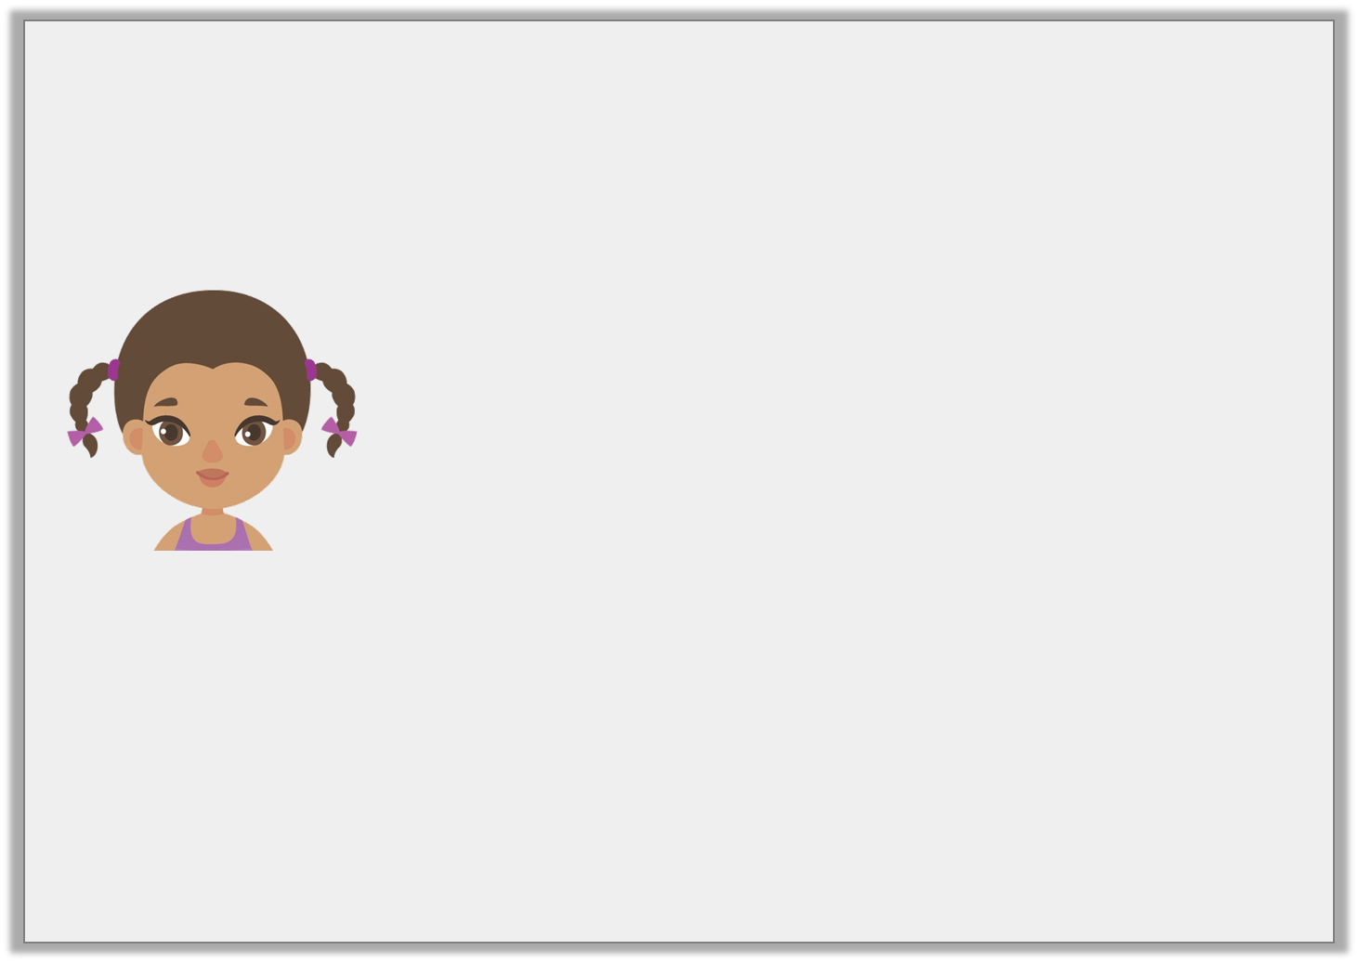
Reasoning 1
Sian is learning about negative numbers.
She says,
Is Sian correct? Explain why.
The temperature outside is -2ºC. If it changes by 6ºC it will either be 8ºC or -8ºC.
© Classroom Secrets Limited 2018

Slide 15
Reasoning 1
Sian is learning about negative numbers.
She says,
Is Sian correct? Explain why.
Sian is incorrect because…
The temperature outside is -2ºC. If it changes by 6ºC it will either be 8ºC or -8ºC.
© Classroom Secrets Limited 2018

Slide 16
Reasoning 1
Sian is learning about negative numbers.
She says,
Is Sian correct? Explain why.
Sian is incorrect because if the temperature increases by 6ºC, it will be 4ºC, not 8ºC. If it decreases it will be -8ºC.
The temperature outside is -2ºC. If it changes by 6ºC it will either be 8ºC or -8ºC.
© Classroom Secrets Limited 2018

Slide 17
Problem Solving 1
Fill in the blanks by using any two-digit number so that each answer is between 0 and 5.
How many calculations can you create?
A. | -19 | + |  |  | =
B. | -20 | + |  |  | =
C. | -14 | + |  |  | =
© Classroom Secrets Limited 2018

Slide 18
Problem Solving 1
Fill in the blanks by using any two-digit number so that each answer is between 0 and 5.
How many calculations can you create?
Various answers, examples given above.
A. | -19 | + |  | 23 | = | 4
B. | -20 | + |  | 22 | = | 2
C. | -14 | + |  | 16 | = | 2
© Classroom Secrets Limited 2018

Slide 19
Problem Solving 2
Use the digit cards to create a calculation
which equals -12.
You can only use each digit card once per calculation, but do not need to use all of them.
Is there more than one possible answer?
0
1
2
5
8
© Classroom Secrets Limited 2018

Slide 20
Problem Solving 2
Use the digit cards to create a calculation
which equals -12.
You can only use each digit card once per calculation, but do not need to use all of them.
Is there more than one possible answer?
Various answers, for example: -10 – 2, 0 – 12 or -12 – 0
0
1
2
5
8
© Classroom Secrets Limited 2018

