Slide 1
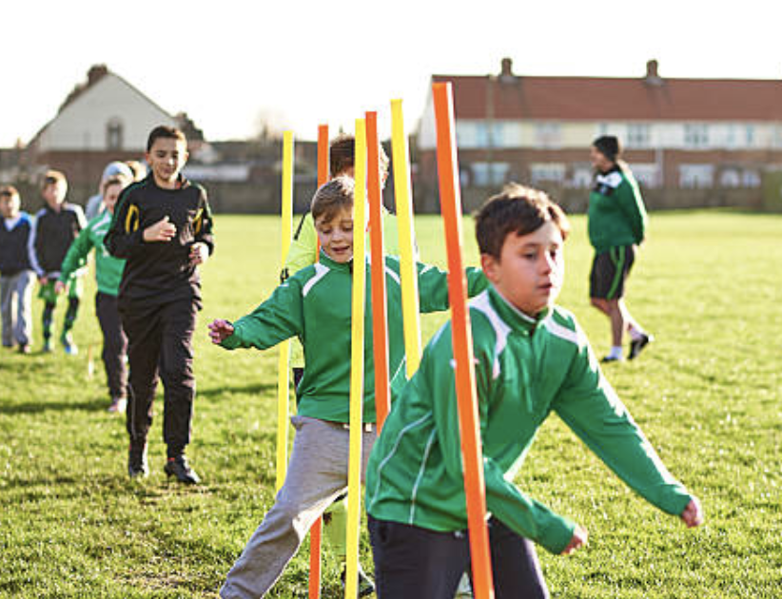
We will learn…
What fitness is
Why we need to keep it
How we can maintain our fitness

Slide 2
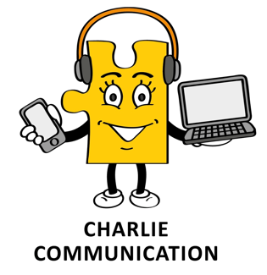
Words and phrases I will hear and use
Healthy body
Oxygen
Exercise
Activity
Muscles
Heart Rate
Fitness
Strength
Flexible

Slide 3
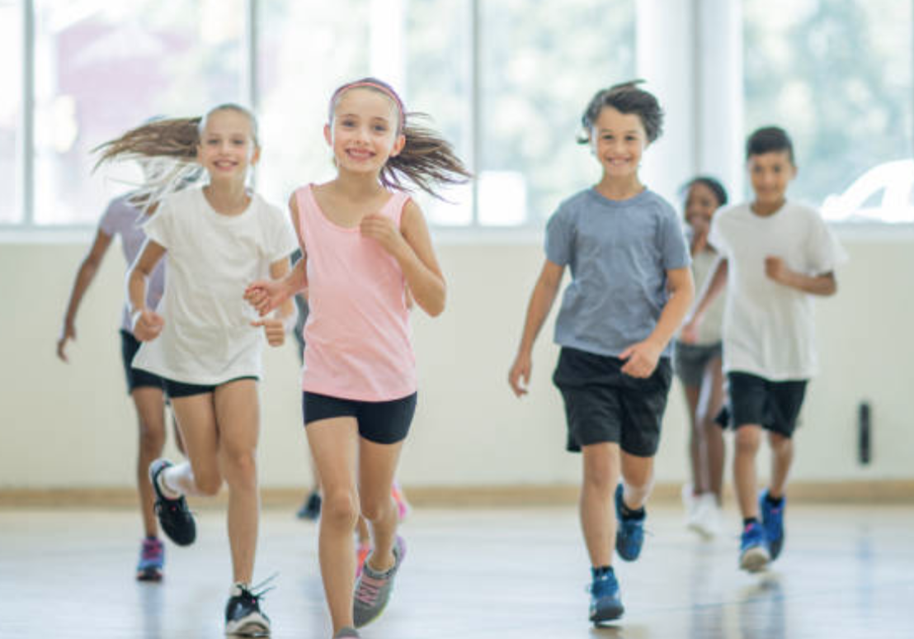
What do we mean by fitness?
The condition of being physically fit and healthy.
Having strong muscles and bones.
Keeping our hearts, lungs and other body organs healthy.
Doing exercise and keeping active, e.g. jogging, rowing, jumping rope, swimming or even dancing.
Resting is as important as exercise.

Slide 4
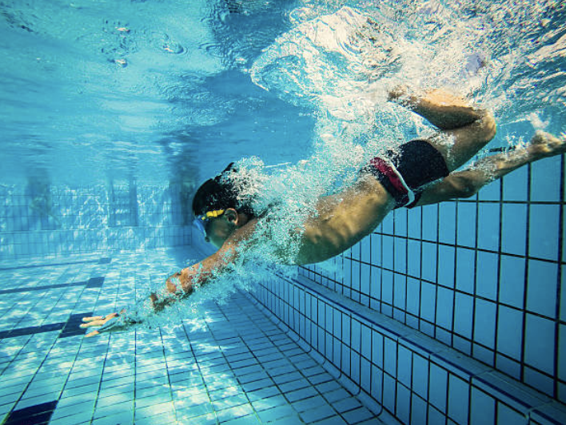
Discussion questions
How do you stay fit and active?
Which physical activities do you like and why?
How does being active make you feel?

Slide 5
Fit quiz
1. List three things you can do to be physically fit.
2. True or false: Exercise is a kind of activity that requires oxygen?
3. If you eat more calories than your body needs, it may be stored as excess _______
4. Sweat leaves your skin through tiny holes called ________
5. List two activities that can build strong muscles:
6. True or false: Exercise helps keep your heart healthy?
7. True or false: Exercise strengthens muscles?
8. True or false: Exercise makes you flexible?
9. True or false: Exercise makes you feel good?
10. True or false: Young people shouldn’t exercise or be active every day?

Slide 6
Fit quiz answers
1. List three things you can do to be physically fit – SWIM, RUN, SKIP, CYCLE, DANCE,
GYM, ETC
2. True or false: Exercise is a kind of activity that requires oxygen? TRUE
3. If you eat more calories than your body needs, it may be stored as excess FAT
4. Sweat leaves your skin through tiny holes called PORES
5. List two activities that can build strong muscles: PRESS UPS, SQUATS, ETC.
6. True or false: Exercise helps keep your heart healthy? TRUE
7. True or false: Exercise strengthens muscles? TRUE
8. True or false: Exercise makes you flexible? TRUE
9. True or false: Exercise makes you feel good? TRUE
10.True or false: Young people shouldn’t exercise or be active every day? FALSE

Slide 7
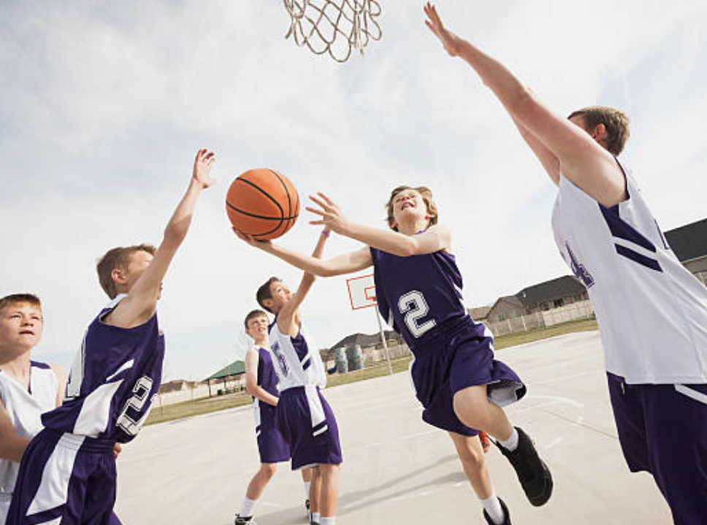
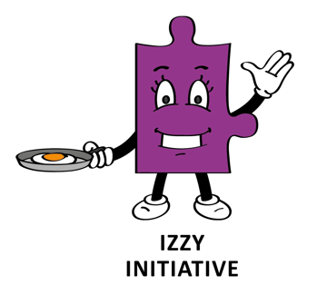
Understanding exercise
When muscles are doing more work they need more oxygen.
To get more blood to the muscles, the heart beats faster and our heart rate or pulse rate increases.
Izzy is going to help us measure our pulse rates..

Slide 8
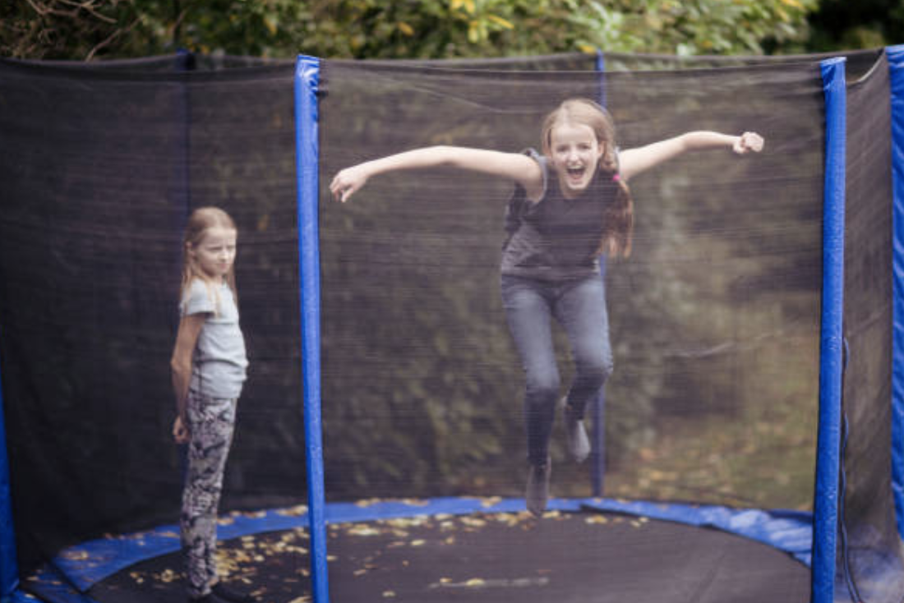
Activity: Measuring pulse rate
Locate your pulse on your wrist or neck.
Count the number of beats in 15 seconds.
Multiply this by 60 seconds.
This is how many times your heart beats per minute.
Let’s jump up and down for 2 minutes.
Now let’s re -measure our pulse.
Average beats per minute
4-5 years | 80-120 beats per min
6-8 years | 70-115 beats per min
9–11 years | 60-110 beats per min

Slide 9
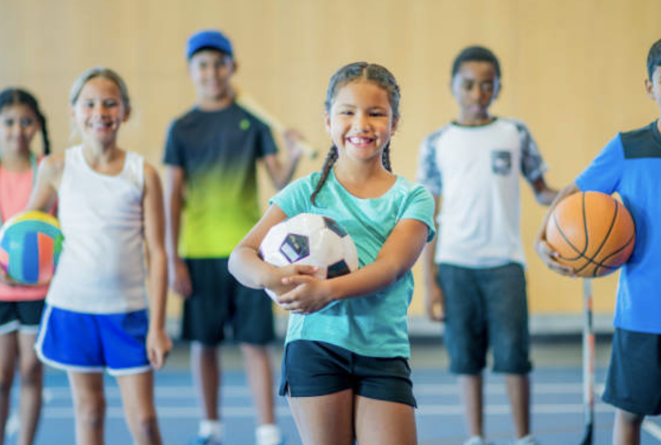
What are your favourite activities?
TASK:
Choose one of your favourite activities.
Describe some of the movements you do in your chosen activity, e.g. playing football – you need to run, kick and tackle.
Can you think of any physical activities or exercises that would help you improve your chosen activity?

Slide 10
How much fitness?
To stay healthy or to improve health, young people need to do three types of physical activity each week:
aerobic exercise.
exercises to strengthen their bones.
exercises to strengthen their muscles.

Slide 11
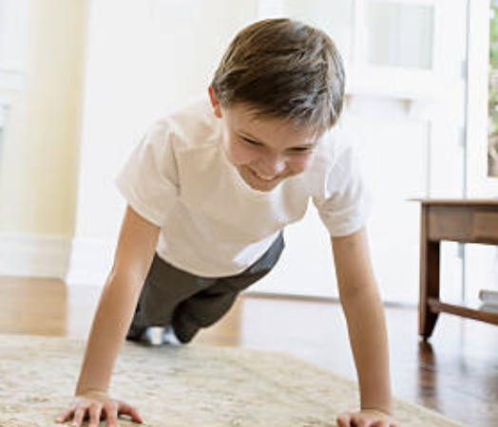
Types of fitness
At least 60 minutes of physical activity every day – this should range from moderate activity, such as cycling and playground activities, to vigorous activity, such as running and tennis.
On three days a week, these activities should involve exercises for strong muscles and bones, such as swinging on playground equipment, hopping and skipping, and sports such as gymnastics or tennis.

Slide 12
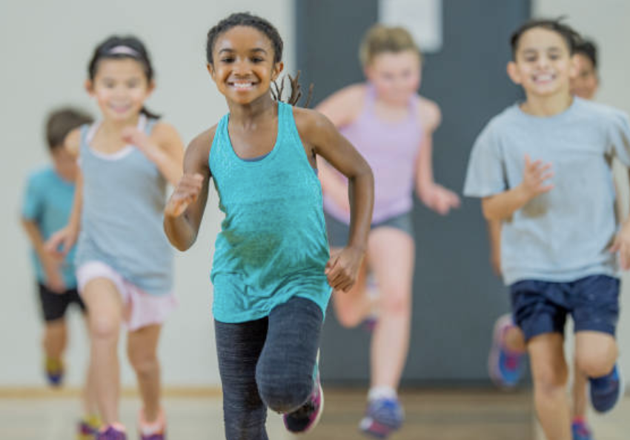
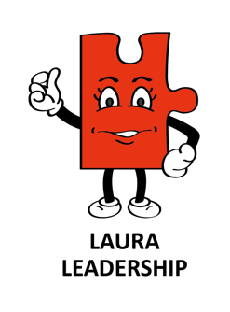
GROUP TASK: Keeping fit
Write down all the different ways you could keep each body part fit and healthy (arms, legs, stomach, heart and lungs, back, etc.).
Get ready to share your ideas with the class.

Slide 13
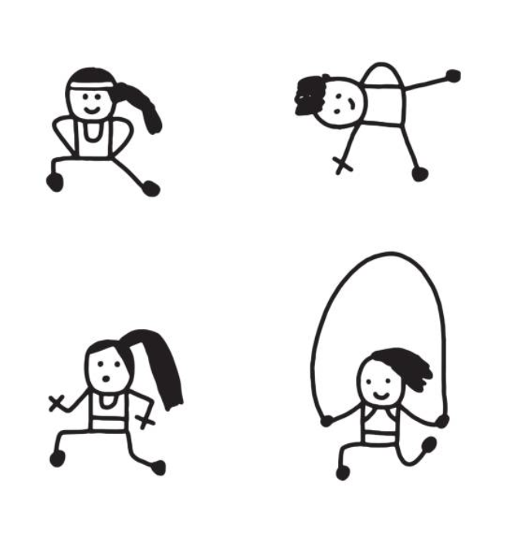
TASK: Fitness circuit
Design a circuit of fitness activities which you could do at home.
Think of any equipment you could use, or be creative, e.g. using tin cans or bottles of water for weights.

Slide 14
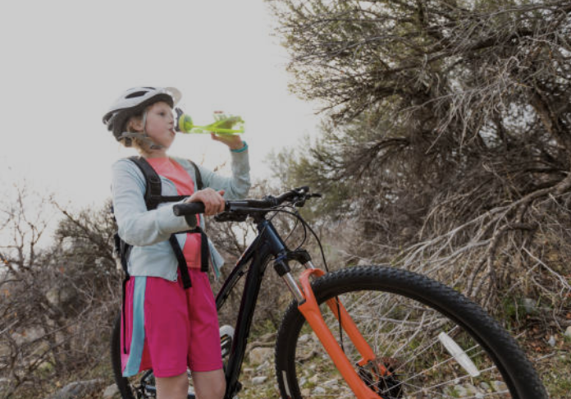
Discussion questions
You know you feel great after a bike ride, but why?
What does exercise actually do for your body?
What could happen if you don’t lead a healthy and active lifestyle?

Slide 15
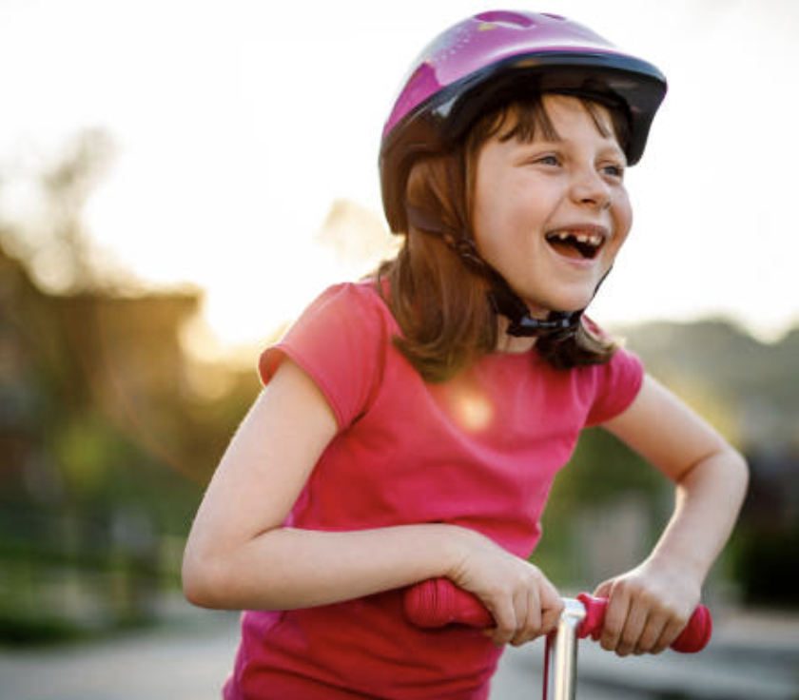
Design a poster showing all the benefits that physical activity can have on your mind and body.

