Slide 1
Being Positive

Slide 2
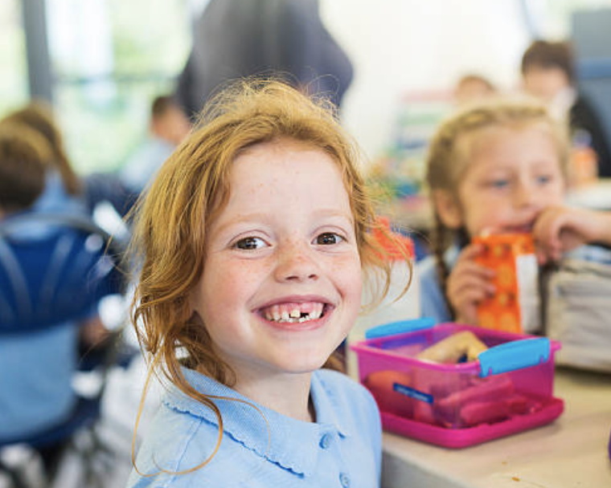
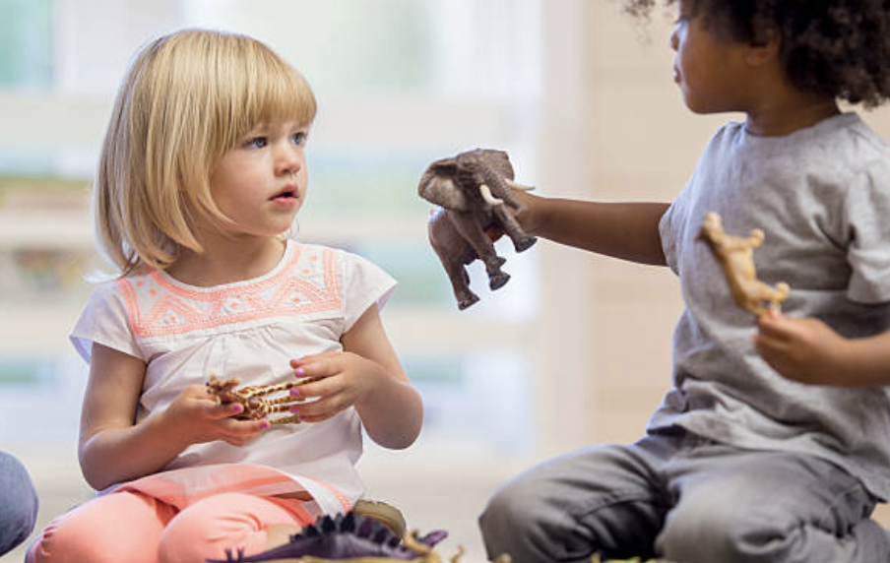
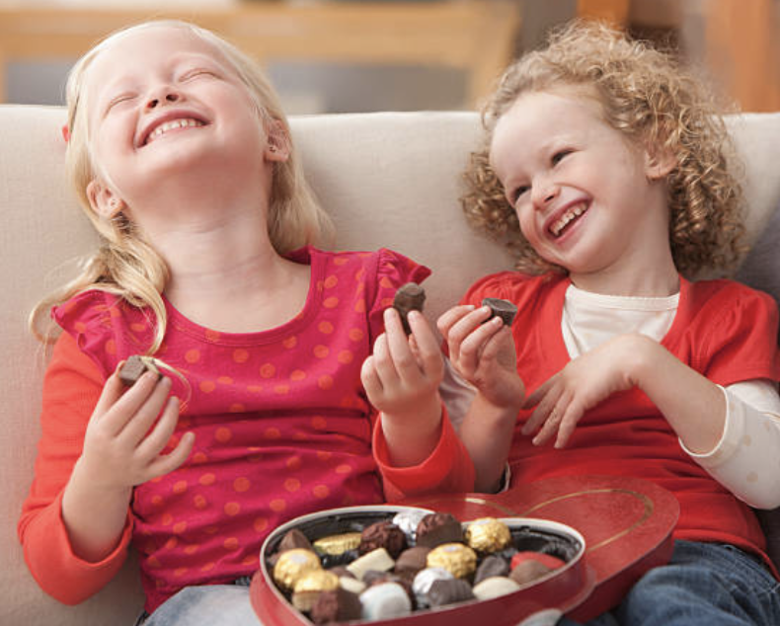
Being positive is about…
Smiling
Being kind
Being happy

Slide 3
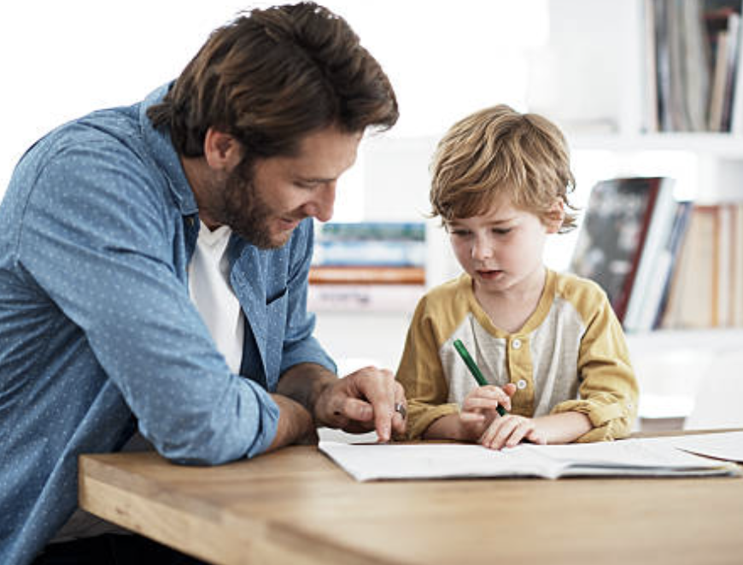
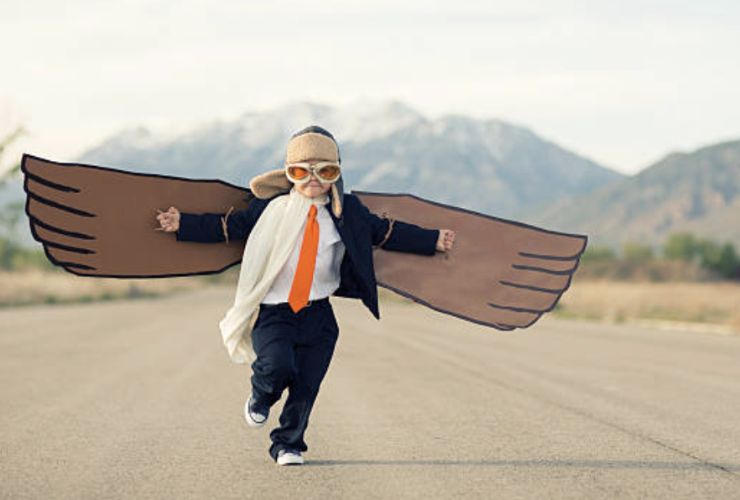
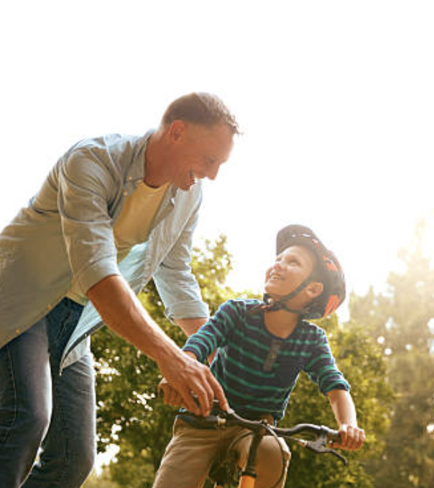
Being positive is about…
Trying
Not giving up
Letting others help you

Slide 4
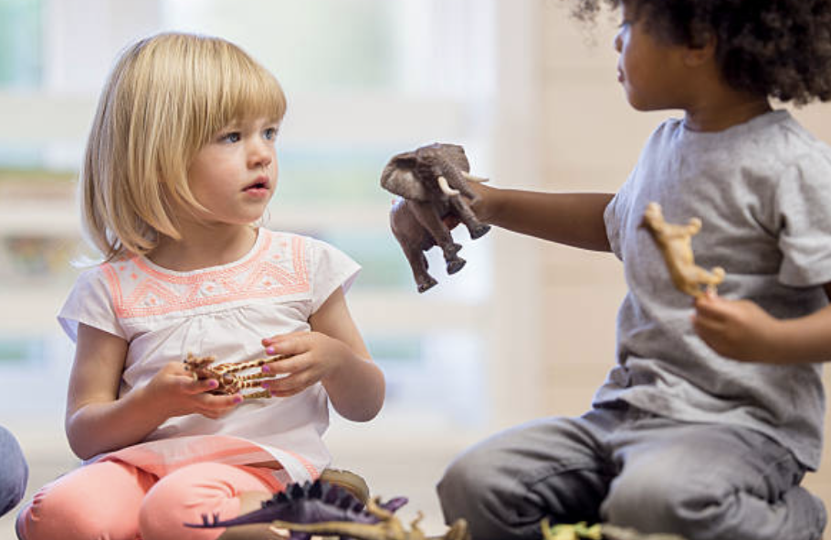
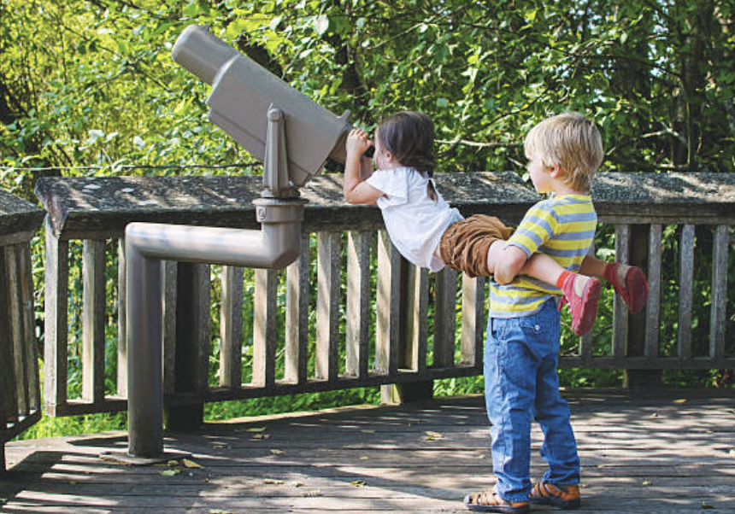
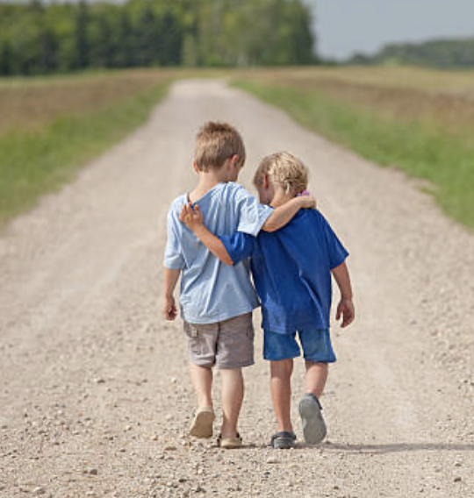
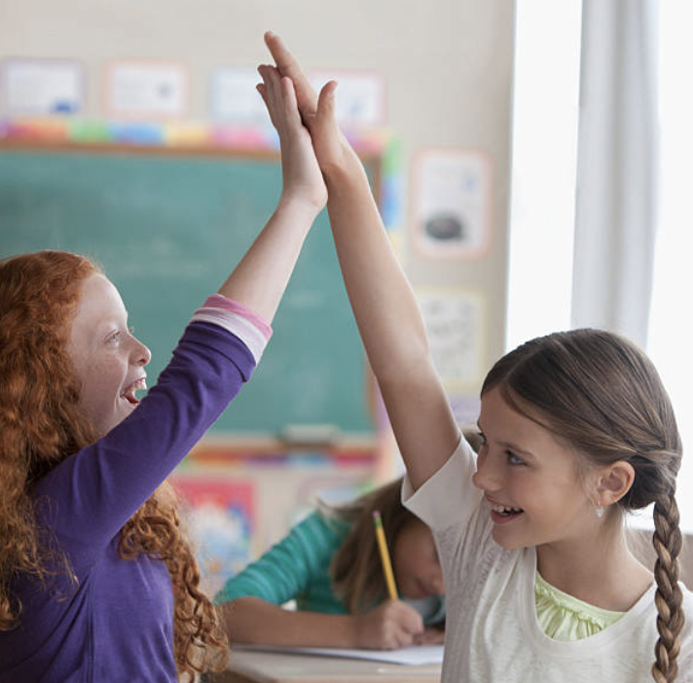
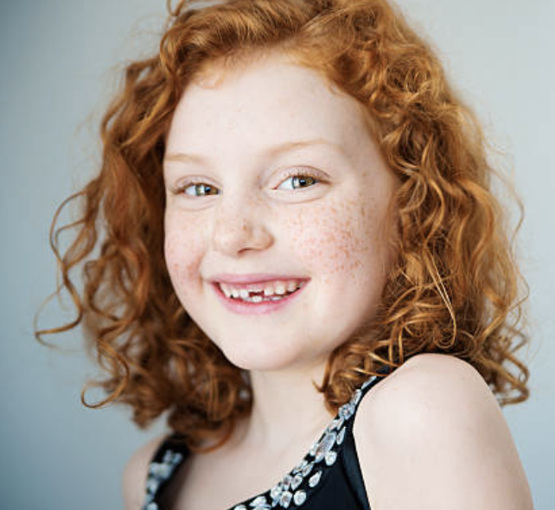
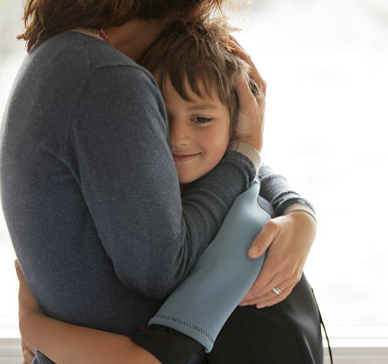
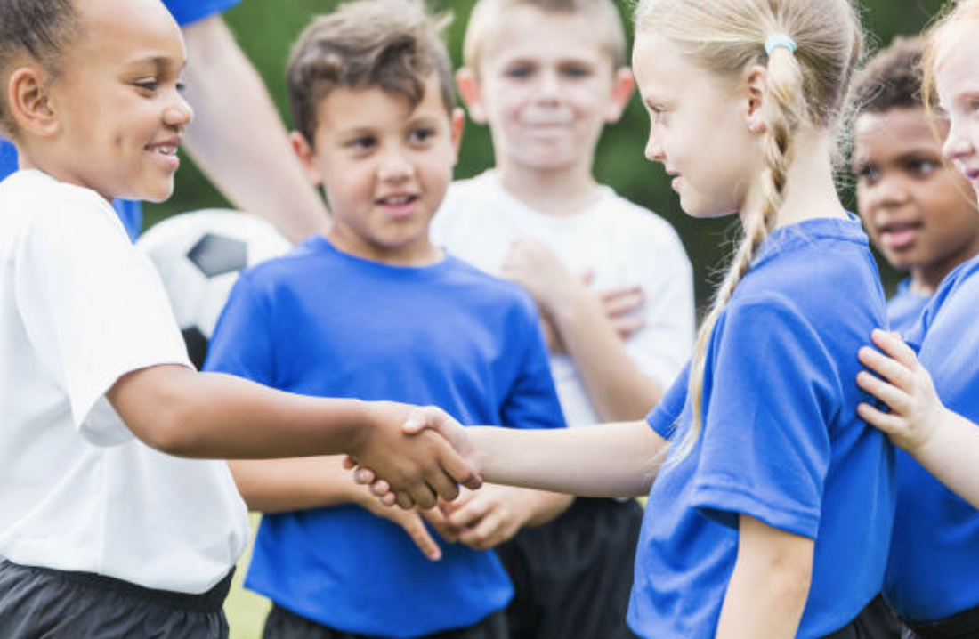
Positive actions

Slide 5
Positive Words
Like
Keep going
Keep calm
Please can you help me
Well done
Keep trying
Relax
Good work
Ask for help

Slide 6
Smile
Feel good fan

Slide 7
Try hard
Feel good fan

Slide 8
Feel good fan

Slide 9
Feel good fan

