Slide 1
Calculate 6,393 ÷ 3
How many groups of 6 are there in 9,288?
1,458 1,548 1,485 1,845
1000
1000
100
10
10
10
1
One
1000
1000
100
10
10
10
1
Four
1000
1000
100
10
10
10
1
Divide the number represented below by 4.
Use the digit cards to complete the calculation.
1000
1000
1000
1000
100
10
10
10
1
1
1
1
Two
1000
1000
1000
1000
100
10
10
10
1
1
1
1
1
2
3
4
5
6
Use a method of your choice to calculate:
9
2
÷
5
=
8
5
Three
9,935 ÷ 5
Five

Slide 2
6,393 ÷ 3 = 2,131
1,548
One
Four
8,268 ÷ 4 = 2,067
Two
9
3
2
5
÷
5
=
1
8
6
5
9,935 ÷ 5 = 1,987
Three
Five

Slide 3
Aim
Divide numbers up to 4 digits by a one-digit number using the formal written method of short division and interpret remainders appropriately for the context.

Slide 4
Divide with Remainders
Match each division question with its place value representation and short division calculation. Then, work out the missing digits in the calculation.
5367 ÷ 4 = 1341r3
1269 ÷ 6 = 211r3
4 | 5 | ¹3 | ¹6 | 7
 | 1 | 3 | 4 | 1 | r3
4 | 5 | ¹3 | ¹6 | 7
Th | H | T | O
 | 0 | 2 | 1 | 1 | r3
6 | 1 | ¹2 | 6 | 9
1000
1000
1000
1000
100
100
100
100
10
10
10
10
1
1
1
1
1000
100
100
100
100
10
10
10
10
1
1
1
100
100
100
100
10
10
10
10
100
10
10
10
10
Th | H | T | O
1000
100
100
100
100
100
100
10
10
10
10
10
10
1
1
1
1
1
1
100
100
100
100
100
100
1
1
1

Slide 5
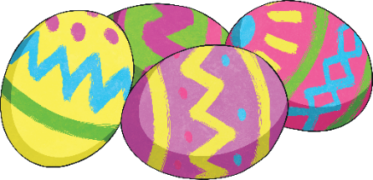
Divide with Remainders
A chocolate factory has made 3208 chocolate eggs. They pack them in trays of 6.
3208 ÷ 6 = 534r4 so 535 trays are needed.
How many trays are needed?
How many full trays will the factory produce?
534 trays
2 more eggs
How many more eggs will be needed to fill the final tray?

Slide 6
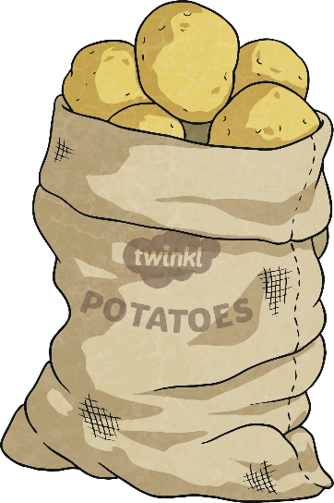
Divide with Remainders
Dovedale Farm has 1523 potato plants. The potatoes are planted in rows of 6.
Freddie the farmer says he needs 253r5 rows for the potatoes.
Do you agree? Explain your thinking.
Freddie is incorrect. He has completed the calculation correctly but he has incorrectly interpreted the remainder. You cannot have r5 of a row. He will need 254 rows but the final row will not be full - it will only contain 5 potato plants.
Using this question as an example, write your own maths story where the remainder needs to be rounded down.

Slide 7
Divide with Remainders
Choose a divisor and a dividend from the lists below. Predict whether your answer will have a remainder or not.
Divisor
Dividend
Can you explain your reasons?
Carry out a short division to check each prediction.
3
4
5
6
1435
2748
3750
4206
7825
2324
How do you know that 1435 divided by 5 will have no remainder? Explain your thinking.
1435 ends with 5 so it is a multiple of 5. Therefore, it will not have a remainder.

Slide 8
