Slide 1
Van Gogh
Starry Night

Slide 2
Starry Night
One of Vincent’s most admired paintings is The Starry Night. It was painted on canvas using oil paints. The painting is Vincent’s impression of the view from his hospital room. Vincent used many different tones of blue to give a feeling of depth. In the top right-hand corner, there is the moon and to the left of the centre is the planet, Venus. The other circles are stars. The sky and the hills look almost like rolling waves, creating a sense of movement. The dark shape at the front of the painting is a cypress tree and there are lights visible in some of the windows of the houses in the village. Although he painted the picture in France, the church steeple is similar to churches in the Netherlands where Vincent grew up and where his dad was a minister.

Slide 3
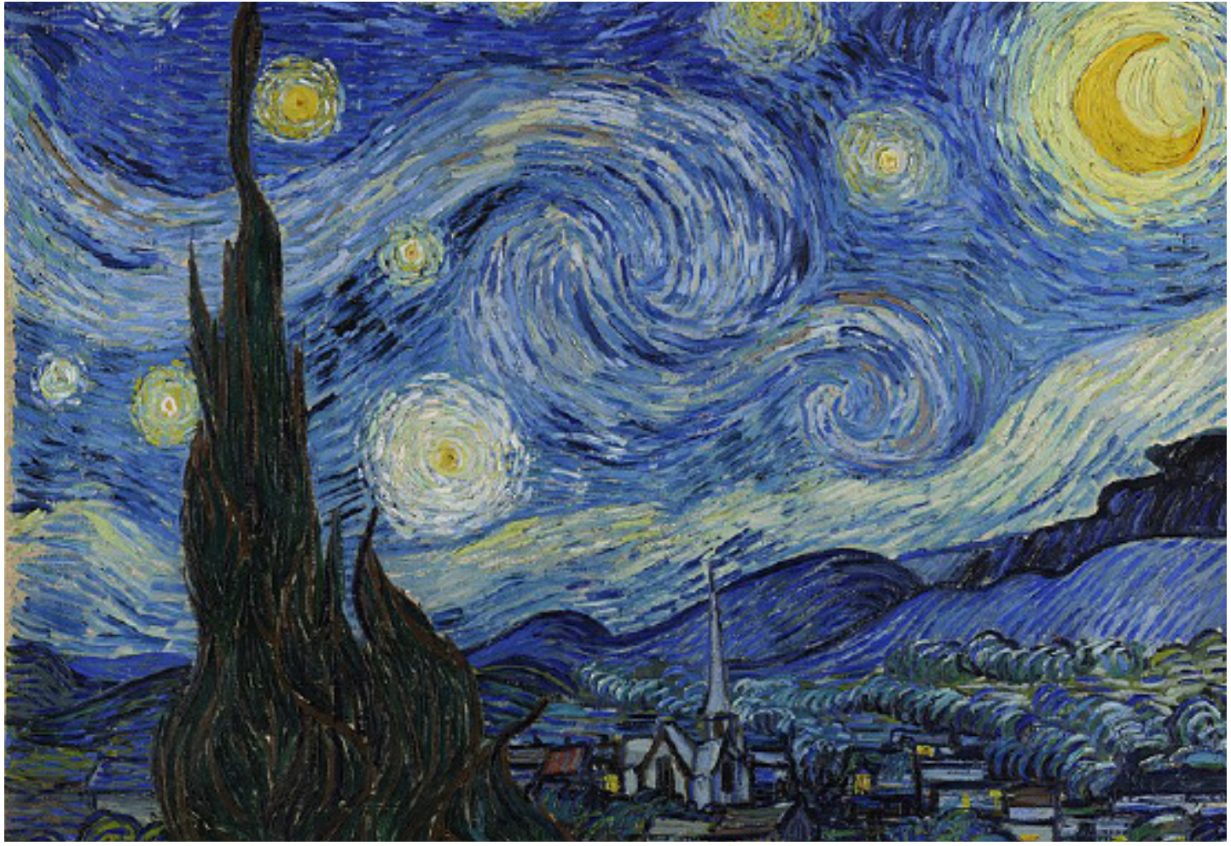

Slide 4
Your Task
Have a go at trying your drawing again- have a look carefully at the different lines that make up Van Goghs painting – there are lots of individual colour marks that build up the overall depth and images in the picture- there are not many blocks of one colour!
See if you can add these to yours- I would draw a very faint pencil outline then use colour strokes to try and replicate the style of Van Gogh. You could use paint if you have them or even other media if you can.
Alternatively you could create a collage using lots of coloured paper – old magazines are ideal! have a look at the video for inspiration-https://www.youtube.com/watch?v=ukerVctrvZ8
This can be done over the whole week- don’t rush it!

