Slide 1
VE Day.
http://www.youtube.com/watch?v=6AC2vzAA5N8

Slide 2
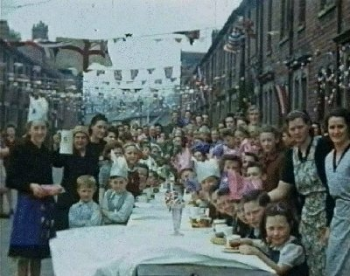
VE Day.
What does ‘VE’ stand for?
What does it celebrate?

Slide 3
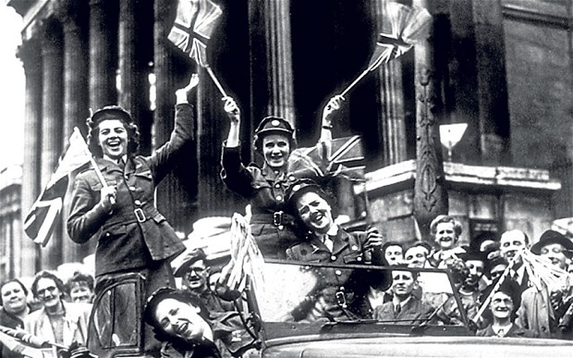
On May 8th in the year that WWII ended the Germans surrendered to the Allies.
They agreed that they had lost the war and that the fighting should stop.
Millions of people had died in WWII so everyone was really happy that the fighting was over.

Slide 4
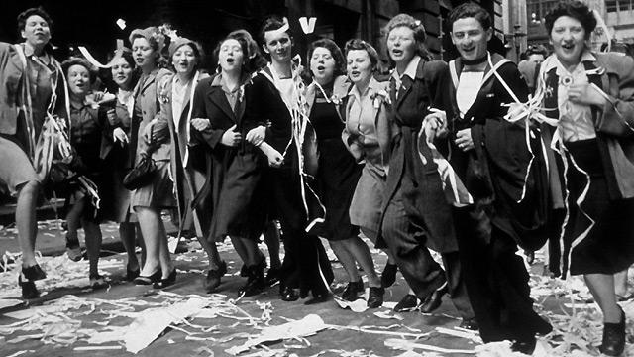
Many people found out about it because the church bells started ringing.
Why would church bells spread the news?

Slide 5
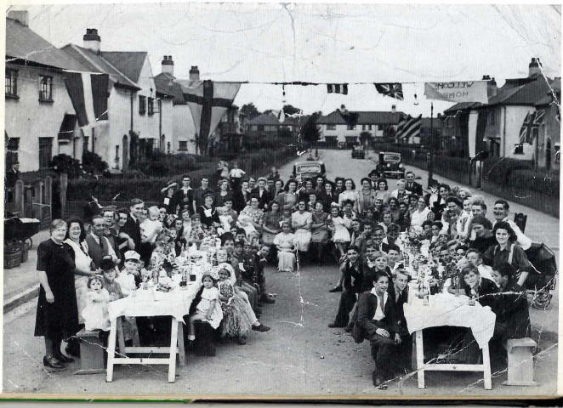
Lots of people came out onto the street dressed in red, white and blue. –Why these colours?
They held parties in the street to celebrate with everyone that the war was over.

Slide 6
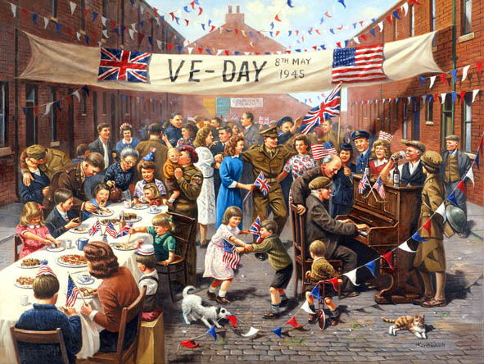
Because of rationing there wasn’t lots of food for sale so everyone coming to the party had to bring something.

Slide 7
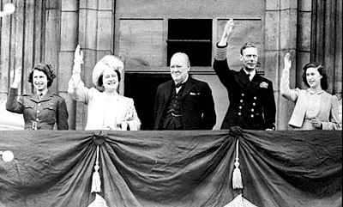
The King and Queen waved to everyone from the balcony of Buckingham palace.
Our current Queen and her sister went out and joined the party in the street! No-one knew who they were!

Slide 8
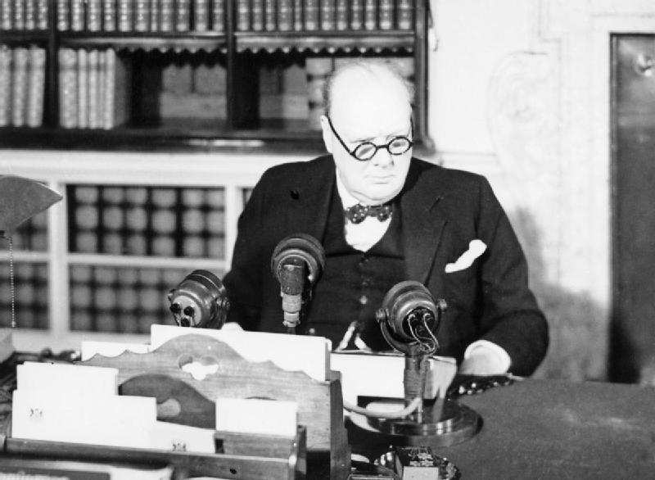
Winston Churchill went on the radio and told everyone about Germany surrendering. At the end of his speech he said
“This is your victory… Advance Britannia”.

Slide 9
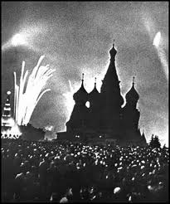
Everyone stayed up and there were bonfires and fireworks to celebrate.
Lots of the pubs completely ran out of alcohol!

Slide 10
http://www.youtube.com/watch?v=gtzrA2VfV7E

Slide 11
Postcard task
Write a ‘Postcard from the Past’
Imagine you were at the first VE day and heard the news that the war had ended.
What might you tell your family about what you heard? What you did? What you ate?
Draw a picture on the reverse showing what happened.

