Slide 1
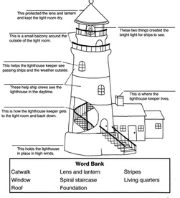
Year 2 Homework Summer Term 1
Please complete your chosen tasks by the last week of this half term (week beginning 22.5.2023)
Geography Maps Create a treasure map of where you live. Can you draw the streets and houses around you? Where will you mark your treasure? | Writing Create a Quiz about the seaside to text your friends. Can you include any questions about lighthouses? | Maths There are 24 starfish in the rockpool habitat. Can you share them equally into 8 groups? What is this fraction? How many animals are in each group? How many animals are in four groups? What is this fraction? Can you say it another way? | Your own idea
Writing Turn this senses poem into your own seaside poem with more description. Can you add another verse that is more exciting? | Creative Build a 3D Model of a lighthouse. | Creative Could you make a seaside in a Jar? What key things could you include to represent the seaside? | Please try to complete at least three of these activities. When you complete one or more please bring it in to share with the class.

