Slide 1
5
16
Words with ‘silent’ letters at the start.

Slide 2
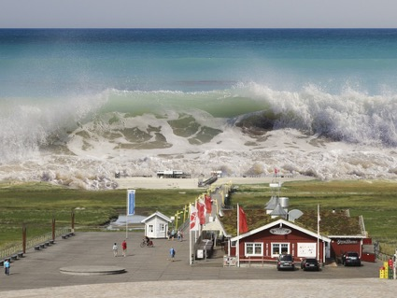
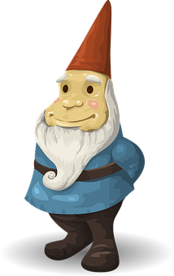
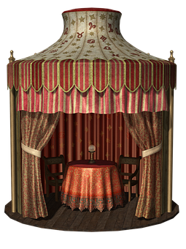
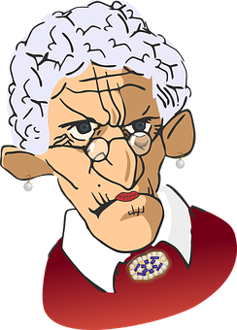
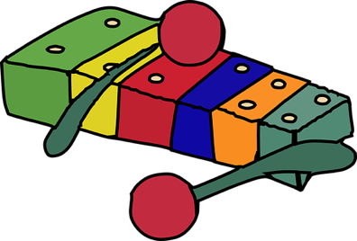
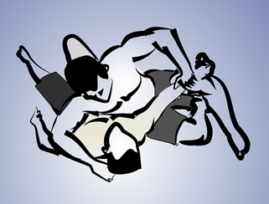
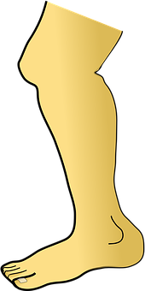
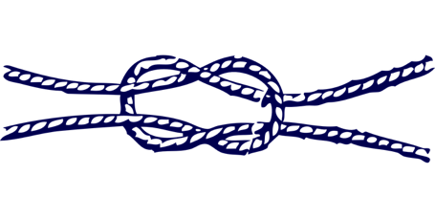
What are these pictures?
_ s _ _ a m _
_ _ i _ k _ e
_ _ o _ e
_ s _ c _ _ c
_ y _ _ p _ _ _ e
w _ e _ _ _ e
_ n _ t
_ _ e _
_ a _ _ p _ ño

Slide 3
What are these pictures?
t s u n a m i
Answers:
Spellings
knight
wreckage
writer
knowledge
knuckle
wreath
pterodactyl
mnemonic
wrestler
knife
w r i n k l e
g n o m e
p s y c h i c
x y l o p h o n e
w r e s t l e
k n o t
k n e e
j a l a p i ñ o

Slide 4
Stage: 5 | Words with ‘silent’ letters at the start. Name:
List: 16
Spellings | 1st Attempt | 2nd Attempt | 3rd Attempt | 4th Attempt | 5th Attempt
knight
wreckage
writer
knowledge
knuckle
wreath
pterodactyl
mnemonic
wrestler
knife

Slide 5
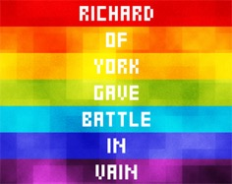
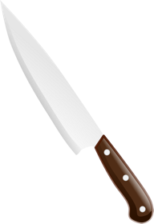
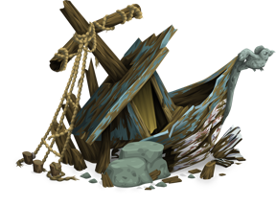
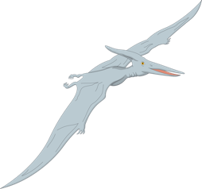
Stage: 5 | Words with ‘silent’ letters at the start. Name:
List: 16
Spellings
knight
wreckage
writer
knowledge
knuckle
wreath
pterodactyl
mnemonic
wrestler
knife
Match each spelling with the correct image.

Slide 6
Stage: 5 | Words with ‘silent’ letters at the start. Answers:
List: 16
Spellings
knight
wreckage
writer
knowledge
knuckle
wreath
pterodactyl
mnemonic
wrestler
knife
Match each spelling with the correct image.
wrestler | writer | mnemonic | knowledge | wreath
wreckage | pterodactyl | knife | knuckle | knight

