Slide 1

Simple Chemical Reactions

Slide 2
Learning objectives:
Identify reversible and irreversible changes
Identify chemical and physical changes
Be able to recognise when a chemical reaction is taking place.

Slide 3
What do you already know?
what do we mean by ‘irreversible reaction’
What do we mean by ‘reversible reaction’

Slide 4
What is a reversible change?
A reversible change is:
something that can be reversed e.g. water freezes then it melts
No new substance is formed.

Slide 5

What is an irreversible change?
A irreversible change starts off with one material and ends up into a new one.
These materials or food cannot be reversed.
Wood burns to ash
Bread goes off
Change is permanent.

Slide 6
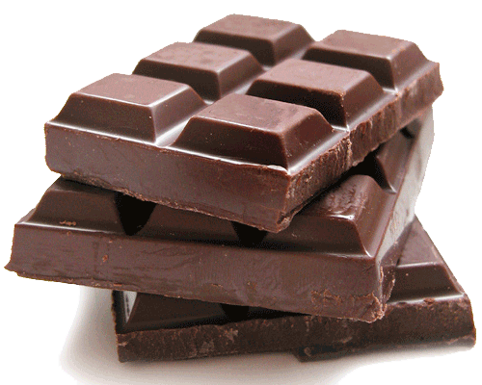
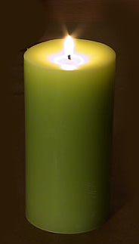
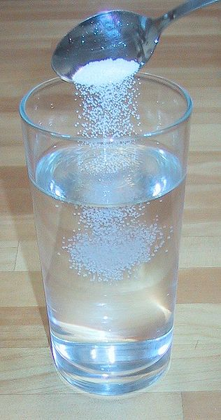
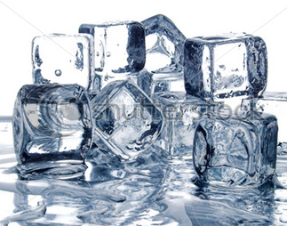
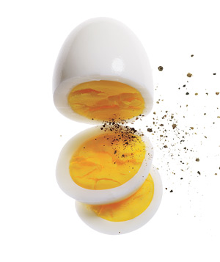
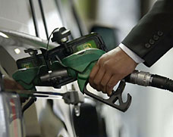
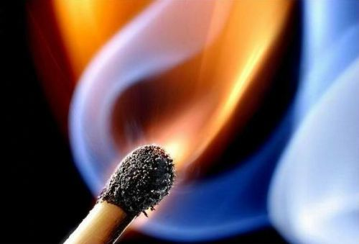
Reversible or Irreversible Reaction?

Slide 7
What do you already know?
what do we mean by ‘physical change?’
What do we mean by ‘chemical change?’

