Slide 1
Y6 Diagnostic Task Evolution and Inheritance
Commissioned by The PiXL Club Ltd.
Example 2017
This resource is strictly for the use of member schools for as long as they remain members of The PiXL Club. It may not be copied, sold nor transferred to a third party or used by the school after membership ceases. Until such time it may be freely used within the member school.
All opinions and contributions are those of the authors. The contents of this resource are not connected with nor endorsed by any other company, organisation or institution.
© Copyright The PiXL Club Limited, 2017

Slide 2
Y6 Diagnostic Task Evolution and Inheritance
Assessment Focus
WORKING SCIENTIFICALLY
WS11 Use scientific evidence to answer questions, or to support their findings.
WS12 Identify scientific evidence that has been used to support or refute ideas or arguments.

Slide 3
Y6 Diagnostic Task Evolution and Inheritance
Assessment Focus
PROGRAMME OF STUDY
B6f Recognise that living things have changed over time and that fossils provide information about living things that inhabited the Earth millions of years ago.

Slide 4
Fossil Board Game

Slide 5
Target Words
archaeologist
palaeontologist
fossil
fossilisation
evidence
eroded
sediment
sedimentary rock
permeable
compressed
remains
minerals
impression
trace
conditions
petrified
dissolving
original
stages
process
species
discovered

Slide 6
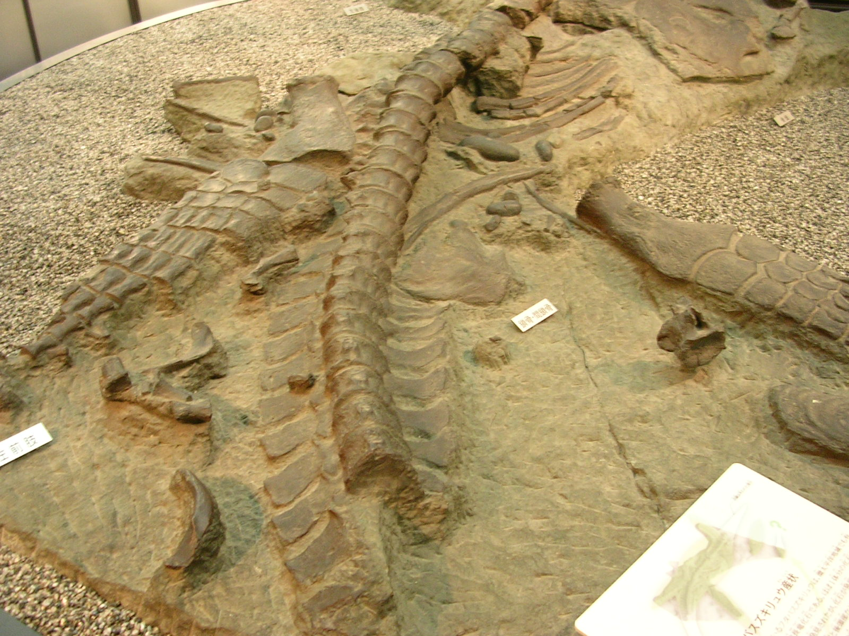
Look at the image of the fossil and discuss the following:
How do you think it was made?
Which organism do you think it used to be? What is the evidence for this?
How old do you think the fossil is? How do you know?
What CAN we learn from a fossil?
What CAN’T we learn from a fossil?
Where would we find the answers to these questions?

Slide 7
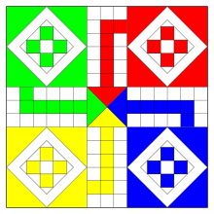
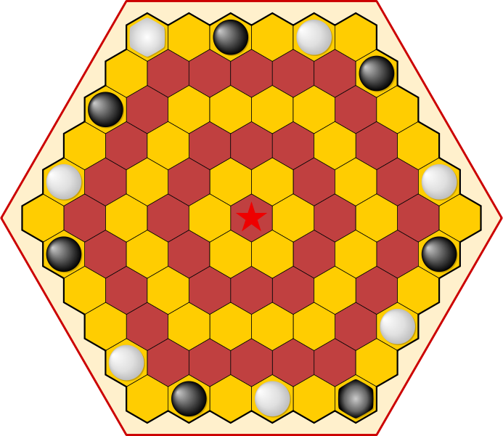
Your challenge: You have been asked to create a board game based on fossils. The game must be: a) informative about fossil formation b) engaging and entertaining c) challenging for your target audience
Decide on your target audience.
Younger children – easier level
Adults – more challenge scientifically and in how the game operates.

Slide 8
The objective of the game is to reach the end through a series of forward steps (stages in fossil formation) and negative steps (something goes wrong in the process).
What do you need to KNOW to be successful?
Which SKILLS do you need to be successful?

Slide 9
Can you: Use scientific evidence to answer questions, or to support your findings? Recognise that living things have changed over time and that fossils provide information about living things that inhabited the Earth millions of years ago?

Slide 10
Structured Research: bronze, silver or gold?
Research time:
use reference materials to prove the statements true or false. Make notes in relevant sections.
2. Talk Time:
use the ‘Target Word’ and ‘Conjunction’ lists. Can you explain the process of fossil formation to your partner? You gain a point/counter each time you use one of the words.
3. The process of fossil formation: record the stages of fossil formation using the format on your worksheet?

Slide 11
The Game!
Now that you are an expert on fossil formation, design your board game. Remember:
It needs to involve moving along a series of steps from a start to a finish.
It must take you through the sequence of fossil formation (moving forwards).
It must include some incidents where the process of fossil formation is interrupted/goes wrong (backward steps).
It must include scientific vocabulary and use some of the ‘Target Words’.

Slide 12
Play the Games!
Ask a family member to play your game and ask them to evaluate it for you.

