Slide 1
Year 6 – Spring Block 6 – Ratio – Ratio and Fractions
National Curriculum Objectives:
Mathematics Year 6: (6R1) Solve problems involving the relative sizes of two quantities where missing values can be found by using integer multiplication and division facts
Mathematics Year 6: (6R4) Solve problems involving unequal sharing and grouping using knowledge of fractions and multiples
© Classroom Secrets Limited 2019

Slide 2
Year 6 – Spring Block 6 – Ratio
Ratio and Fractions
© Classroom Secrets Limited 2019

Slide 3
Introduction
Complete the sentence to describe the objects below.
There are _____________________ for every ____________________ .
© Classroom Secrets Limited 2019

Slide 4
Introduction
Complete the sentence to describe the objects below.
There are 4 lightning bolts for every 3 squares.
© Classroom Secrets Limited 2019

Slide 5
Varied Fluency 1
Match the fraction of circles to the correct set of objects.
2
5
2
8
3
6
© Classroom Secrets Limited 2019

Slide 6
Varied Fluency 1
Match the fraction of circles to the correct set of objects.
2
5
2
8
3
6
© Classroom Secrets Limited 2019

Slide 7
Varied Fluency 2
True or false?
If there are 3 bananas for every 5 peaches, of the fruit are peaches.
3
8
© Classroom Secrets Limited 2019

Slide 8
Varied Fluency 2
True or false?
If there are 3 bananas for every 5 peaches, of the fruit are peaches.
False, of the fruit are bananas.
3
8
3
8
© Classroom Secrets Limited 2019

Slide 9
Varied Fluency 3
Complete the sentence below if are squares and are circles.
There are ________ squares for every ________ circles.
4
9
3
9
© Classroom Secrets Limited 2019

Slide 10
Varied Fluency 3
Complete the sentence below if are squares and are circles.
There are 4 squares for every 3 circles.
4
9
3
9
© Classroom Secrets Limited 2019

Slide 11
Varied Fluency 4
Use the statement below to complete the bar model.
There are 6 squares for every 2 circles.
Write a fraction showing each quantity.
 | 2
=
=
© Classroom Secrets Limited 2019

Slide 12
Varied Fluency 4
Use the statement below to complete the bar model.
There are 6 squares for every 2 circles.
Write a fraction showing each quantity.
8
6 | 2
6
8
2
8
=
=
© Classroom Secrets Limited 2019

Slide 13
Problem Solving 1
Gemma is making a bracelet using orange and blue beads.
Each bracelet contains 18 beads in total.
Write 5 pairs of fractions to show the possible ratio blue to orange beads.
© Classroom Secrets Limited 2019

Slide 14
Problem Solving 1
Gemma is making a bracelet using orange and blue beads.
Each bracelet contains 18 beads in total.
Write 5 pairs of fractions to show the possible ratio blue to orange beads.
Various answers, for example:
blue beads and orange beads
11
18
7
18
© Classroom Secrets Limited 2019

Slide 15
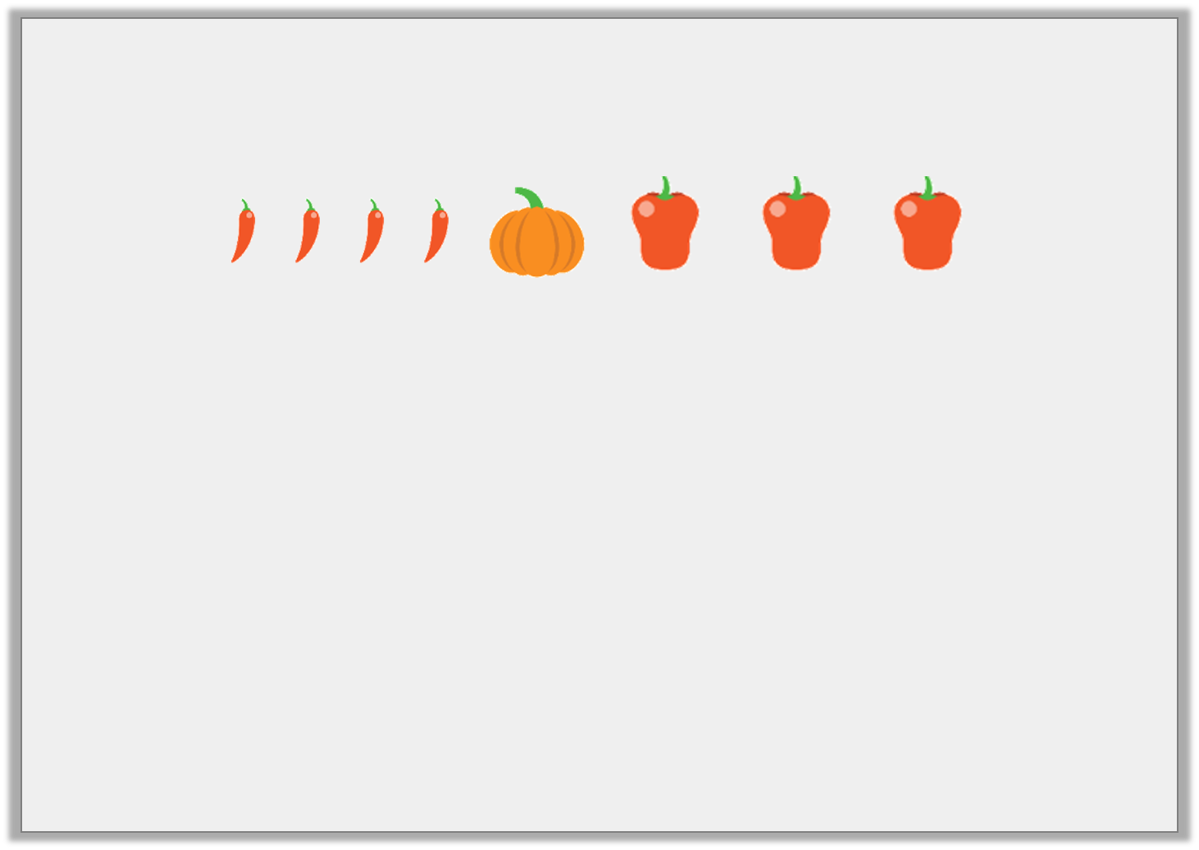
Reasoning 1
Which of the following statements match the image?
of the vegetables are pumpkins.
There are 3 chillies for every 4 peppers.
There are 8 items in total.
Explain how you know.
1
6
© Classroom Secrets Limited 2019

Slide 16
Reasoning 1
Which of the following statements match the image?
of the vegetables are pumpkins.
There are 3 chillies for every 4 peppers.
There are 8 items in total.
Explain how you know.
Statement C because…
1
6
© Classroom Secrets Limited 2019

Slide 17
Reasoning 1
Which of the following statements match the image?
of the vegetables are pumpkins.
There are 3 chillies for every 4 peppers.
There are 8 items in total.
Explain how you know.
Statement C because there are four chillies, one pumpkin and three peppers, which makes 8 in total.
1
6
© Classroom Secrets Limited 2019

Slide 18
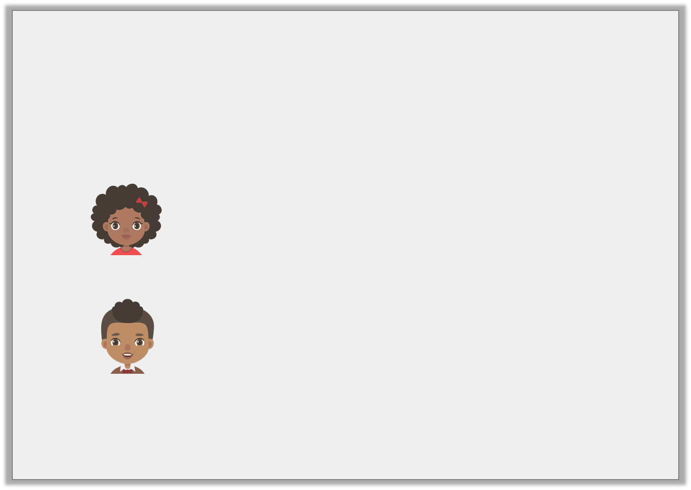
Reasoning 2
Emma has a bag of 1p and 2p coins.
of the coins are 1p coins.
Emma says,
Nick says,
Who is correct? Explain how you know.
9
13
There are more 2p coins than 1p coins.
There are four 2p coins.
© Classroom Secrets Limited 2019

Slide 19
Reasoning 2
Emma has a bag of 1p and 2p coins.
of the coins are 1p coins.
Emma says,
Nick says,
Who is correct? Explain how you know.
Nick is correct because…
9
13
There are more 2p coins than 1p coins.
There are four 2p coins.
© Classroom Secrets Limited 2019

Slide 20
Reasoning 2
Emma has a bag of 1p and 2p coins.
of the coins are 1p coins.
Emma says,
Nick says,
Who is correct? Explain how you know.
Nick is correct because there are 13 coins in total and if there are nine 1p coins, there must be four 2p coins.
9
13
There are more 2p coins than 1p coins.
There are four 2p coins.
© Classroom Secrets Limited 2019

