Slide 1
Which are multiples of 4?
6 9 12 14 16 20 32 46
Complete the statement.
A prime number has two factors - ______ and ______.
One
Four
Use factors to complete the number sentence.
__ × __ = 24
Ranjit has been learning about square numbers.
Is he correct? Explain your reasoning!
Two
9² = 18
True or False?
9 and 13 share 3 as a common factor.
Three
Five

Slide 2
Aim
Multiply two-digit and three-digit numbers by a one-digit number using formal written layout.

Slide 3
Multiply 2 Digits by 1 Digit
Complete the missing parts of each calculation.
52 × 3 = 156
156
Place Value Counters
Expanded Multiplication
Short Multiplication
H | T | O
 | H | T | O
 |  | 5 | 2
× |  |  | 3
 |  |  |  | (3 × 2)
+ |  |  |  | (3 × 50)
 | H | T | O
 |  | 5 | 2
× |  |  | 3
10
10
10
10
10
1
1
10
10
10
10
10
1
1
100
10
10
10
10
10
1
1
6
1
5
6
1
5
0
¹
1
5
6

Slide 4
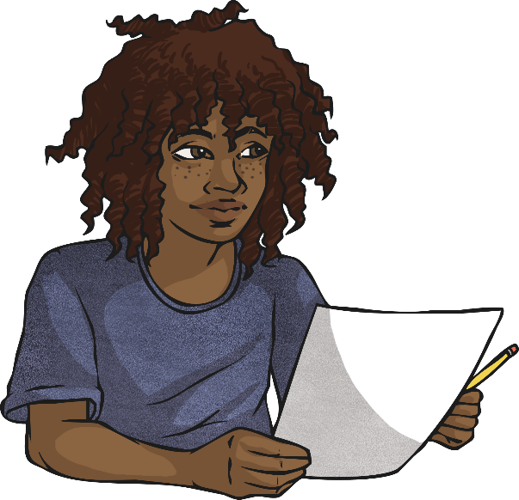
Multiply 2 Digits by 1 Digit
Use short multiplication to solve these calculations.
62 × 8 = 496
496
55 × 6 = 330
330
H
T
O
H
T
O
6
2
5
5
×
8
×
6
4
9
6
3
3
0
⁴
¹
³
³

Slide 5
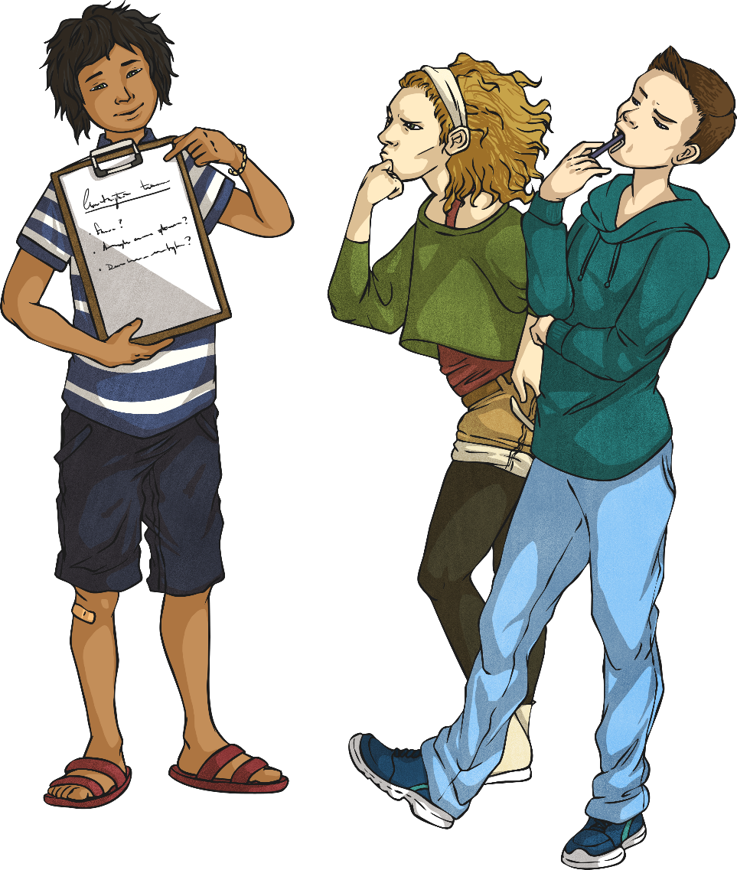
Multiply 2 Digits by 1 Digit
Read the statement below. Is it true or false? Explain your answer.
When multiplying a 2-digit number by 2, you will never need to exchange.
False. If the 2-digit number contains digits that are 5 or larger, you will need to exchange because you will get an amount higher than 9 when multiplying by 2.
Therefore, you will need to regroup, e.g.
 | 2 | 6
× |  | 2
 | 5 | 2
 | ¹

Slide 6
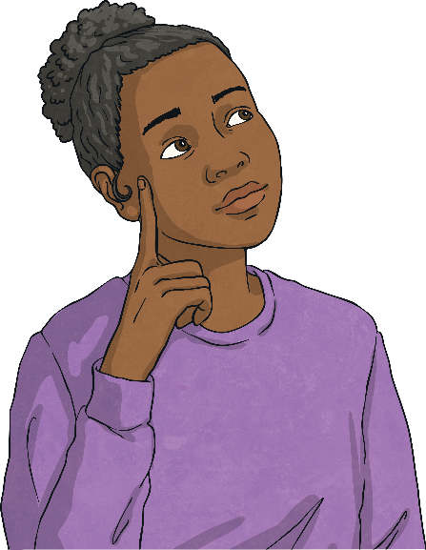
Multiply 2 Digits by 1 Digit
Which of these methods is the odd one out? Explain your reasoning.
A
B
C
 | H | T | O
 |  | 7 | 2
× |  |  | 3
 | 2 | 1 | 6
 | ² | ¹
 | H | T | O
 |  | 5 | 6
× |  |  | 4
 |  | 2 | 4 | (4 × 6)
+ | 2 | 0 | 0 | (4 × 50)
 | 2 | 2 | 4
 | H | T | O
 |  | 9 | 7
× |  |  | 2
 | 1 | 9 | 4
 | ¹ | ¹
B is the odd one out because it is the only calculation that has been completed using the expanded multiplication method. A and C have both been solved using the short multiplication method.

Slide 7
Multiply 2 Digits by 1 Digit
Identify and explain the mistake in Carrie’s work. Then, work out the correct answer.
8 7
× 3
2 6 8
^{2x}
Carrie has incorrectly calculated 3 × 7 as 28 instead of 21.
The correct answer for this calculation should be:
8 7
× 3
2 6 1
^{2x}

Slide 8
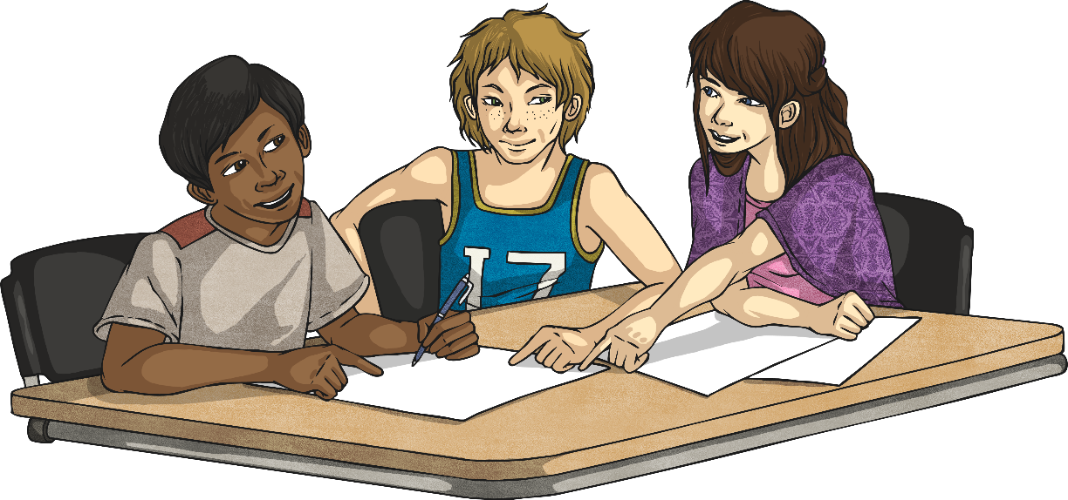
Multiply 2 Digits by 1 Digit
Can you identify the missing digits in this calculation?
 |  |  | 9
×
 | 5 | 5 | 3
 |  | ⁶
7
7
⁵

Slide 9
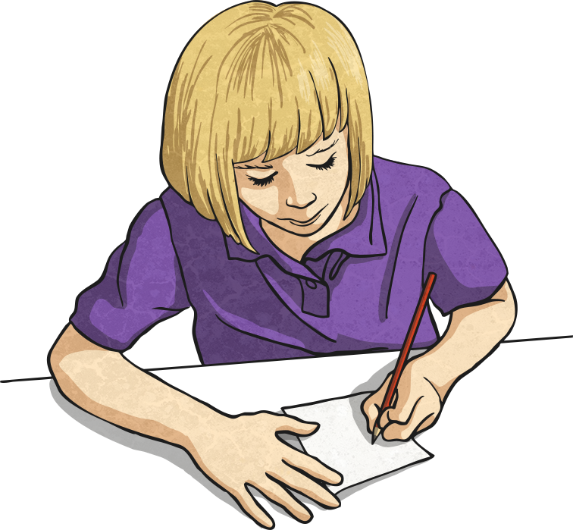
Multiply 2 Digits by 1 Digit
Each letter stands for a number - either 2, 4, 5 or 8. The 0 has already been identified.
Can you identify which letter represents each number to solve the calculation?
 |  | A | B
× |  |  | C
 | D | A | 0
 | ^{D} | ^{A}
4
8
5
2
4
²
⁴
A = 4
B = 8
C = 5
D = 2

Slide 10
