Slide 1
Identify the fraction which is equivalent to
Use the models to show
4
8
One
4
8
5
16
1
2
Four
Calculate
Caleb calculates…
1
2
6
8
Two
+
Find the missing fraction.
Three
1
3
2
?
2
3
2
+
4
=
6
Five
Can you spot Caleb’s mistake?
Explain your reasoning!
©Deepening Understanding LTD 2021

Slide 2
1
2
One
Four
10
8
Two
D – Caleb is incorrect.
A – Caleb has added the denominators.
B – 2 + 3 = 6
7
9
9
18
5
18
Three
Five

Slide 3
Aim
Add and subtract fractions with the same denominator and denominators that are multiples of the same number.

Slide 4
Subtract 2 Mixed Numbers
Noor has drawn a bar model to subtract 2 mixed numbers.
Use the bar model to solve her calculation.
1
5
2
1
2 – 1 =
–
=
6
3
6
2
5
–
1
2
=
1
1
6
3
6
Can you use Noor’s method to solve this calculation?
1
3 – 2 =
5
1
3
3
5
–
2
1
=
2
3
–
=
8
4
8
8
4
8

Slide 5
Subtract 2 Mixed Numbers
Husnain has used a different method to subtract 2 mixed numbers.
2
1
–
1
3
=
1
5
–
1
3
=
1
10
–
1
3
7
=
4
8
4
8
8
8
8
Use Husnain’s method to solve this calculation.
2
2
1
7
1
7
1
7
14
7
7
–
=
–
=
1
–
1
=
5
10
5
10
10
10
10

Slide 6
Subtract 2 Mixed Numbers
4
3
–
1
1
=
The answer is .
8
4
3
2
4
What mistake has Jagvir made?
He has tried to subtract the fractions without first making sure that the denominators are the same.
What is the correct answer?
4
3
–
1
1
=
4
3
–
1
2
=
3
1
8
4
8
8
8

Slide 7
Subtract 2 Mixed Numbers
Which calculation is the odd one out? Explain your thinking.
A
4
5
–
1
1
=
3
3
A could be the odd one out because the answer is more than 2.
8
4
8
B
2
1
1
2
1
B could be the odd one out because the answer is a whole number.
–
=
4
8
C
3
2
–
2
5
=
1
1
C could be the odd one out because the denominators are both odd.
3
9
9
Did you think of a different answer?

Slide 8
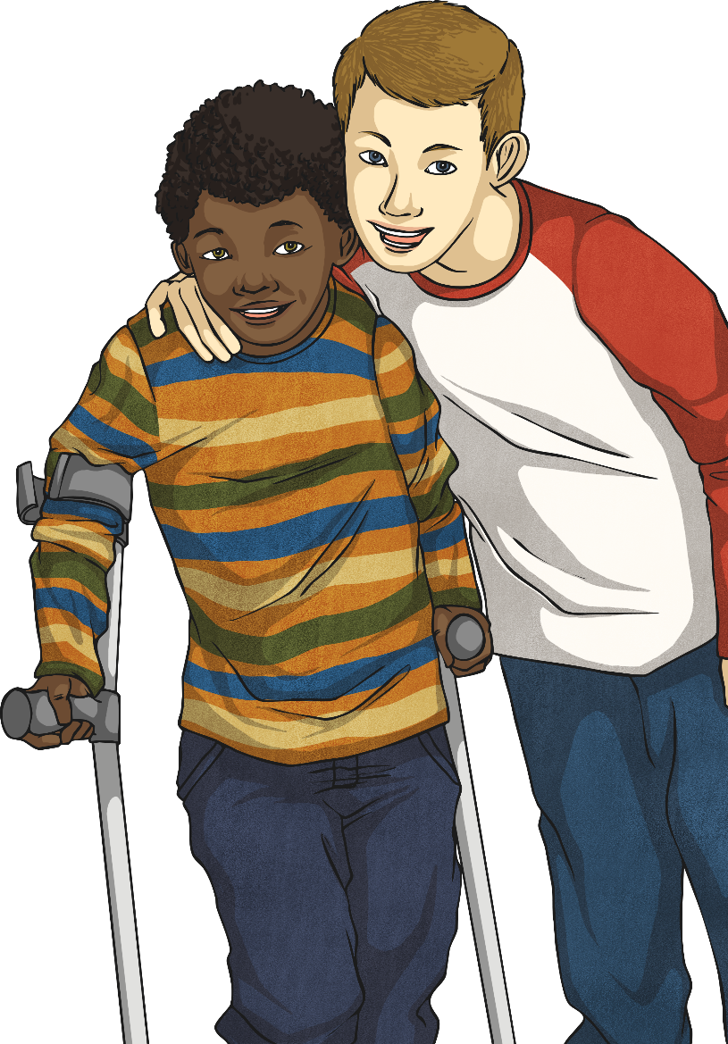
Subtract 2 Mixed Numbers
Harry and Jayden had a pizza party. They started with 5$\frac{1}{2}$ pizzas and they had 1$\frac{1}{4}$ pizzas left at the end. How much pizza could each of them have eaten?
5
1
–
1
1
=
4
1
2
4
4
Jayden and Harry must have eaten a total
of 4 pizzas.
1
4
1
There are lots of different possible answers that add up to 4 . For example: Jayden ate 2 pizzas and Harry ate 2 pizzas.
4
1
4
Did you find a different answer?

Slide 9
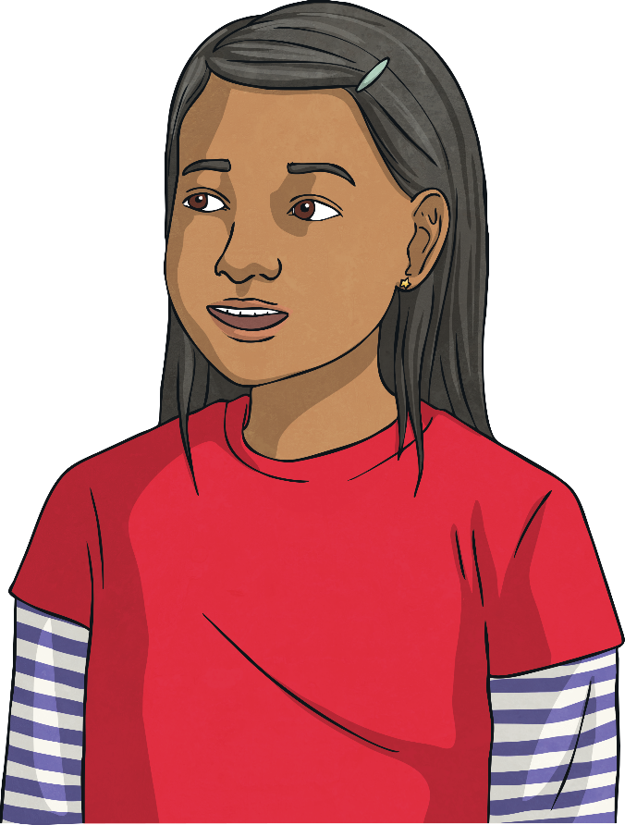
Subtract 2 Mixed Numbers
Use each digit card once to make this calculation have the smallest possible answer.
4
8
5
3
–
3
1
=
2
1
8
4
8

Slide 10
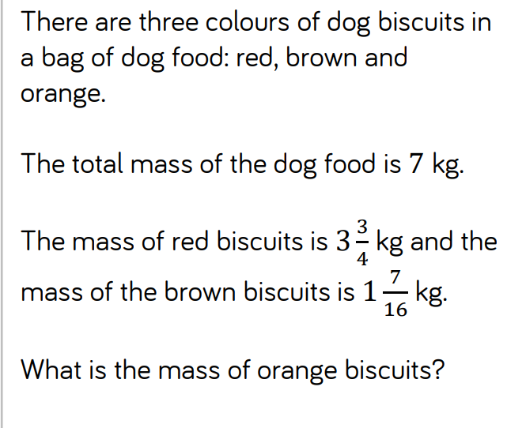

Slide 11
