Slide 1
Use < > or = to compare the fractions.
Can you identify the largest fraction?
One
6
4
8
6
Four
Use the bar model to identify the largest fraction.
Alfie believes…
“The larger the denominator, the larger the fraction.”
Two
Draw a bar model to represent
<
Three
11
6
15
7
Five
Is Alfie correct?
Explain your reasoning!
©Deepening Understanding LTD 2021

Slide 2
6
4
8
6
>
One
Four
D – Alfie is incorrect.
A – The larger the denominator is, the smaller the fraction can be.
B – is smaller than
Both fractions are equal.
Two
1
5
1
4
Three
<
Five
©Deepening Understanding LTD 2021

Slide 3
Aim
Add and subtract fractions with the same denominator and denominators that are multiples of the same number.

Slide 4
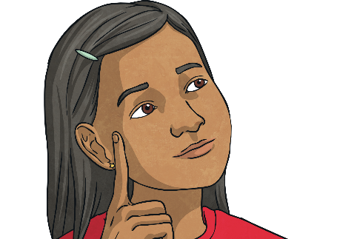
Subtract Fractions
4 5
1 10
−
=
Kemi is subtracting fractions. She has drawn a bar model to help.
Use the bar model to complete Kemi’s calculation.
4 5
1 10
7 10
−
=
Now, use Kemi’s bar model method to solve this calculation. Give your answer in its simplest form.
9 10
−
2 5
5 10
1 2
=
=

Slide 5
Subtract Fractions
Jude is subtracting fractions by finding the difference. He has drawn a number line to help. Use the number line to complete Jude’s calculation.
+
1 6
4 6
+
5 3
−
5 6
=
5 6
5 6
1
5 3
10 6
=
Use Jude’s number line method to solve these calculations.
+
4 9
2 3
2 9
4 9
−
=
2 9
2 3
6 9
=

Slide 6
Subtract Fractions
Jude is subtracting fractions by finding the difference. He has drawn a number line to help. Use the number line to complete Jude’s calculation.
+
1 6
4 6
+
5 3
−
5 6
=
5 6
5 6
1
5 3
10 6
=
Use Jude’s number line method to solve these calculations.
+
2 10
+
2 10
6 5
8
10
2 5
−
=
2
10
+
2
10
4
10
2 5
8 10
=
=
1
6 5
12 10
=

Slide 7
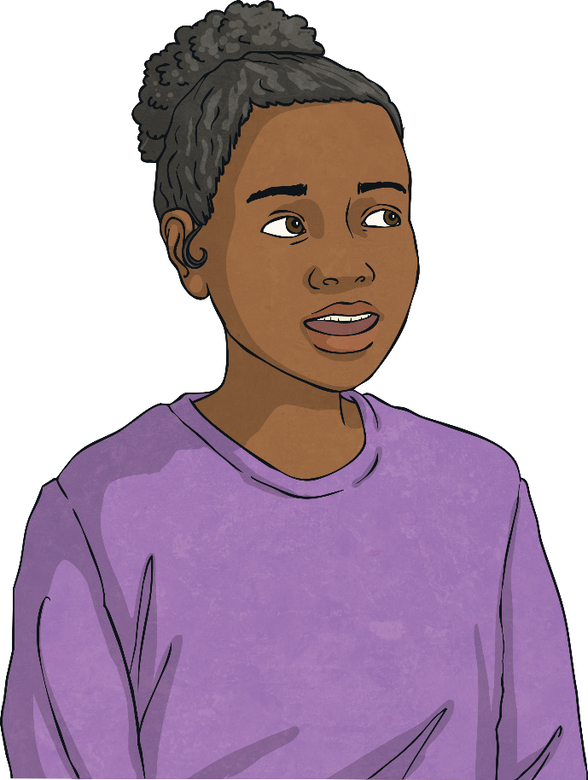
Subtract Fractions
Is Sophia’s statement always, sometimes or never true?
Explain how you know.
When you subtract one fraction from another, the answer will be smaller.
This is always true. You cannot subtract any positive number from another and end up with a larger answer.

Slide 8
Subtract Fractions
13 10
Afzol used a number line to find the difference between and .
Here is his working out:
1 5
+
8 10
+
3 10
1 5
2 10
1
13 10
=
8 10
3 10
11 20
1 5
13 10
11 20
+
=
The difference between and is .
What mistake did he make?
Afzol has added the fractions incorrectly. The denominators should stay the same, so the difference between and is .
1 5
13 10
11 10

Slide 9
Subtract Fractions
Fill in the missing numbers.
5
7
3
−
=
6
12
12

Slide 10
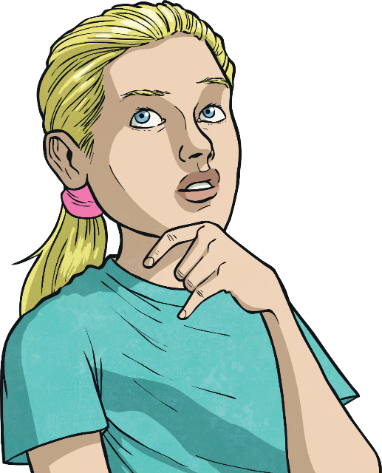
Subtract Fractions
Clara is thinking of two fractions.
They have a difference of .
Each fraction is less than one whole.
One of the fractions has a numerator of 1.
The fractions are in their simplest form.
1 2
Which two fractions could she be thinking of?
and
and
1 4
3 4
1 3
5 6
Did you find a different answer?

Slide 11
