Slide 1
Calculate and write your answer as an improper fraction.
- =
What is the total when multiplied?
1
2
2
5
One
13
7
2
7
Four
×
Write a calculation to represent the image below.
Jerry uses the bar model to calculate
Two
X | X | X
X | X
Calculate
6
11
× 4
=
24
44
Three
9
10
Is Jerry correct?
Explain your reasoning!
3 ×
Five
Wednesday
©Deepening Understanding LTD 2021

Slide 2
11
7
1
5
One
Four
5
16
11
16
D - Jerry is incorrect.
A - He has multiplied the denominator and the numerator.
B -
1 - =
Two
6
11
24
11
2
11
× 4
= or 2
27
10
7
10
Three
or 2
Five
©Deepening Understanding LTD 2021

Slide 3
Aim
To be able to multiply non unit fractions by an integer

Slide 4
Multiply Non-Unit Fractions by an Integer
Match the calculation to the correct model that represents it and then complete the calculation.
2 9
2 9
0
1
3 10
6 10
3 5
3 10
3 10
3 10
2 × =
=
3 10
3 10
3 10
2 9
4 9
× 2 =
1 5
1 5
1 5
1 5
3 15
6 15
2 5
1 5
1 5
1 5
1 5
× 2 =
=
1 5
1 5
2 5
10 5
2
5 × =
=
1 15
1 15
1 15
1 15
1 15
1 15
3 15
3 15

Slide 5
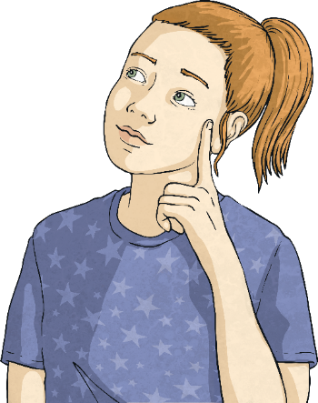
Multiply Non-Unit Fractions by an Integer
Complete these calculations. Simplify your answer where possible.
2 12
8 12
2 3
3 8
6 8
3 4
4 × =
=
× 2 =
=
4 20
16 20
4 5
4 16
× 3 =
12 16
3 4
4 × =
=
=

Slide 6
Multiply Non-Unit Fractions by an Integer
True or false? Prove it!
3 15
× 4 =
12 30
3 15
× 4 =
12 15
12 30
=
6 15
12 15
>
6 15
False
2 20
× 8 >
2 10
× 3
16 20
=
8 10
8 10
>
6 10
True
4 20
× 4 <
3 10
× 3
16 20
=
8 10
8 10
<
9 10
True
2 8
× 3 <
2 16
× 2
2 8
× 3 =
6 8
4 16
=
2 8
6 8
>
2 8
False

Slide 7
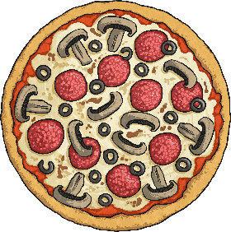
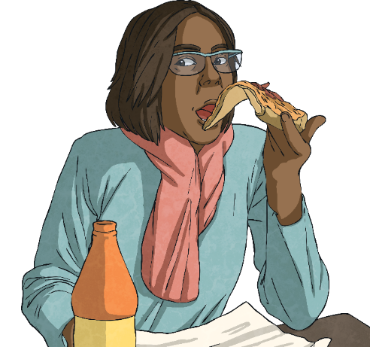
Multiply Non-Unit Fractions by an Integer
Harley is having a pizza party for his birthday with 3 friends. They make 1 pizza and cut it into 15 slices. They each eat of a pizza.
3 15
How many slices have they eaten altogether? How many slices are left over?
3 15
× 4 =
12 15
12 slices eaten
3 slices left over

Slide 8
Multiply Non-Unit Fractions by an Integer
Find 3 possible solutions where the product is less than 1.
3
× =
15
Possible answers include:
3 15
× 2 =
6 15
=
2 5
3 15
× 3 =
9 15
=
3 5
2 5
× 2 =
4 5
=
12 15

Slide 9
Multiply Non-Unit Fractions by an Integer
Now find 3 possible solutions where the product is greater than 1 but less than 2.
3
× =
1
15
Possible answers include:
3 15
× 6 =
18 15
=
1
3 15
3 15
× 7 =
21 15
1
6 15
=
3 5
× 3 =
9 5
=
27 15
=
1
12 15

Slide 10
Multiply Non-Unit Fractions by an Integer
Sofia multiplies a non-unit fraction by an integer.
The fraction has a denominator which is a multiple of 6.
The product is greater than 1 but less than 2.
The integer is a factor of 15.
What could the calculation be? Find 4 possibilities. Remember to simplify the product where possible.
Possible answers include:
2 6
× 5 =
10 6
=
1
4 6
=
1
2 3
7 18
× 3 =
21 18
=
1
3 18
=
1
1 6
4 12
× 5 =
20 12
=
1
8 12
=
1
2 3
2 6
× 5 =
10 6
=
1
4 6
=
1
2 3

