Slide 2
Diving into Mastery Guidance for Educators
Each activity sheet is split into three sections, diving, deeper and deepest, which are represented by the following icons:
These carefully designed activities take your children through a learning journey, initially ensuring they are fluent with the key concept being taught; then applying this to a range of reasoning and problem-solving activities.
These sheets might not necessarily be used in a linear way. Some children might begin at the ‘Deeper’ section and in fact, others may ‘dive straight in’ to the ‘Deepest’ section if they have already mastered the skill and are applying this to show their depth of understanding.
Diving
Deeper
Deepest

Slide 3
Aim
Recognise and show, using diagrams, families of common equivalent fractions.

Slide 4
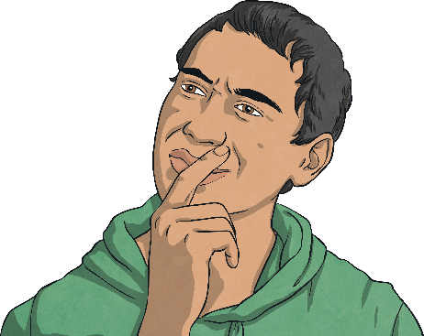
Fractions Greater Than 1
Diving
Complete the table.
Part-Whole Model
Sentence
There are eighths altogether.
eighths = whole and eighth.
9
9
1
1
8
1
1
= whole
8
8

Slide 5
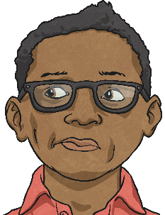
Fractions Greater Than 1
Diving
Complete the sentences to match the image.
1 4
1 4
1 4
1 4
1 4
1 4
1 4
1 4
1 4
1 4
1 4
1 4
1 4
There are quarters altogether.
quarters = whole ones and quarter
13
13
3
1

Slide 6
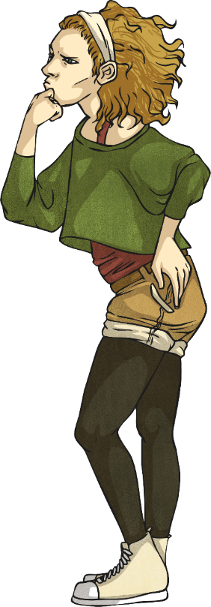
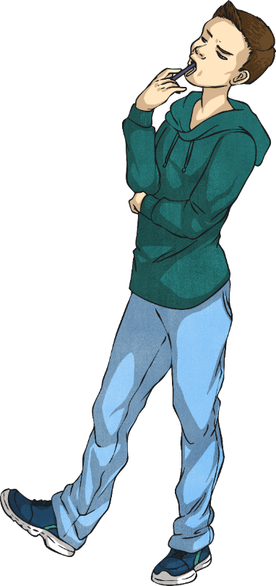
Fractions Greater Than 1
Diving
Complete the calculation. You can draw part-whole models to help you.
19 5
15 5
5
5
4
4
=
+
=
3

Slide 7
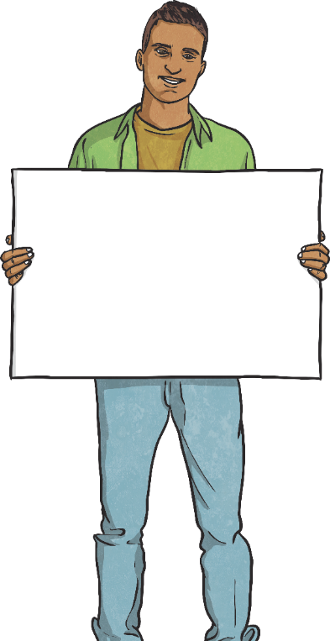
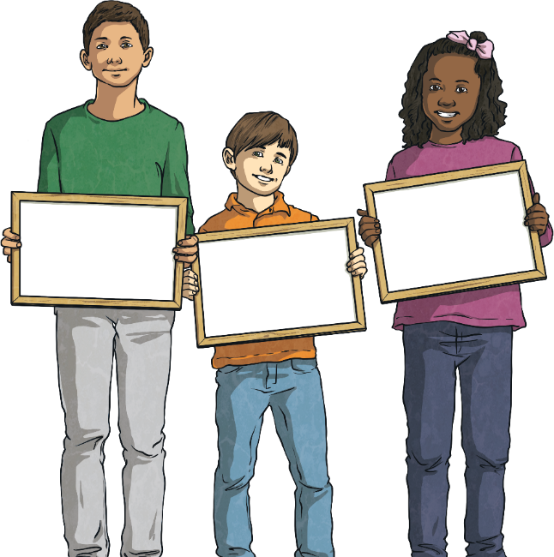
Fractions Greater Than 1
Deeper
Which one is the odd one out? Explain why.
1 1
20 20
99 100
5 5
99 100
is the odd one out because it is less than a whole. The others are all equal to one whole because the numerator is the same as the denominator.

Slide 8
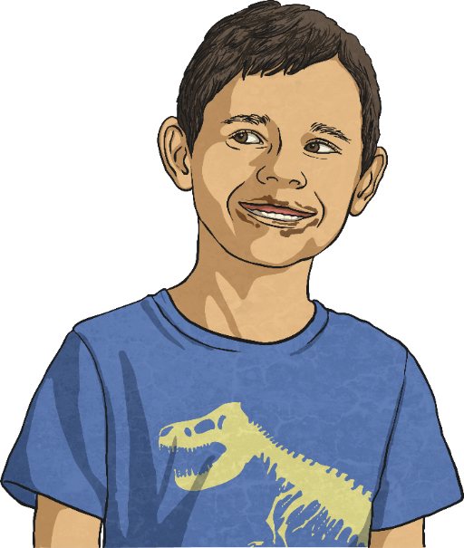
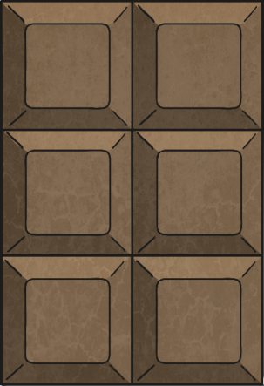
Fractions Greater Than 1
Deeper
Bars of chocolate have 6 squares.
If 38 squares of chocolate are eaten, how many whole bars of chocolate have been eaten?
6 whole bars have been eaten - and 2 extra squares.

Slide 9
Fractions Greater Than 1
Deeper
Read the statement.
Do you agree or disagree? Explain your reasoning.
The denominator will be greater than the numerator if there is more than one whole.
The statement is not correct. The denominator represents the number of equal parts in a whole. If the denominator is greater than the numerator, you have less than one whole.
In order for there to be more than one whole, the numerator must be larger than the denominator.
4 6

Slide 10
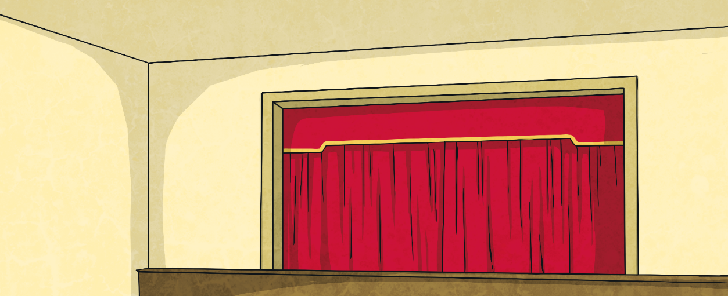
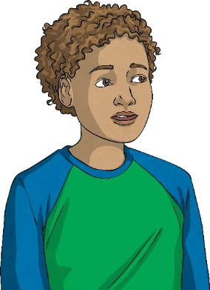
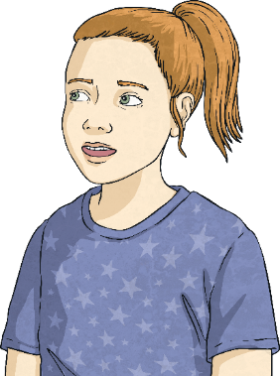
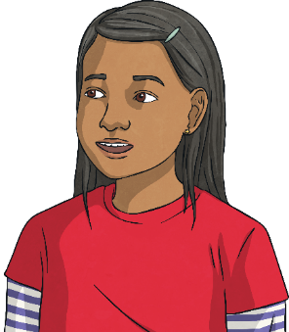
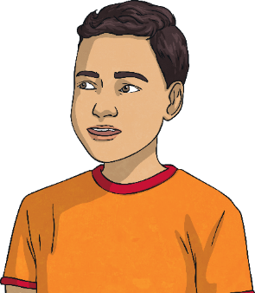
Fractions Greater Than 1
Deepest
The children ate some cake. Each cake was cut into 5 slices.
I ate 6 slices.
I ate 8 slices.
I ate 15 slices.
I ate 2 slices.
Ben
Penny
Amos
Cora
Who ate less than a whole cake?
Who ate 3 whole cakes?
How many more slices of cake would Penny need to eat in order to eat 2 whole cakes?
Cora
Amos
She would need to eat 2 more.

Slide 11
Fractions Greater Than 1
Deepest
Use the digit cards to make improper fractions (where the numerator is larger than the denominator) that equal 2 whole ones.
Your denominator can only be a single-digit number.
Each digit card may only be used once per solution.
Find all 9 possibilities.
0
1
2
3
4
5
6
7
8
9
2 1
4 2
6 3
8 4
10 5
12 6
14 7
16 8
18 9
,
,
,
,
,
,
,
,

Slide 12
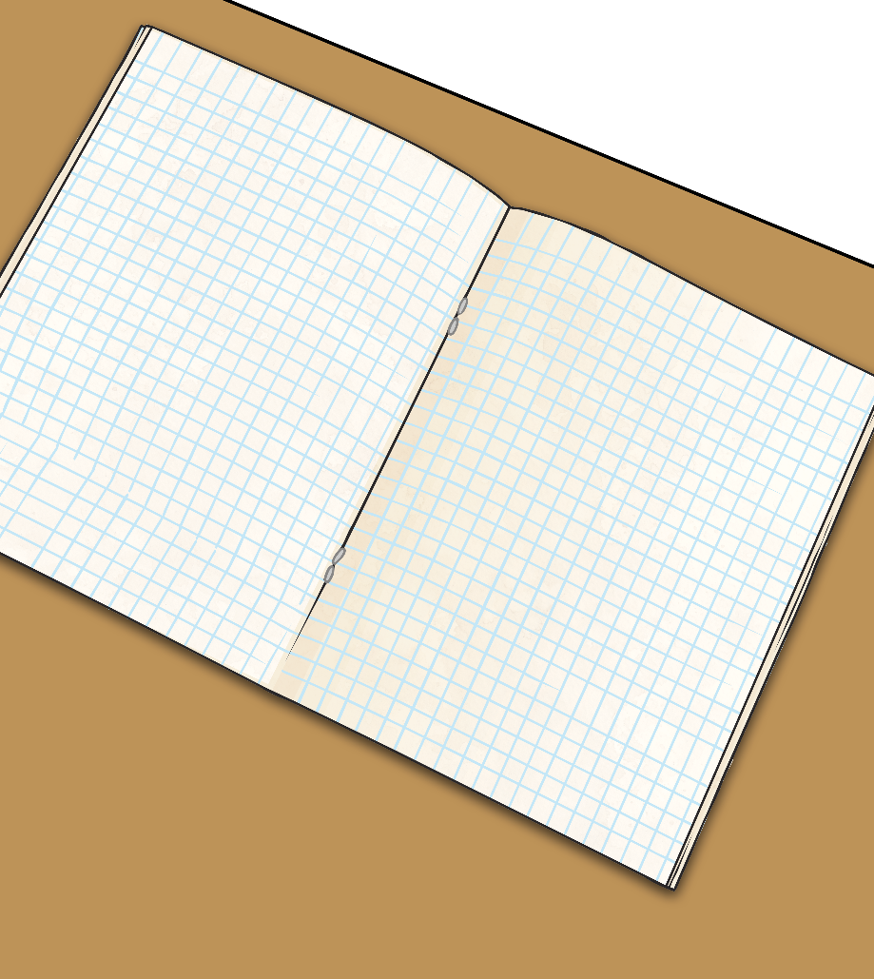
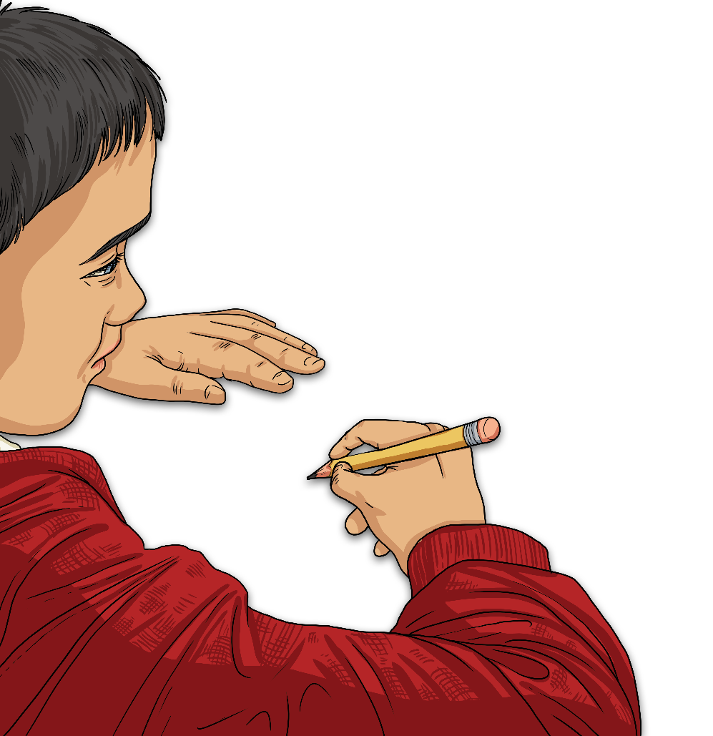
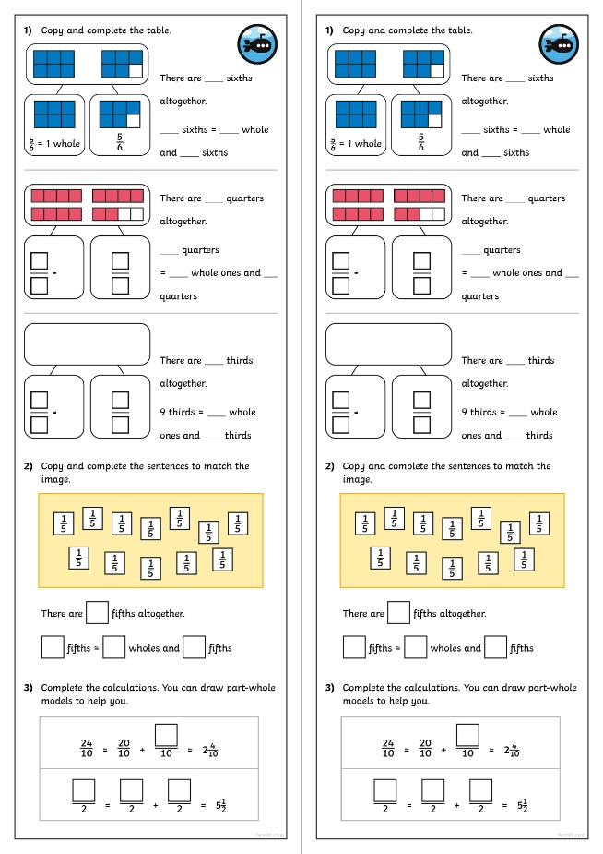
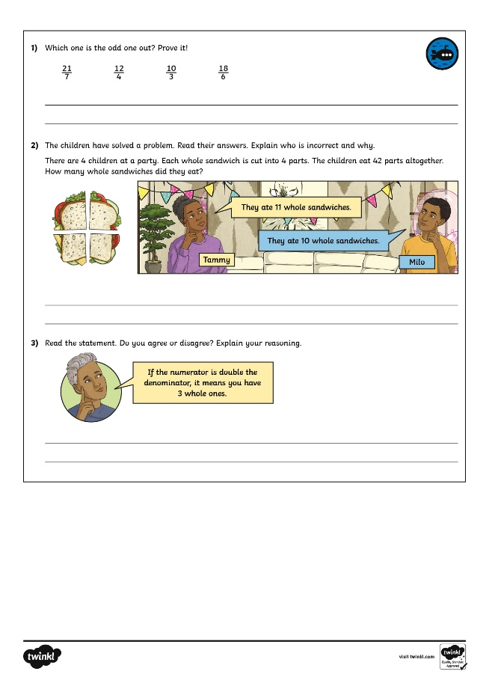
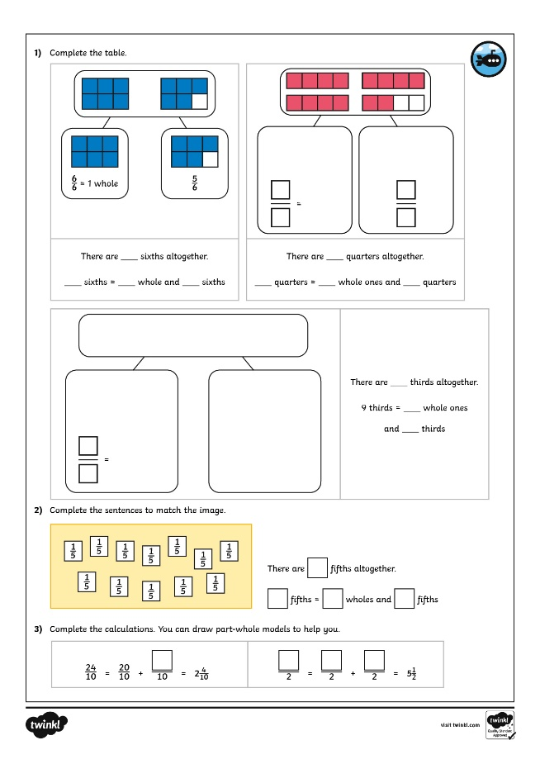
Fractions Greater Than 1
Dive in by completing your own activity!

Slide 13
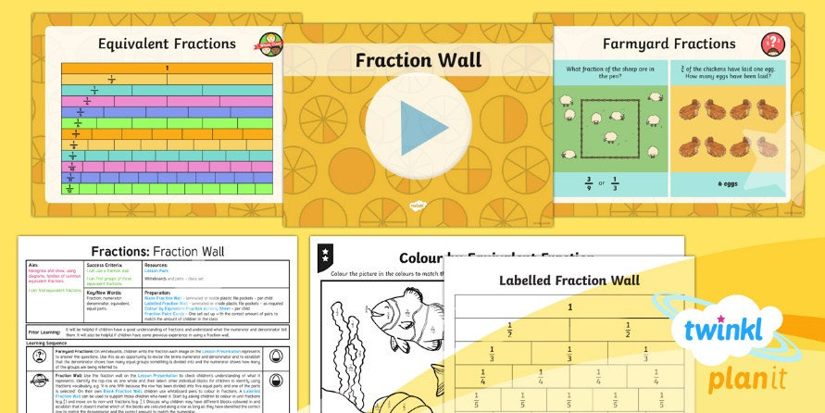
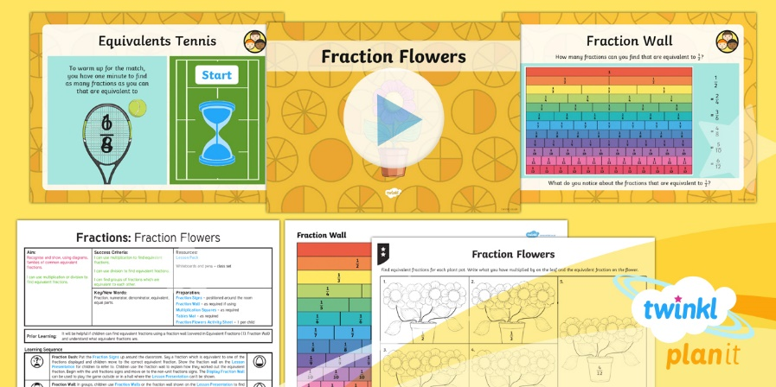
Need Planning to Complement this Resource?
National Curriculum Aim
Recognise and show, using diagrams, families of common equivalent fractions.
For more planning resources to support this aim, click here.
Twinkl PlanIt is our award-winning scheme of work with over 4000 resources.

