Slide 1
Calculate the equivalent fraction.
=
Complete the calculation.
9
12
3
?
?
?
x2
16
32
One
Four
Which fraction is equivalent to three fifths?
Prove it…
Two
5
15
7
14
6
10
21
27
7
9
can only be simplified to
Which two shapes show the same fraction?
Do you agree?
Explain your reasoning!
Three
Five

Slide 2
3
4
8
16
One
Four
D – True.
A – The fraction cannot be simplified in a different way.
B – can be simplified to
6
10
Two
21
27
7
9
e
Three
Five

Slide 3
Aim
Add and subtract fractions with the same denominator and denominators that are multiples of the same number.

Slide 4
Add and Subtract Fractions
Use the bar models to complete the calculations.
2
6
5
6
7
6
1
6
3
4
2
4
5
4
1
4
– + – =
–
= 1–
– + – =
–
= 1–
4
5
4
5
8
5
3
5
2
3
2
3
4
3
1
3
– + – =
–
= 1–
– + – =
–
= 1–

Slide 5
Add and Subtract Fractions
Use the bar models to complete the calculations.
3
4
2
4
1 4
6 7
3 7
3 7
– − – =
–
– − – =
–
4 6
3 6
1 6
2 6
4 6
– − – =
–
1 − – =
–

Slide 6
Add and Subtract Fractions
Marcus is adding fractions.
Here is what he has written:
3 5
4 5
7 10
– + – = —
Marcus is incorrect.
Explain why.
Marcus has added the denominators as well as the numerators.
When adding fractions, we only add the numerators. We can see from the bar model that – + – = – (which is equivalent to 1– ).
3
5
4
5
7
5
2
5

Slide 7
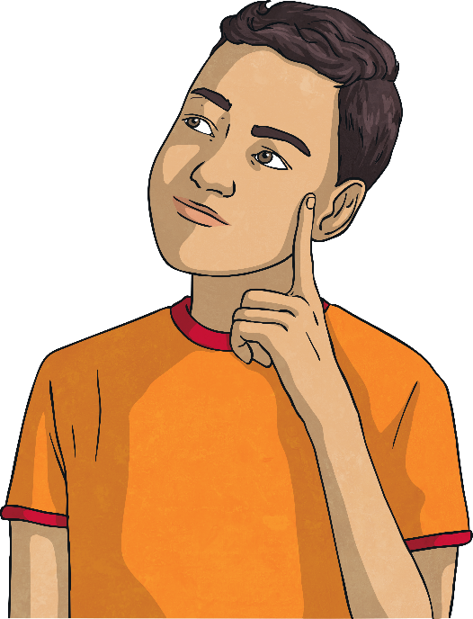
Add and Subtract Fractions
Find 3 ways to make this statement true
?
6
?
6
?
6
?
6
– + – > – + –
Each fraction in the statement must be different and each must be greater than 0 but less than 1.
Possible solutions include the following:
5
6
4
6
2
6
3
6
3
6
4
6
2
6
1
6
5
6
2
6
1
6
3
6
– + – > – + –
– + – > – + –
– + – > – + –

Slide 8
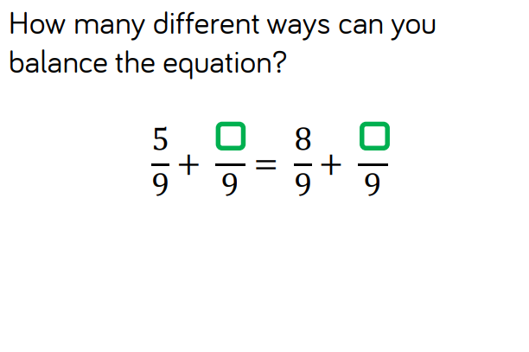
Can you make your own ones up?
Can you make your own ones up?

Slide 9
