Slide 1
Write the improper fraction as a mixed number.
Write seventeen fifteenths as a mixed number.
One
46
7
Four
Write the fraction represented as a mixed number.
Millie believes…
“Seventeen fifths is less than eighteen thirds.”
Two
Draw a bar model to represent
Three
21
6
Five
Is Millie correct?
Explain your reasoning!

Slide 2
4
7
2
15
6
1
One
Four
D – Millie is correct.
A – Seventeen fifths is less than eighteen thirds.
B – = 3
= 6
5
8
3
Two
17
5
2
5
Three
18
3
Five

Slide 3
Aim
Add and subtract fractions with the same denominator and denominators that are multiples of the same number.

Slide 4
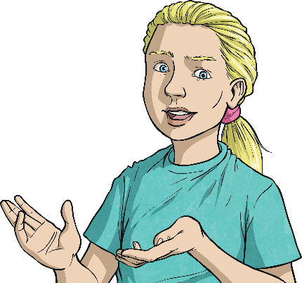
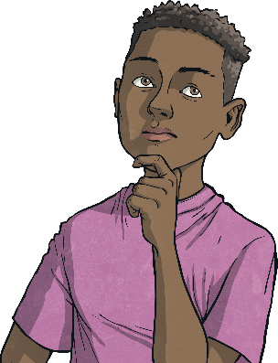
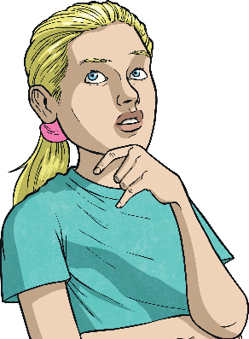
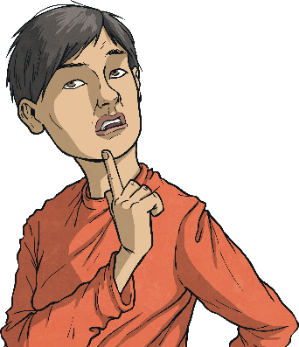
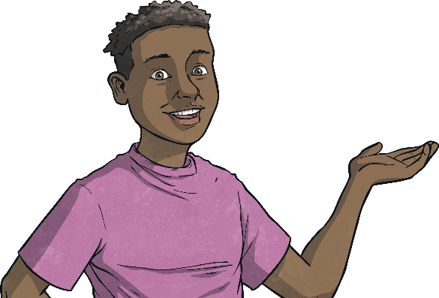
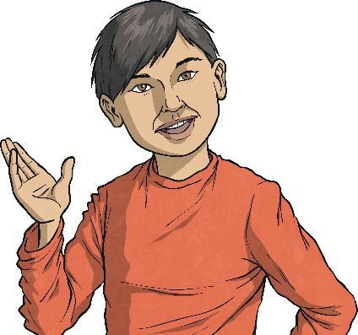
Add Fractions within 1
Use the bar models to find a common denominator and then complete the sum.
1 4
3 8
2 8
3 8
5 8
+
=
+
=

Slide 5
Add Fractions within 1
Use the bar models to find a common denominator and then complete the sum.
1 3
3 6
2 6
3 6
5 6
+
=
+
=

Slide 6
Add Fractions within 1
Use the bar models to find a common denominator and then complete the sum.
2 5
3 10
4 10
3 10
7 10
+
=
+
=
Now complete these sums. Draw your own bar models to help, if needed.
3 4
1 8
7 8
3 5
3 10
9 10
1 3
4 9
7 9
Find a common denominator.
+
=
+
=
+
=
Click for a top tip.

Slide 7
Add Fractions within 1
Deeper
Are these statements true or false? Prove it!
True
False
5 8
1 4
7 8
2 7
2 14
4 14
+
=
+
=
5 8
2 8
7 8
4 14
2 14
6 14
+
=
+
=
True
False
3 5
1 15
10 15
2 3
1 6
3 9
+
=
+
=
9 15
1 15
10 15
4 6
1 6
5 6
+
=
+
=

Slide 8
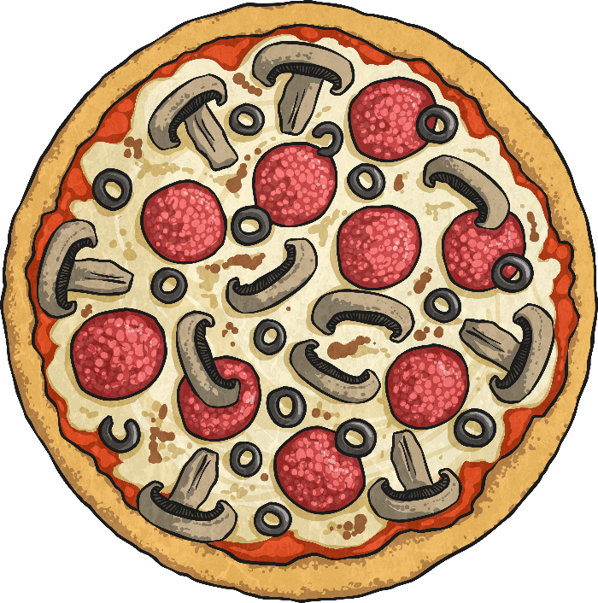
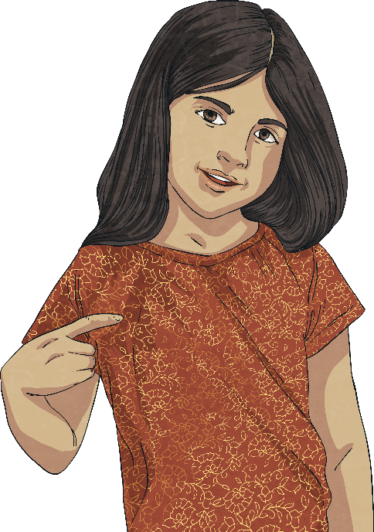
Add Fractions within 1
Hugo and Millie are eating a pizza which is cut into 15 slices.
Hugo eats and Millie eats .
1 5
4 30
How many slices of the pizza did they each eat and who ate the most?
Hugo ate which is equivalent to , so he ate 3 slices. Millie ate which is equivalent to , so she ate 2 slices.
Therefore, Hugo ate the most.
1 5
3 15
4 30
2 15

Slide 9
Add Fractions within 1
Ali is sorting her tin of marbles.
The remainder of the marbles are red and yellow.
3 16
1 4
2 8
are green.
are blue.
are white.
What fraction could be red and what fraction could be yellow? Find all the possibilities.
3 16
1 4
4 16
are green.
are blue, which is equivalent to .
3 16
4 16
4 16
11 16
+
+
=
2 8
4 16
are white, which is equivalent to .
5 16
4 16
3 16
2 16
1 16
This leaves which are red and yellow.
Red
Yellow
There are 4 possibilities:
1 16
2 16
3 16
4 16

Slide 10
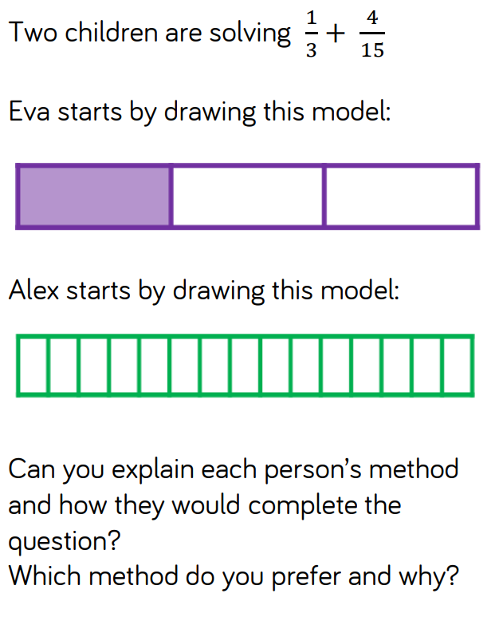

Slide 11
