Slide 1
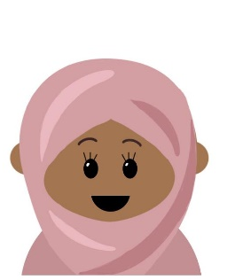
Multiply the number represented below by 7.
Calculate 35 x 14.
x | 30 | 5
10
4
One
1000
100
100
1
1
1
1
Four
100
100
100
10
10
10
10
10
100
10
10
10
10
True or False?
Asha is dividing seven thousand and twenty five by seven.
Do you agree with her?
Explain your reasoning!
Two
39 x 13 = 507
“The answer will have a remainder.”
Which calculation has the smallest answer?
5,125 ÷ 5 6,308 ÷ 3 8,140 ÷ 4
Three
Five
©Deepening Understanding LTD 2020

Slide 2
8,428
35 x 14 = 490
One
Four
True
D – I agree with Asha.
A – The answer will have a remainder.
B – 7,025 ÷ 7 = 1,003 r4
Two
5,125 ÷ 5
Three
Five
©Deepening Understanding LTD 2020

Slide 3
Key Vocabulary
Proper fractions, improper fractions, mixed numbers
Unit fractions
Non Unit fractions
Numerator
Denominator
Equivalent
Vinculum

Slide 4
Aim
Recognise, find and write fractions of a discrete set of objects: unit fractions and non-unit fractions with small denominators.

Slide 5
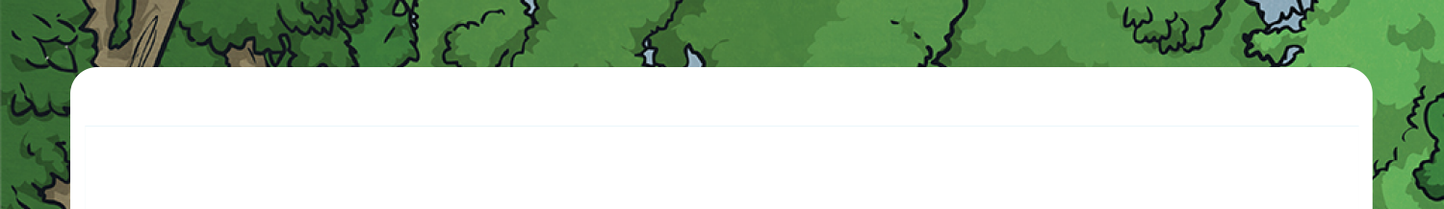



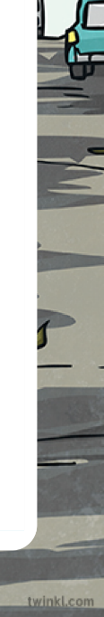
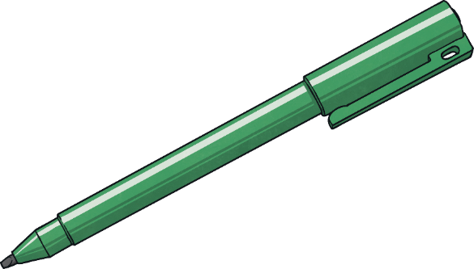
What Is a Fraction?
Have these shapes been split into fractions?
Yes, these are fractions. The four smaller triangles are identical.
No, these are not fractions because each part is not the same size.
Yes, these are fractions as the two halves are the same size.
No, these are not fractions as the sections are different sizes.

Slide 6
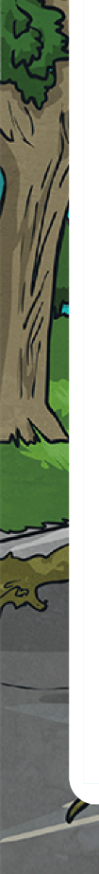
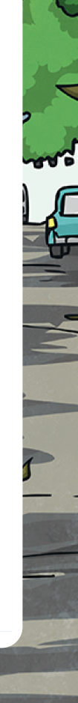

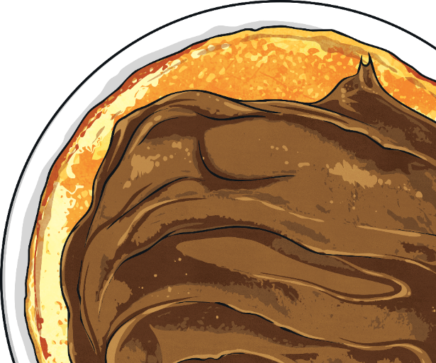
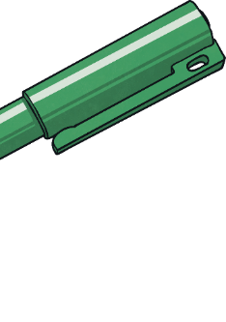
What Is a Fraction?
Complete the table.
Words | Fraction | Shape | Number Line | Quantity
three quarters
3
4
0
1
2
3
1
4
4
4
1
half
2
0
1
1
2

Slide 7
What Is a Fraction?
Look at the images and decide if each one is a unit fraction or a non-unit fraction.
Words | Fraction | Shape | Number Line | Quantity
three quarters
 | Unit Fraction | Non-Unit Fraction
3
4
✓
0
1
2
3
1
4
4
4
✓
3
half
4
✓
0
1
1
2

Slide 8
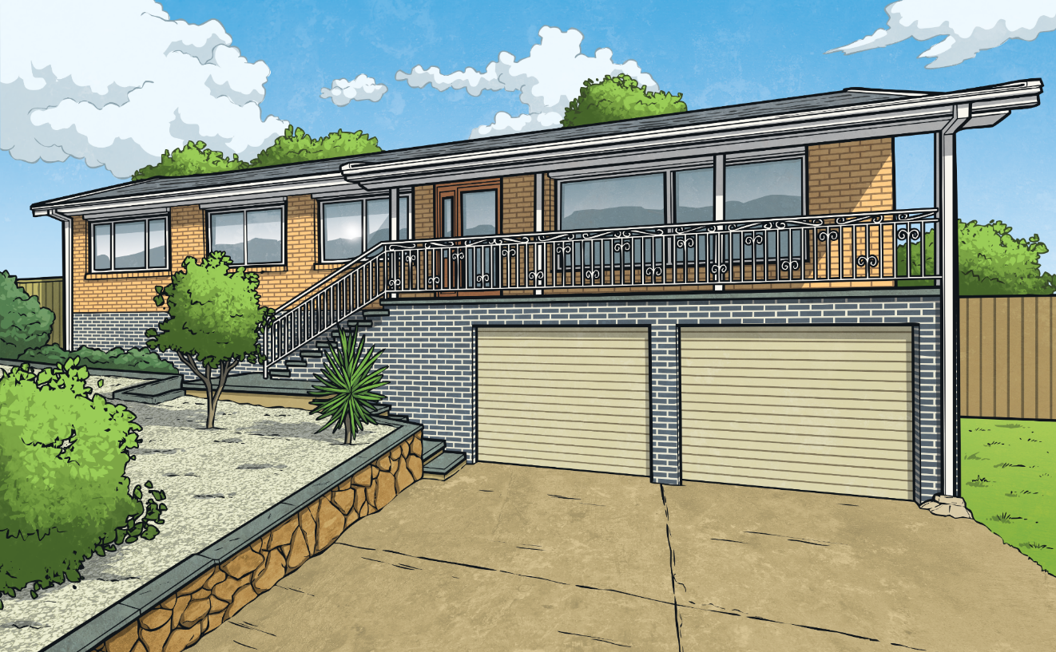


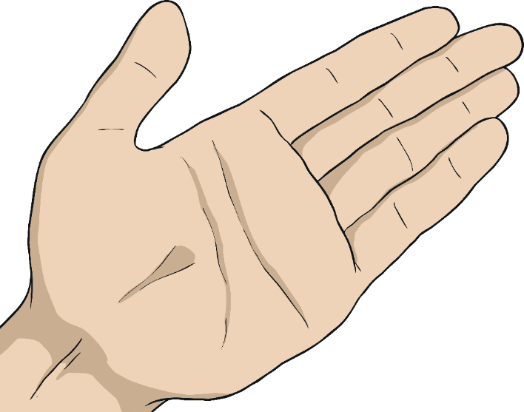

What Is a Fraction?
Look at this fraction bar. Label each part as a fraction.
1
1
2
2
1
1
1
1
4
4
4
4

Slide 9
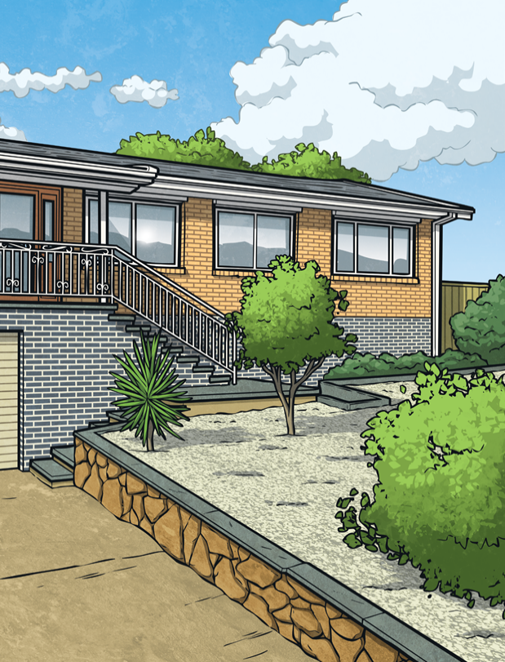

What Is a Fraction?
a
Rebecca has sorted these fractions.
b
two quarters
Yes, Rebecca is correct. She has grouped them into representations
of two quarters and three quarters.
The odd one out is a
is a because it has a denominator of 6. The other fractions both have a denominator of 5.
3
4
c
0
0
3
1
2
1
4
Do you think she is correct? Explain your reasoning.
5
Which is the odd one out and why?

Slide 10

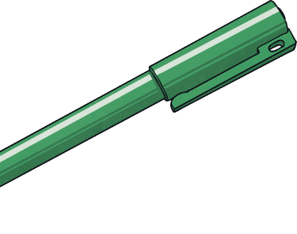
What Is a Fraction?
Look at the image of the circles. Read the statements and complete the table.
Statement | True or False If it’s false, explain how it can be corrected.
The image
represents
False - 1 circle out of 3 is white so the numerator should be 1 and the denominator should be 3.
3
1
The image
represents one third.
1
True because of the circles are white.
3
The image represents
False - The whole should be split into 3 equal sections, with 1 section white and 2 sections blue.

Slide 11


What Is a Fraction?
Reece has 3 red counters, 2 blue counters and 1 yellow counter. He uses 4 counters each time
to make a fraction representation. Can you find 4 different representations he could make? The first one has been done for you. Remember to record a fraction for each colour used in each representation.
There are many possibilities.
Here are some example answers.
Solution 1:
3
yellow =
1
red =
4
4
Solution 2:
2
blue =
1
yellow =
1
red =
4
4
4
Solution 3:
1
blue =
2
yellow =
1
red =
2
blue =
2
4
red =
4
4
4
4

Slide 12
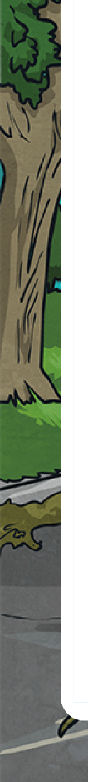




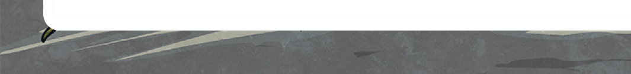
What Is a Fraction?
d
Dawn
My fraction is a unit fraction.
Read the statements and match the fraction representation to
the correct child.
Johan
My fraction has an odd numerator and an even denominator.
a
2
c
c
3
Sid
My fraction has a digit sum of 5.
b
b
a
Julia
My fraction has a denominator of 3.
d

Slide 13
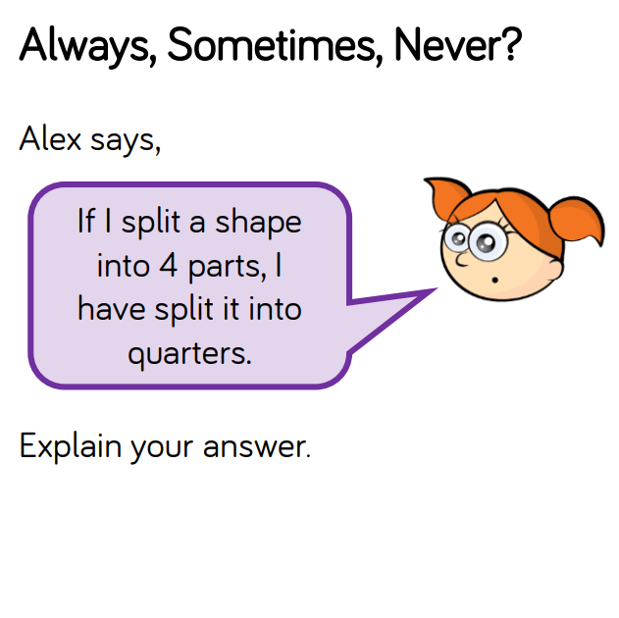

Slide 14
