Slide 1
Introduction
Which is the odd one out? Explain your choice.
Name each shape.
Y4
© Classroom Secrets Limited 2018

Slide 2
Introduction
Discuss these statements about polygons.
Are they true or false?
True | False
They have 5 or more sides
They are made up of straight lines
They are 3D shapes
They are 2D shapes
They are a closed shape (no gaps)
They can have curved sides
They include open shapes
Y5
© Classroom Secrets Limited 2018

Slide 3
Varied Fluency 1
Draw lines to match the true statements to the shape.
It is a rectangle
It has 5 right angles
It has 3 sides
It has equal sides
It has 4 sides
Y4
© Classroom Secrets Limited 2018

Slide 4
Varied Fluency 2
Fill in the blanks to describe the shape.
This shape has ______ sides.
It has ______ right angles.
It has ______ pair of parallel sides.
Y4
© Classroom Secrets Limited 2018

Slide 5
Varied Fluency 3
Draw the shape using the description below.
The shape has:
4 sides
4 right angles
What shape have you drawn?
Y4
© Classroom Secrets Limited 2018

Slide 6
Varied Fluency 4
Circle the quadrilaterals.
Y4
© Classroom Secrets Limited 2018

Slide 7
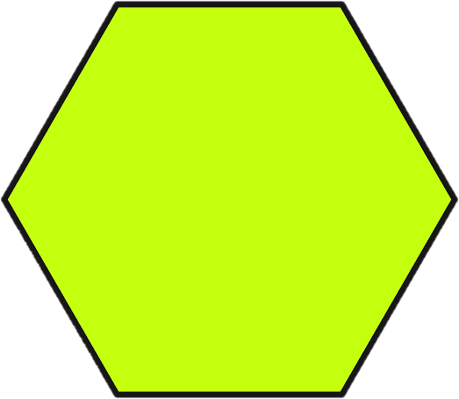
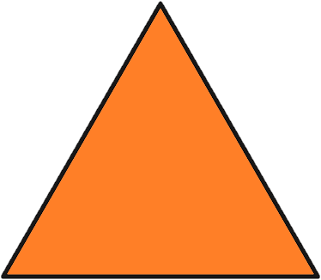
Varied Fluency 1
Circle the regular polygons.
Y5
© Classroom Secrets Limited 2018

Slide 8
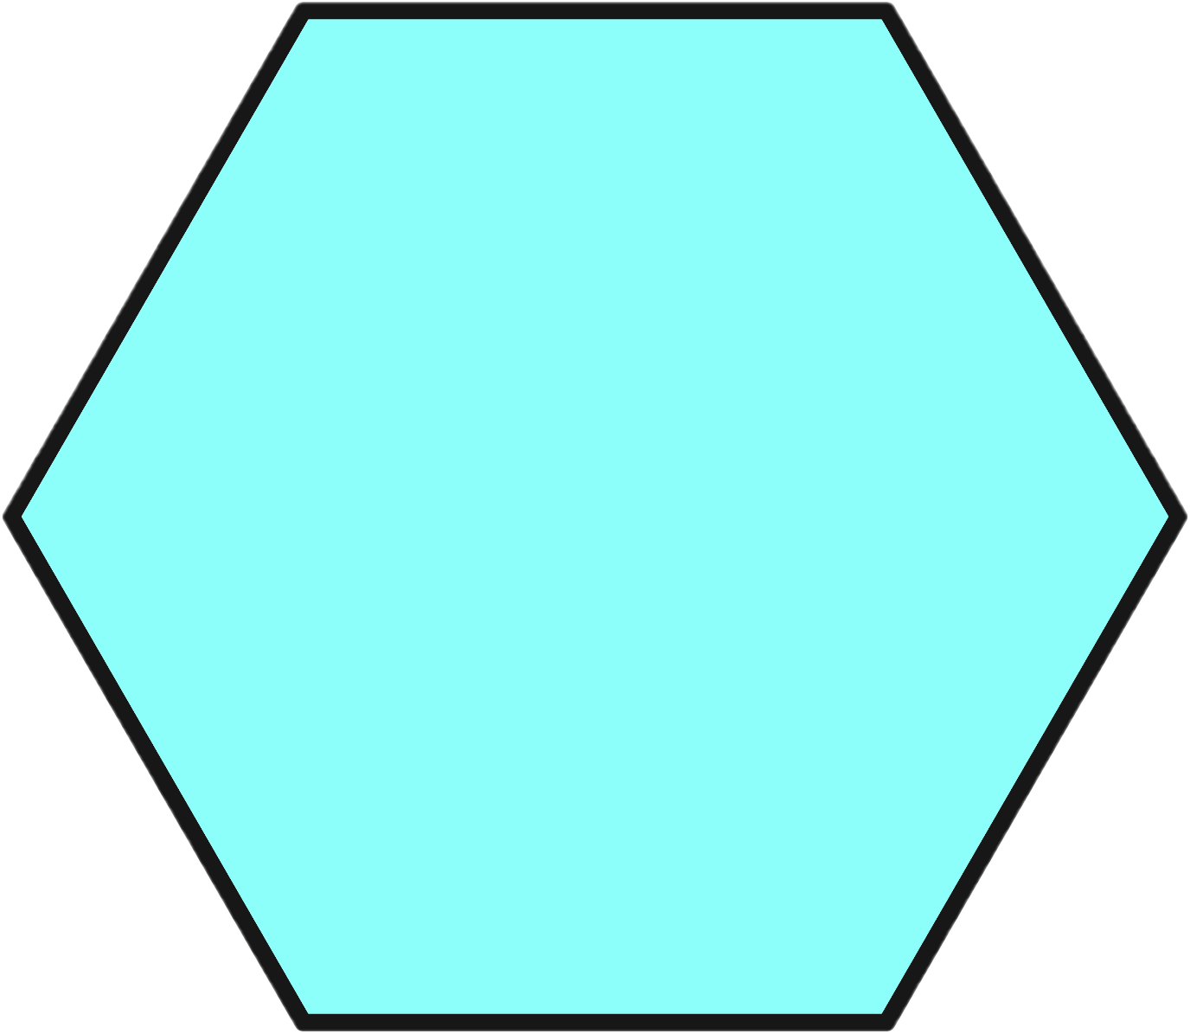
Varied Fluency 2
Identify the name of this shape.
Use a ruler and a protractor to decide whether
it is a regular or irregular polygon.
Y5
© Classroom Secrets Limited 2018

Slide 9
Varied Fluency 3
This is a regular octagon.
True or false?
Y5
© Classroom Secrets Limited 2018

Slide 10
Varied Fluency 4
Draw a regular pentagon.
Measure the length of each side and the size of each angle to make sure that they are equal.
Y5
© Classroom Secrets Limited 2018

Slide 11
Reasoning 1
What is the same about these two shapes?
What is different?
Y4
© Classroom Secrets Limited 2018

Slide 12
Problem Solving 1
Tina is thinking of a shape. It has:
4 equal length sides
No right angles
What shape could Tina be thinking of? Give all possible answers.
Y4
© Classroom Secrets Limited 2018

Slide 13
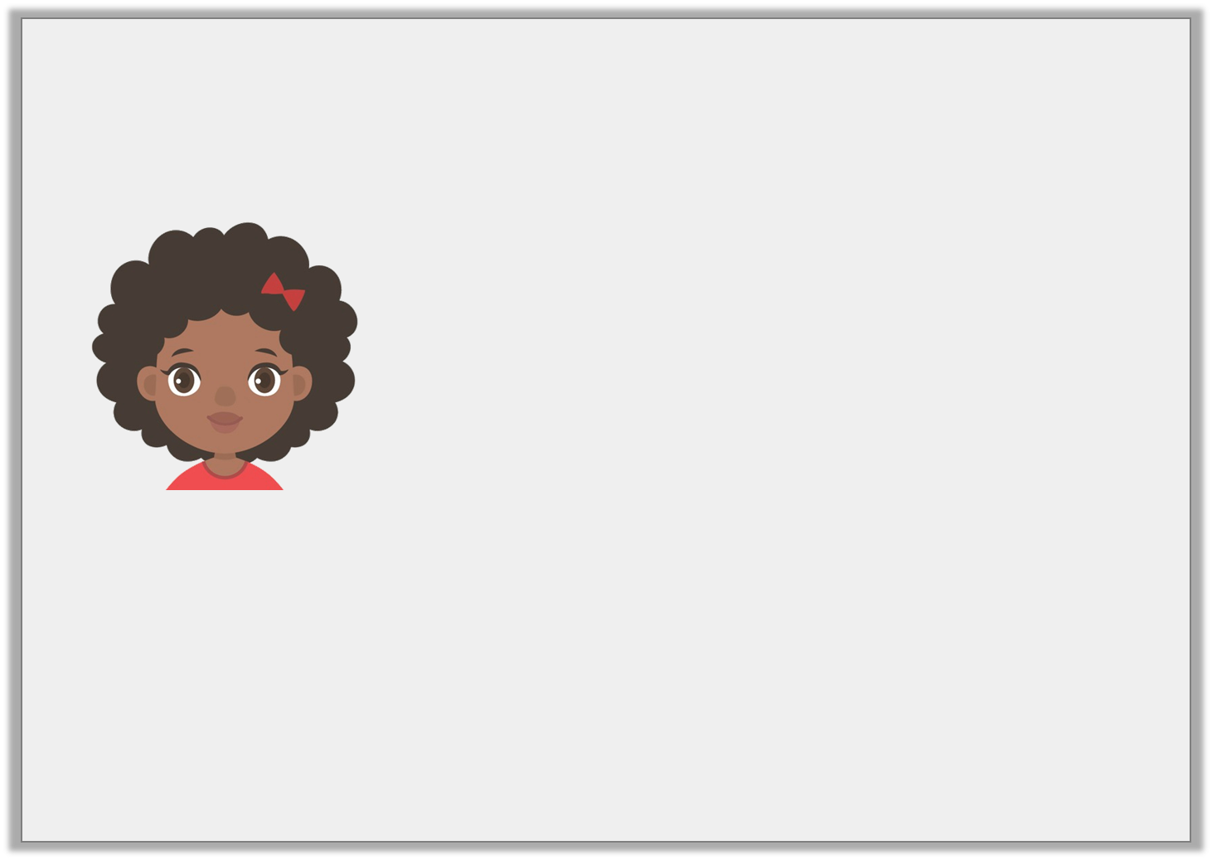
Reasoning 2
Jenny thinks that the shape matches her statement.
Is she correct? Explain your answer.
This quadrilateral has 1 pair of parallel lines and 0 right angles.
Y4
© Classroom Secrets Limited 2018

Slide 14
Reasoning 1
Has Toni sorted these shapes correctly? Explain your answer.
 | Regular Polygon | Irregular Polygon
Has 5 sides
Not 5 sides
A
B
D
E
F
C
Y5
© Classroom Secrets Limited 2018

Slide 15
Reasoning 2
Jade says:
Is Jade correct? Explain your answer.
A rhombus and a square are both regular polygons because they both have sides of equal length.
Y5
© Classroom Secrets Limited 2018

Slide 16
Problem Solving 1
How many regular polygons can you see in this shape?
Y5
© Classroom Secrets Limited 2018

