Slide 1
Lesson 2 sources
Please print these sources and give to students

Slide 2
Source 1
An image from a medieval manuscript shows how farmers used to prepare a field for crops.

Slide 3
Source 2
An image drawn for a school textbook. This man has been convicted of a crime and is having to put his hand in boiling water as a punishment.

Slide 4
Source 3
An image drawn for a school textbook.
This image shows what historians think a Anglo-Saxon town might look like.

Slide 5
Source 4
A description of the English by a monk.

Slide 6
Source 5
A photograph of Earls Barton church tower. This was built in Anglo-Saxon times, around the 10th century.

Slide 7
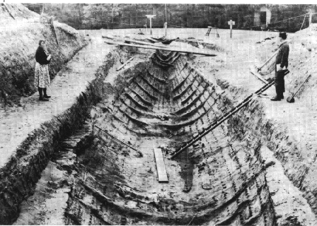
Source 6
An Anglo-Saxon boat was discovered by archaeologists in 1939 on the Suffolk Coast

Slide 8
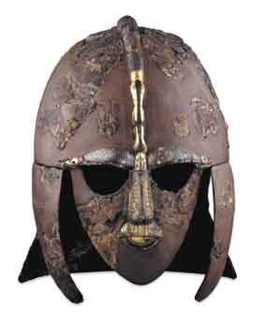
Source 7
This helmet was discovered amongst the ship found off the coast of Suffolk in 1939.

Slide 9
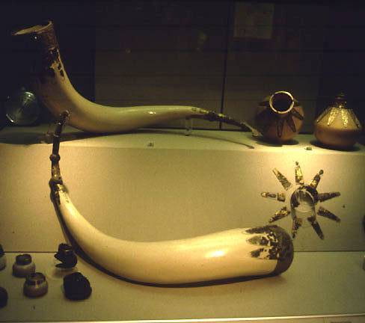
Source 8
Treasures like this were found near the ship.

Slide 10
Sources with questions to assist
These are the same sources as above, and it is unnecessary to print sources above and below.
The sources below have additional questions to support students making inferences.

Slide 11
Source 1
An image from a medieval manuscript shows how farmers used to prepare a field for crops.
How do people farm?
What does this tell us about the Anglo-Saxon diet?
Do they use tools? What does this tell us?

Slide 12
Source 2
An image drawn for a school textbook. This man has been convicted of a crime and is having to put his hand in boiling water as a punishment.
Does this suggest that Anglo-Saxons take the law very seriously?
Does the man look rich or poor?
The bald man is a monk and the punishment is taking place in a church. Who was in charge of punishment in Anglo-Saxon times?

Slide 13
Source 3
An image drawn for a school textbook. This image shows what historians think a Anglo-Saxon town might look like.
What is being sold?
There are lots of sheep to sell. What can you make using sheep?
There is a stall in the bottom right corner. What are they selling? Why might they be selling this?

Slide 14
Source 4
A description of the English by a monk.
What did Anglo-Saxon people look like?
What did Anglo-Saxon people do?
This source was written by a monk. What do you think his opinion is of the normal Anglo-Saxon person?

Slide 15
Source 5
A photograph of Earls Barton church tower. This was built in Anglo-Saxon times, around the 10th century.
Were people religious?
How important was religion?

Slide 16
Why would this have been near the coast?
How skilled were the Anglo-Saxons?
Did Anglo-Saxons have an understanding about travelling?
Who might have travelled to England and left a HUGE boat here?
Source 6 An Anglo-Saxon boat was discovered by archaeologists in 1939 on the Suffolk Coast

Slide 17
Source 7
This helmet was discovered amongst the ship found off the coast of Suffolk in 1939.
Why would someone wear a helmet like this?
Why would this have been found amongst a ship? What might they have been doing?
Was this an expensive helmet?

Slide 18
Source 8
Treasures like this were found near the ship.
Where would they have gone to get this?
What was the point of the boat?

