Slide 2
Historians and arachnologists have uncovered many Ancient Greek vases and vessels that have pictures which tell us all about life in Ancient Greece
Have a look these vases below- many have pictures of Gods and Goddesses on them and many were showing sports that feature in the Olympics.

Slide 3
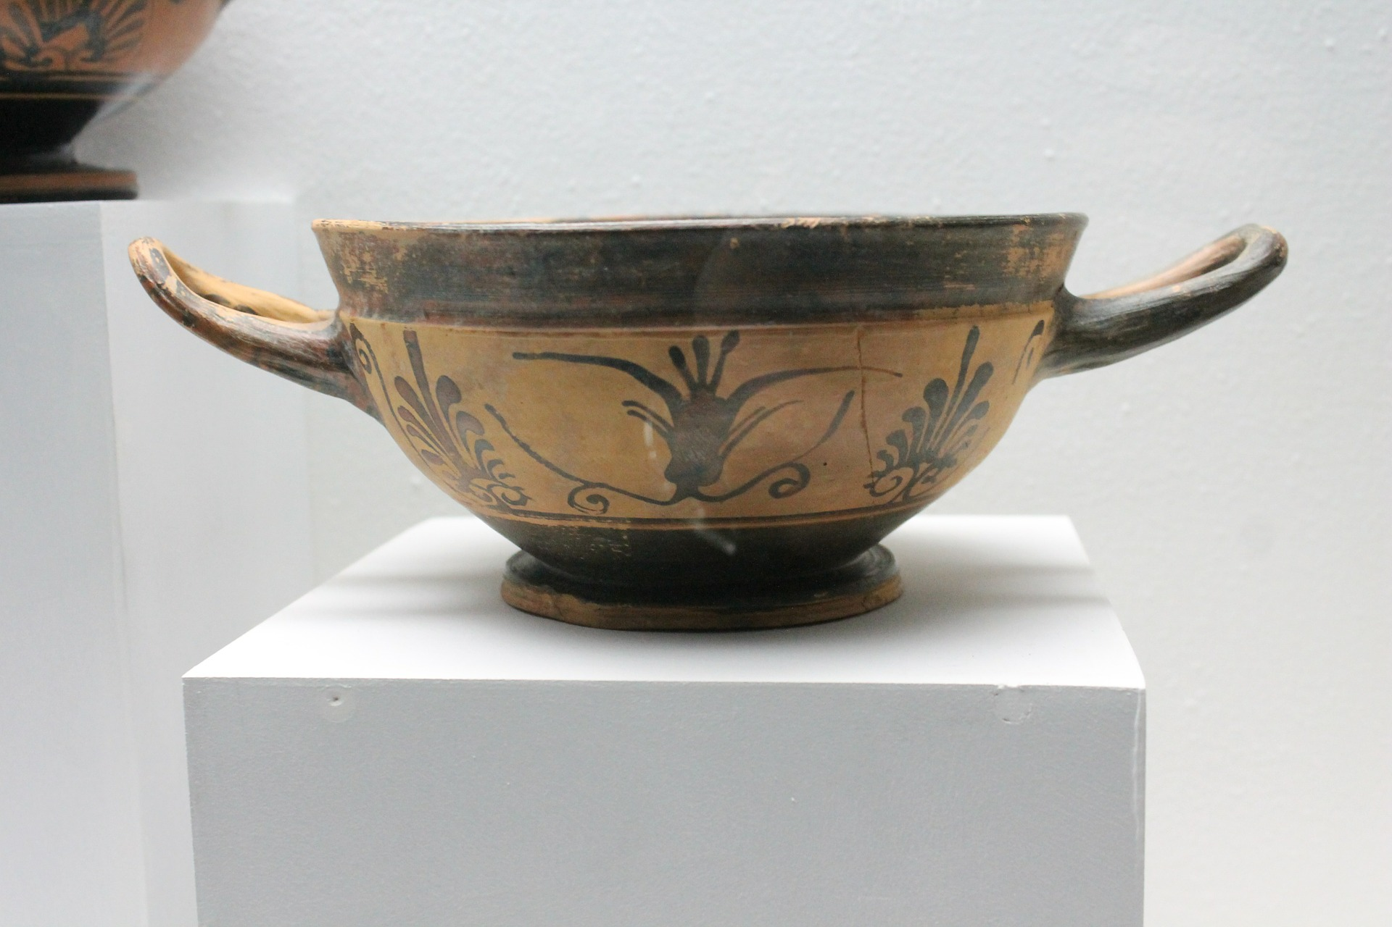

Slide 4
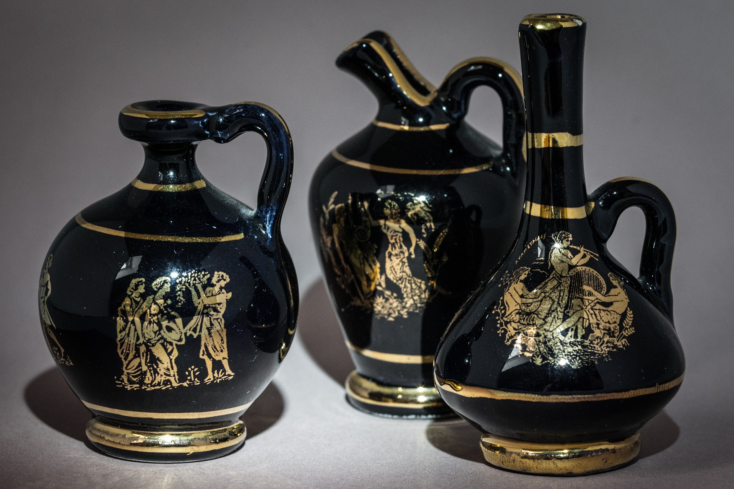

Slide 5
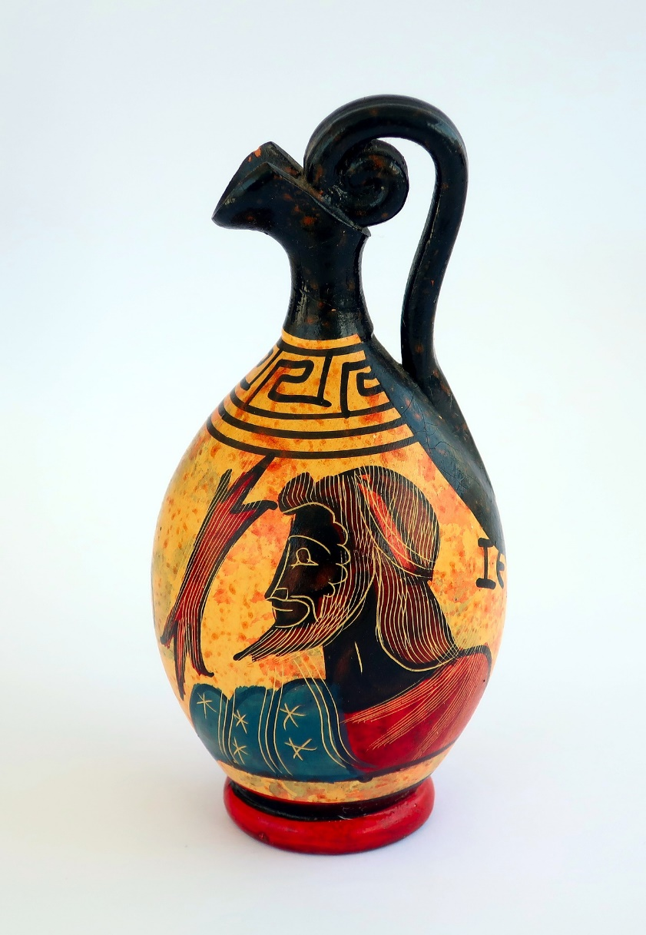

Slide 6
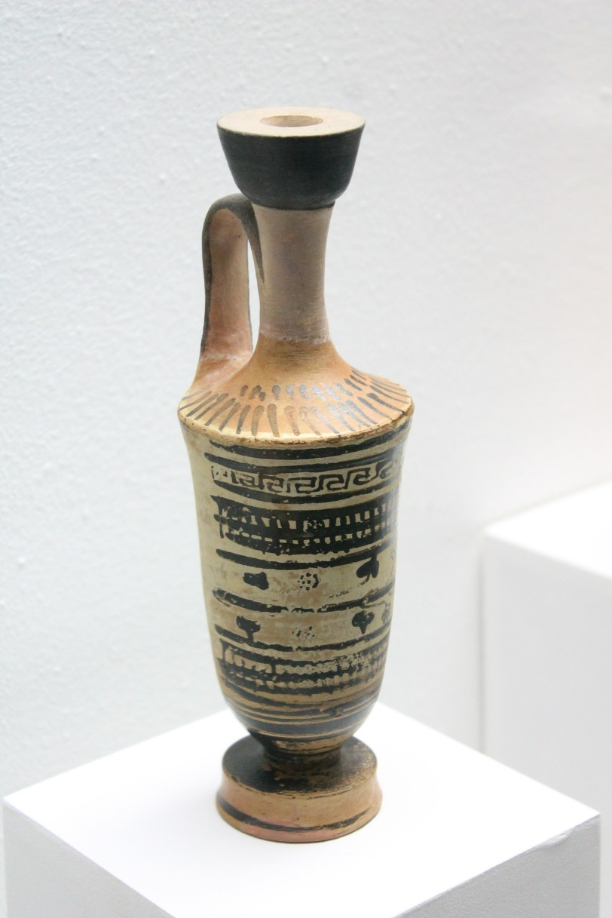
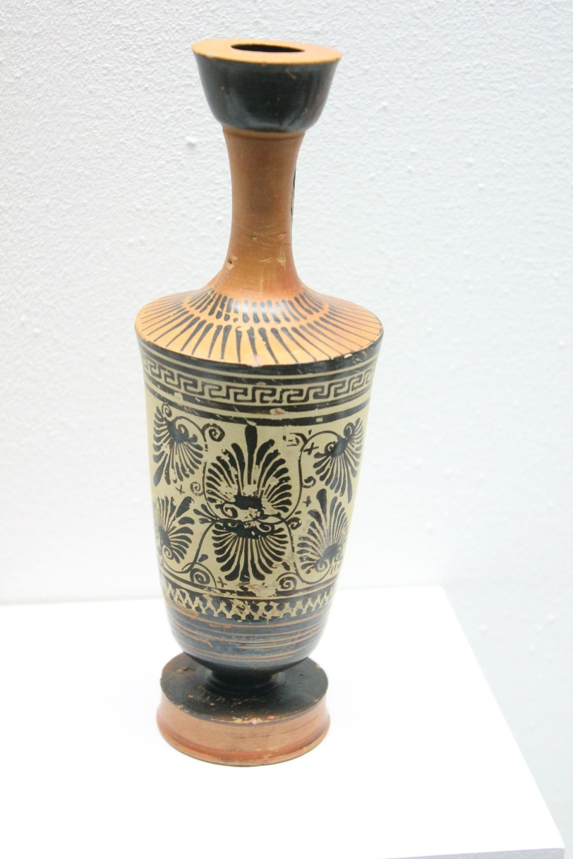

Slide 7
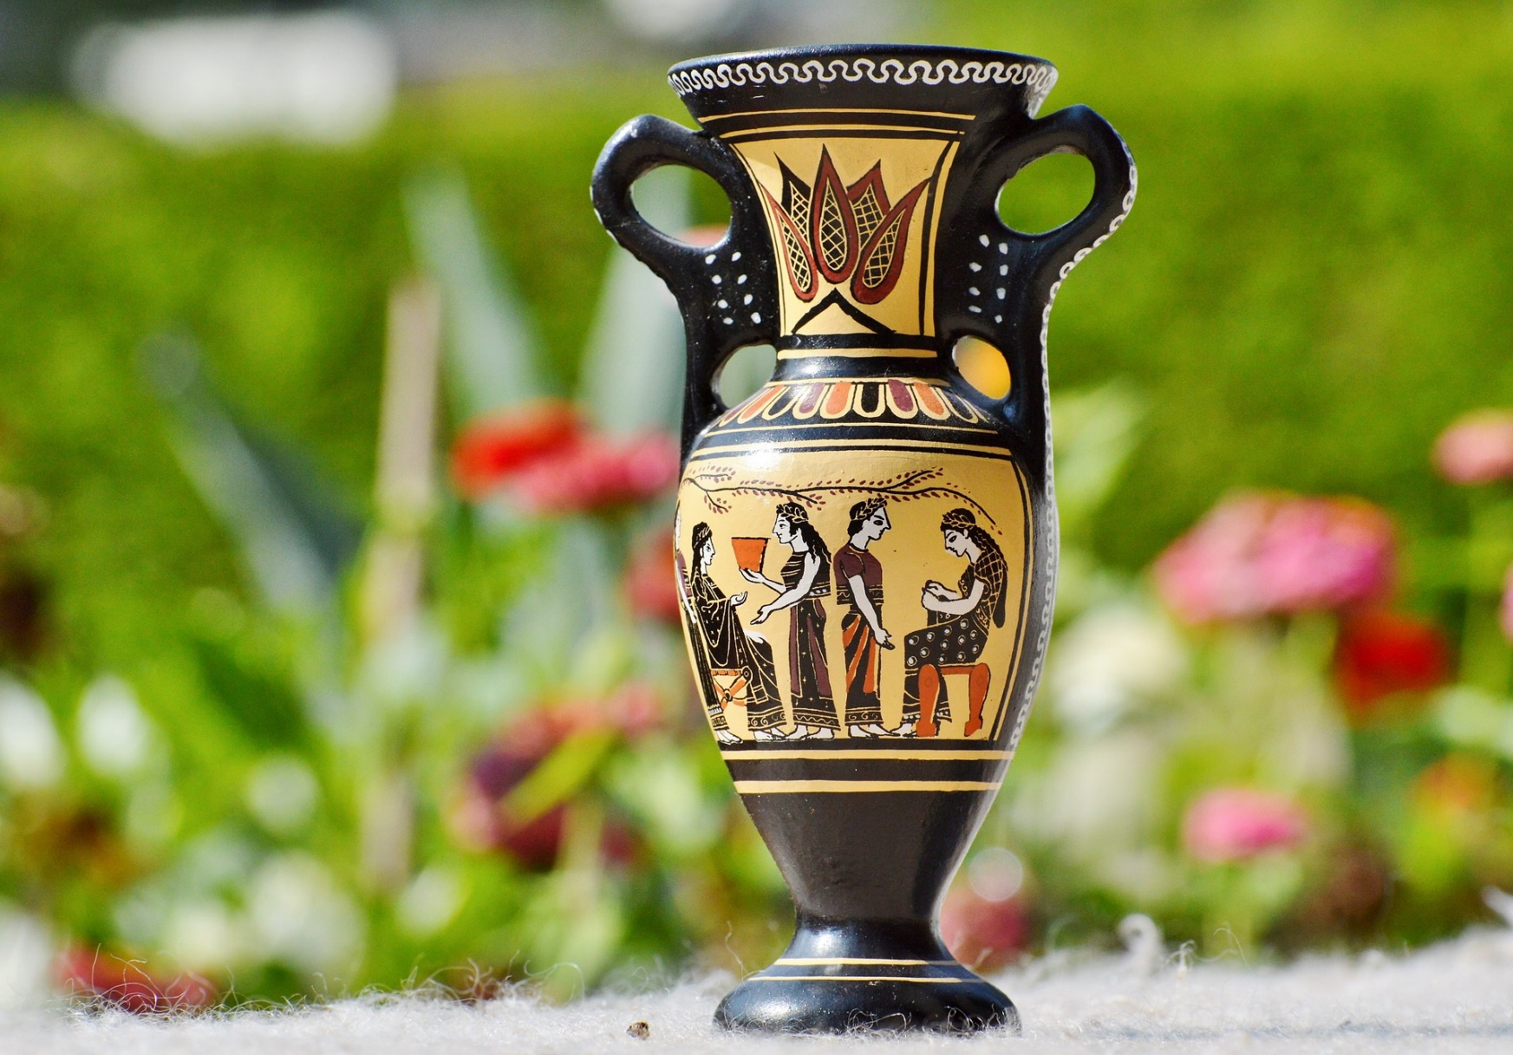

Slide 8
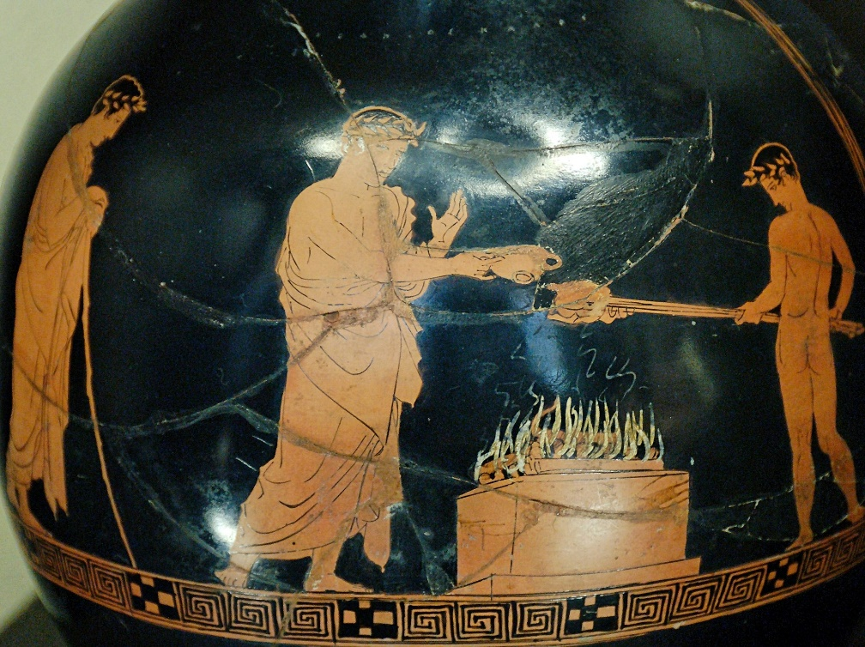
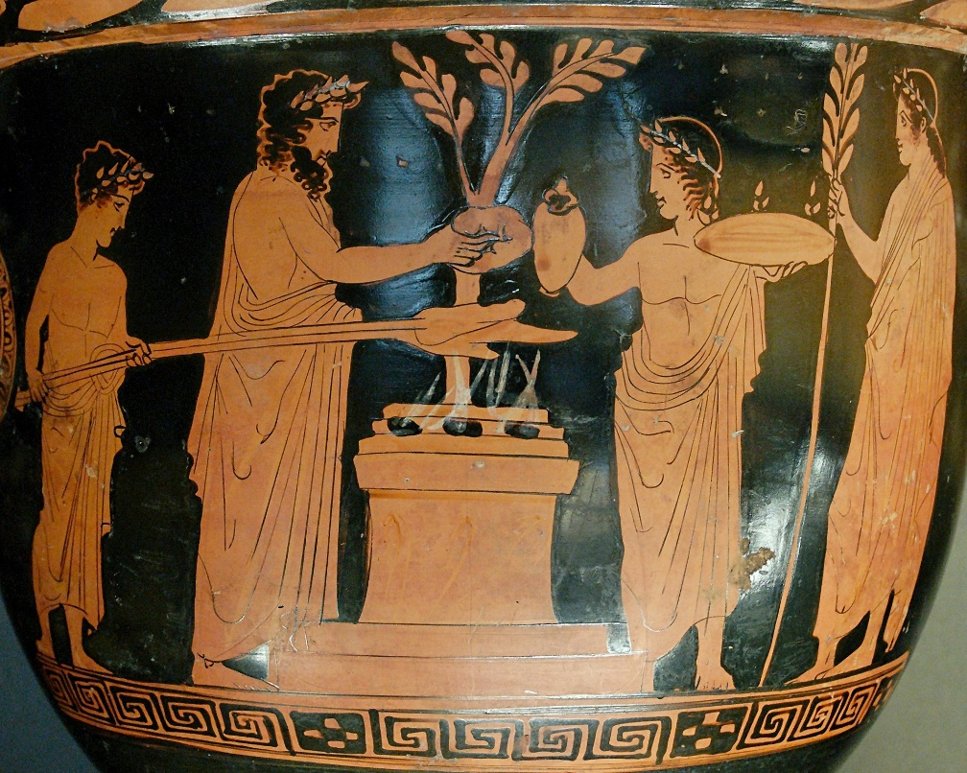

Slide 9
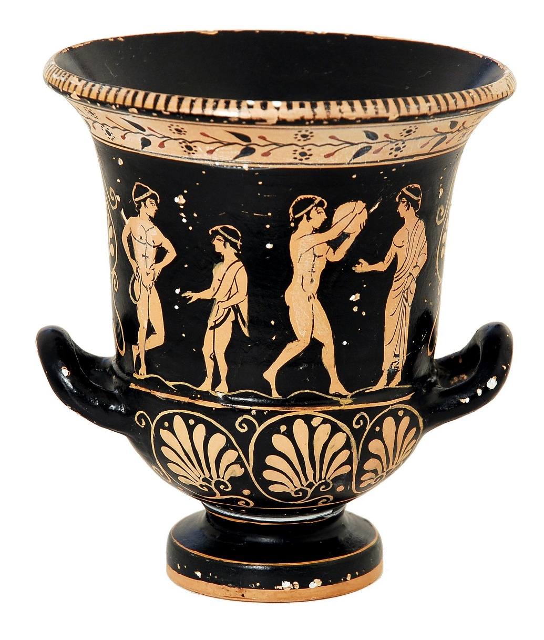

Slide 10
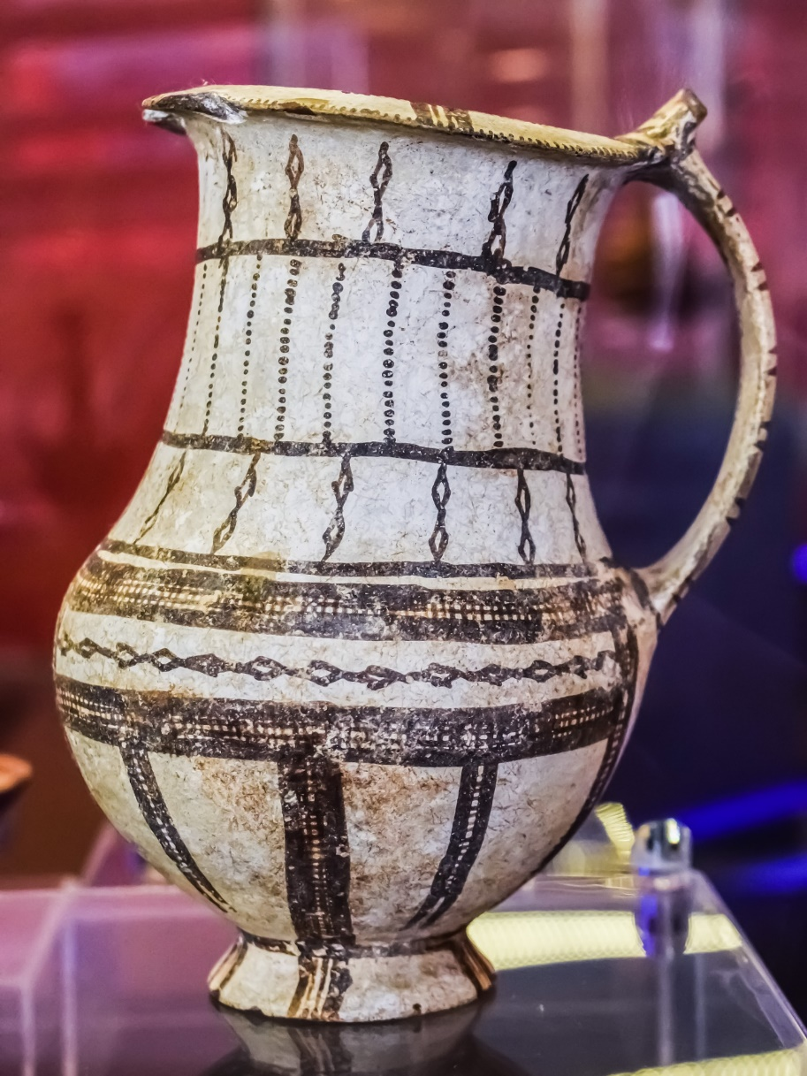

Slide 11
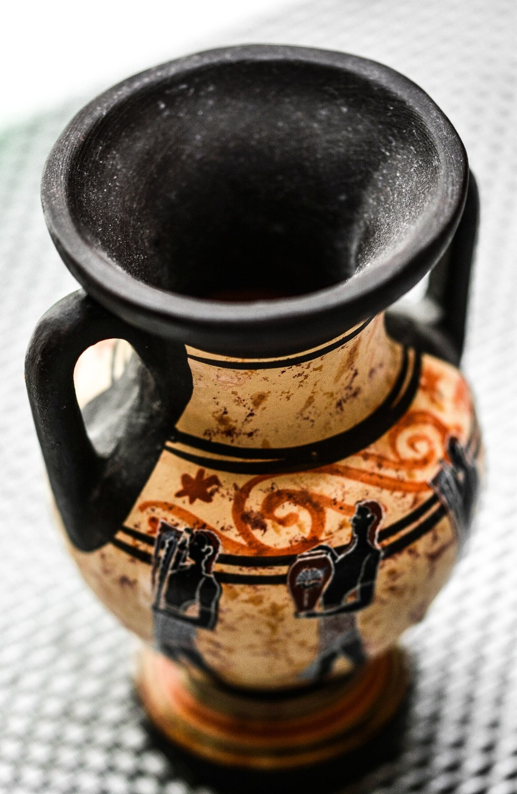

Slide 12
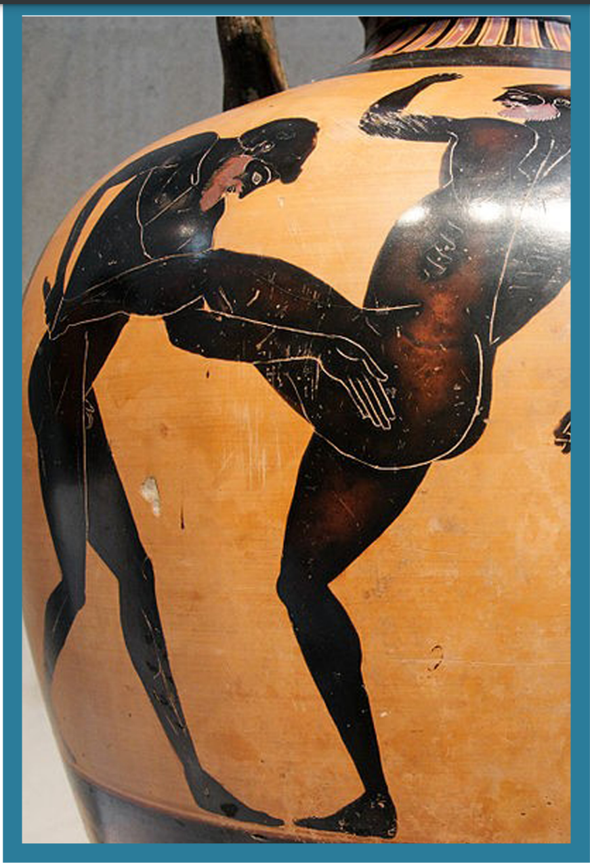
What sport could this be?

Slide 13
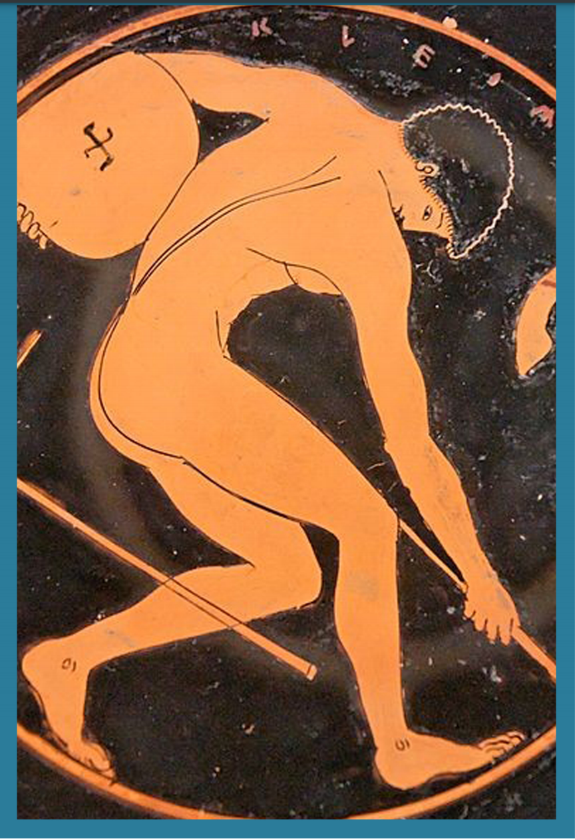
What sport could this be?

Slide 14
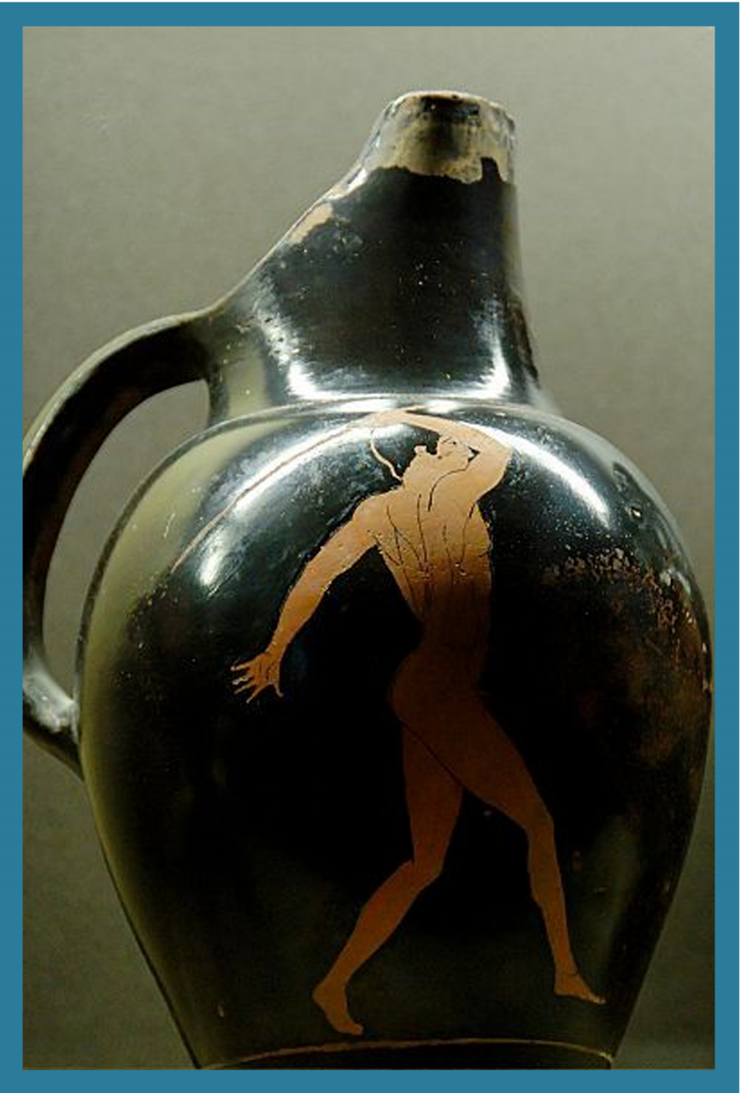
What sport could this be?

Slide 15
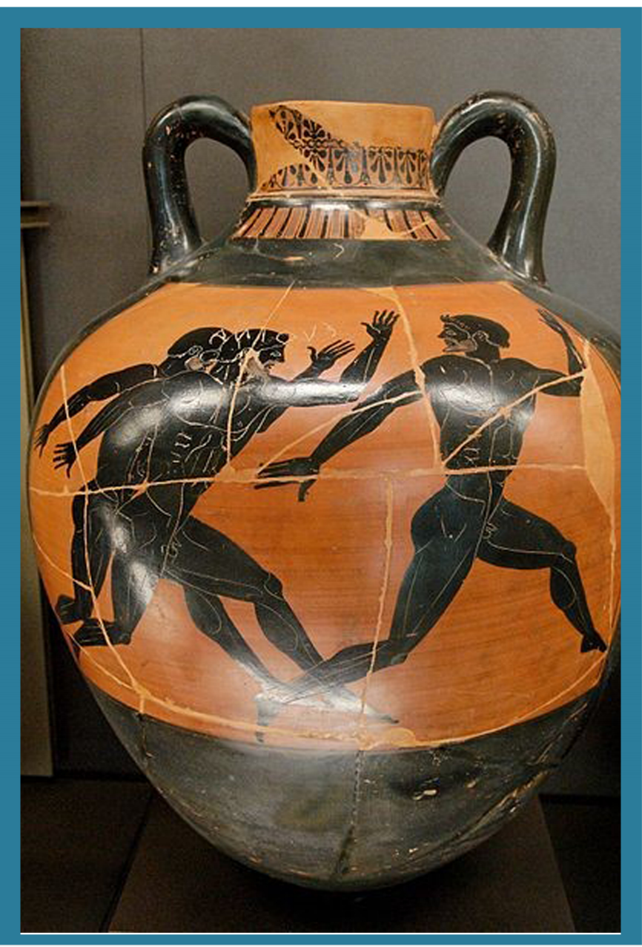
What sport could this be?

Slide 16
Have a go at designing your own Greek vase –

