Slide 1
Year 6 – Converting Units of Length
National Curriculum Objectives:
Mathematics Year 6: (6M6) Convert between miles and kilometres
© Classroom Secrets Limited 2019

Slide 2
Year 6 – Converting Units of Length
Miles And Kilometres
© Classroom Secrets Limited 2019

Slide 3
Introduction
Complete the conversions below.
23,100cm = km
435m = km
278,000cm = km
1,901m = km
© Classroom Secrets Limited 2019

Slide 4
Introduction
Complete the conversions below.
23,100cm = km
0.231
435m = km
0.435
278,000cm = km
2.78
1,901m = km
1.901
© Classroom Secrets Limited 2019

Slide 5
Varied Fluency 1
Calculate the missing conversions.
5 miles | ≈ | 8km
 |  | miles | ≈ | 4.8km
 |  | miles | ≈ | 80km
2.5 miles | ≈ |  |  | km
© Classroom Secrets Limited 2019

Slide 6
Varied Fluency 1
Calculate the missing conversions.
5 miles | ≈ | 8km
 | 3 | miles | ≈ | 4.8km
 | 50 | miles | ≈ | 80km
2.5 miles | ≈ |  | 4 | km
© Classroom Secrets Limited 2019

Slide 7
Varied Fluency 2
Tick the correct statement.
17.5 miles is approximately equivalent to 28km.
A.
9.5 miles is approximately equivalent to 15km.
B.
4.5 miles is approximately equivalent to 8km.
C.
© Classroom Secrets Limited 2019

Slide 8
Varied Fluency 2
Tick the correct statement.
17.5 miles is approximately equivalent to 28km.
A.
✓
9.5 miles is approximately equivalent to 15km.
B.
4.5 miles is approximately equivalent to 8km.
C.
© Classroom Secrets Limited 2019

Slide 9
Varied Fluency 3
Who walked the farthest?
Lily walked 72km.
Frankie walked 55 miles.
Archie walked 90.4km
© Classroom Secrets Limited 2019

Slide 10
Varied Fluency 3
Who walked the farthest?
Archie (56.5 miles or 90.4km)
Frankie (55 miles or 88km)
Lily (45 miles or 72km)
Lily walked 72km.
Frankie walked 55 miles.
Archie walked 90.4km
© Classroom Secrets Limited 2019

Slide 11
Varied Fluency 4
Match the equivalent distances.
5.5 miles
3.2km
9.5 miles
15.2km
8.5 miles
8.8km
2 miles
13.6km
© Classroom Secrets Limited 2019

Slide 12
Varied Fluency 4
Match the equivalent distances.
5.5 miles
3.2km
9.5 miles
15.2km
8.5 miles
8.8km
2 miles
13.6km
© Classroom Secrets Limited 2019

Slide 13
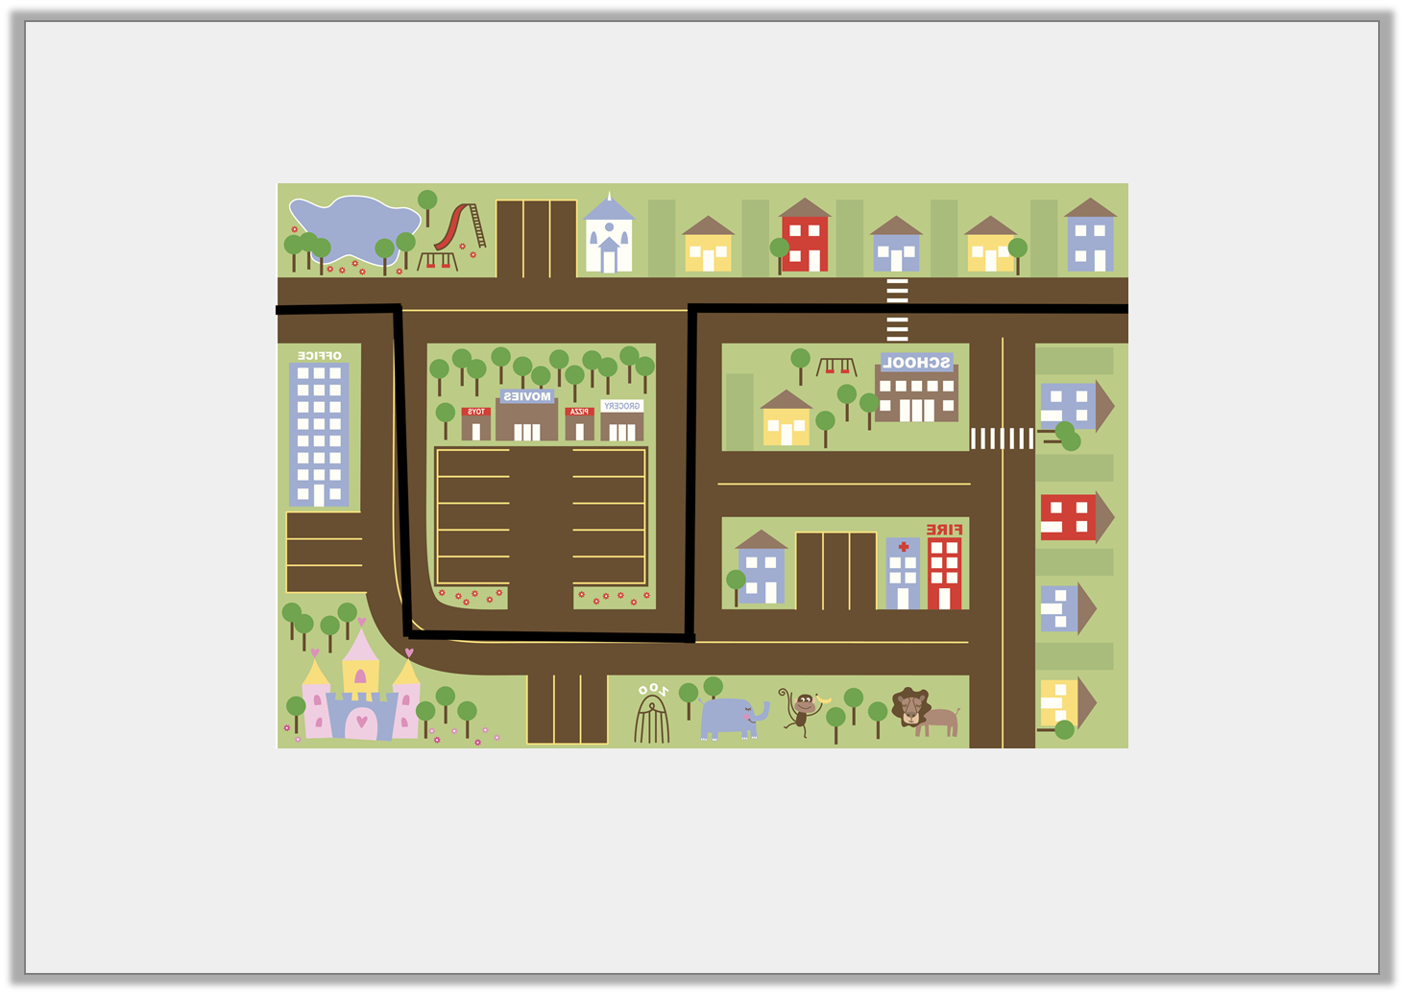
Problem Solving 1
Bianca has planned her route through town on this map.
Approximately how far does she travel in km?
0.5 miles
2.5 miles
2 miles
2 miles
1.5 miles
© Classroom Secrets Limited 2019

Slide 14
Problem Solving 1
Bianca has planned her route through town on this map.
Approximately how far does she travel in km?
Bianca travels approximately 13.6 kilometres.
0.5 miles
2.5 miles
2 miles
2 miles
1.5 miles
© Classroom Secrets Limited 2019

Slide 15
Reasoning 1
Chad says,
Is he correct? Explain your answer.
20.8 kilometres is equal to 16 miles.
© Classroom Secrets Limited 2019

Slide 16
Reasoning 1
Chad says,
Is he correct? Explain your answer.
Chad is incorrect because…
20.8 kilometres is equal to 16 miles.
© Classroom Secrets Limited 2019

Slide 17
Reasoning 1
Chad says,
Is he correct? Explain your answer.
Chad is incorrect because 20.8km is approximately equivalent to 13 miles, 16 miles is equivalent to 25.6km.
(20.8 ÷ 8 = 2.6; 2.6 x 5 = 13 miles)
(16 ÷ 5 = 3.2; 3.2 x 8 = 25.6km)
20.8 kilometres is equal to 16 miles.
© Classroom Secrets Limited 2019

Slide 18
Problem Solving 2
Ivy is planning a cycling trip.
She wants to arrive in Manchester, which is 61.5 miles from her starting point, by 2:00pm.
She starts her journey at 10:00am and has travelled 55.2 kilometres by 1:30pm.
How many miles does she have left?
© Classroom Secrets Limited 2019

Slide 19
Problem Solving 2
Ivy is planning a cycling trip.
She wants to arrive in Manchester, which is 61.5 miles from her starting point, by 2:00pm.
She starts her journey at 10:00am and has travelled 55.2 kilometres by 1:30pm.
How many miles does she have left?
Ivy has travelled 34.5 miles by 1:30pm meaning she has 27 miles left to travel.
(55.2 ÷ 8 = 6.9; 6.9 x 5 = 34.5; 61.5 – 34.5 = 27 miles)
© Classroom Secrets Limited 2019

