Slide 1
Cold Write task Write a defeating the monster story…..

Slide 2
Myths
Myths are traditional stories that attempt to explain the origin of someone or something. Myths were told orally in the days before written language and were passed down through generations.
Many myths include fantastic creatures with unusual features or special abilities.
The existence of these creatures is unproven although they remain popular in books and films to this day.

Slide 3
The Hydra
Many well-known mythical creatures come from ancient Greek or Roman mythology. One of these creatures was the Hydra.
The Hydra was a water monster who lived in the lake of Lerna. It was a terrifying, many-headed beast. Both the Hydra’s breath and blood were so venomous, it would instantly kill anyone who approached it.

Slide 4
The Hydra
Many adventurers had tried to destroy the Hydra by cutting off one of its heads. However, every time they did, two heads would grow back in its place. Myths say that Hercules eventually killed the Hydra as one of his twelve labours.
The goddess Hera is said to have placed the Hydra as a constellation of stars after Hercules killed the beast.
Archaeologists have discovered pictures of the Hydra on ancient Greek pottery.

Slide 5
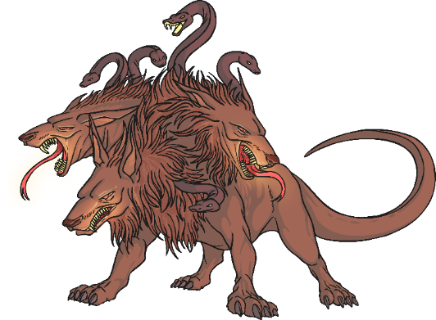
Cerberus
Cerberus was the three-headed dog who guarded the kingdom of Hades, god of the underworld. The underworld was the place where souls went after death.
In some accounts, he also had a serpent for a tail. Cerberus was said to be the son of a serpent monster and the brother of the Hydra.
Cerberus is mentioned in some of ancient Greece’s most well-known poems, ‘The Odyssey’ and ‘The Iliad’. Hercules was said to have captured Cerberus as one of his twelve labours although the beast was later safely returned to Hades.

Slide 6
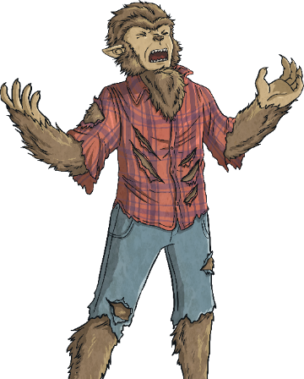
Werewolves
A werewolf is a shape-shifting creature. Stories of werewolves are part of many cultures from ancient Greece to Scandinavia.
Usually, a werewolf exists in human form but at times transforms into a wolf-like beast. In some cultures, a werewolf can transform at any time. However in most stories, the transformation takes place at the time of a full moon.
In some stories, werewolves are born with the condition. In others, they become werewolves when they are bitten by another werewolf.

Slide 7
Werewolves
A werewolf is sometimes called a ‘lycanthrope’.
When a werewolf has transformed, it is said that they become bloodthirsty beasts, desperate to attack people. They are meant to be unaware of their usual human form. In some stories, werewolves get such a taste for blood that they choose to remain living as a werewolf all the time.
Werewolves often feature in popular culture such as films, TV shows and books.

Slide 8
Leprechaun
A leprechaun is a mythical creature from Irish folklore.
They are mischievous creatures who make and mend shoes and enjoy playing practical jokes on people.
It is said that if a person catches a leprechaun, they will be granted three wishes.
Associated with leprechauns is the myth of finding a pot of gold at the end of a rainbow.

Slide 9
Sphinx
The Sphinx is a mythical creature who features in stories from several cultures. In most stories, the Sphinx was a cruel creature who could not be trusted.
In ancient Greece, the Sphinx had the head of a woman, the body of a lion and the wings of an eagle. The Sphinx lived outside the Greek city of Thebes and would set travellers a riddle. If they failed to solve the riddle, she would eat them. She set the hero Oedipus the following riddle: ‘What has four legs in the morning, two in the afternoon, and three in the evening?’
Can you solve the riddle?

Slide 10
Sphinx
Oedipus correctly guessed that the answer to the riddle was a human. A baby crawls on all fours, walks on two legs as an adult and walks on two legs and a walking stick in old age.
In ancient Egypt, the Sphinx was usually portrayed as a man. In Egyptian culture, the Sphinx wasn’t cruel but was instead a symbol of protection. This is why a Sphinx was chosen to protect the Great Pyramids of Giza.

Slide 11
Centaur
A centaur is a creature from Greek mythology. It is a creature with the head and torso of a man, joined to the body and legs of a horse.
It is thought that the stories may have originated when an ancient culture saw people riding on horseback for the first time and didn’t understand what they were seeing.
Centaurs are also present in popular culture including, ‘The Chronicles of Narnia’, ‘Harry Potter’ and the ‘Percy Jackson’ series.

Slide 12
Basilisk
A basilisk is a serpent who could kill with a single glance or a gust from its venomous breath. A basilisk is said to be the king of snakes.
Basilisks were part of folklore from many different European cultures. In the stories, basilisks could be killed in many ways, including from the tears of a phoenix, looking at its reflection in a mirror or hearing the crow of a rooster.
Basilisks can be found in many well-known poems and films including ‘Harry Potter and the Chamber of Secrets’.

Slide 13
Cold write-
Defeating the monster story-
Write a story about a character who defeats a monster – think about:
The setting- where is the story set? Describe-Is there a journey involved?
Who is your hero? Describe….
Who is the monster and does it meet and affect your hero?
How does your hero defeat or overcome the monster?
How does the hero escape?
Is there a sting in the tail?

