Slide 1
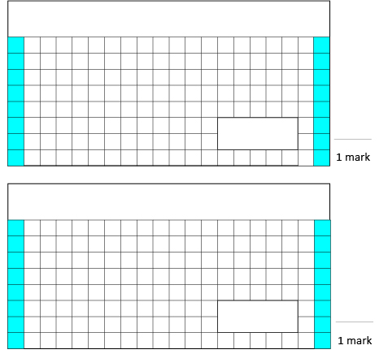
Thursday 30th April 2020 - Maths
3. To make a batch of 8 cereal bars, 125g of butter is needed. How much butter would be needed for 16 cereal bars?
1.
12 + 9 + 8 =
2.
28 + 86 =

