Slide 1
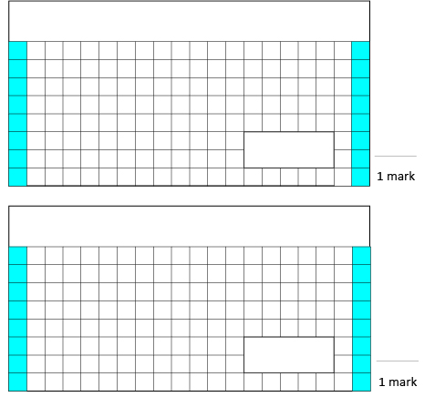
Thursday 26th March 2020 - Maths
3. Tick two fractions which are greater than a half.
$\frac{3}{10}$ $\frac{3}{5}$
$\frac{4}{10}$ $\frac{3}{4}$
1.
89 – 12 =
2.
$\frac{3}{5}$ + $\frac{1}{5}$ =

