Slide 1
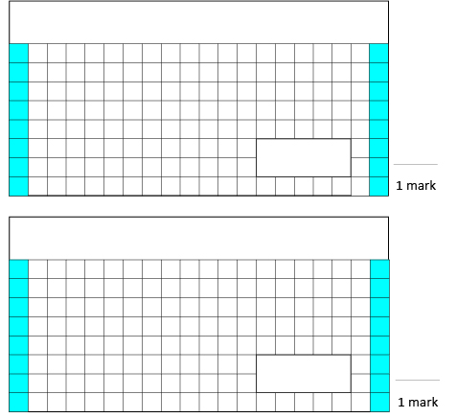
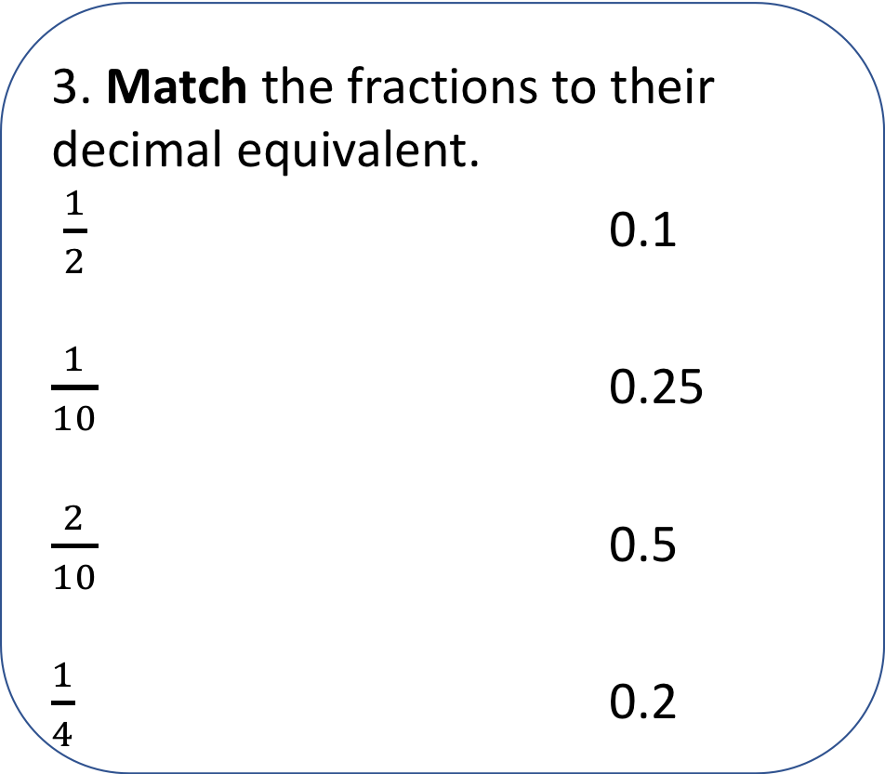
Tuesday 24th March
3. Match the fractions to their decimal equivalent.
$\frac{1}{2}$ 0.1
$\frac{1}{10}$ 0.25
$\frac{2}{10}$ 0.5
$\frac{1}{4}$ 0.2
1.
9 + 7 + 8 =
2.
40 ÷ 10 =

