Slide 1
Task 2: Tricky Teeth
Greetings me hearties!
Captain James Blackmouth here. Blackmouth by name, Blackmouth by nature! My teeth are all rotten and I can’t afford anymore gold ones, so the ship’s dentist tells me I must start brushing them. I haven’t got the foggiest where to begin.
Can you help?

Slide 2
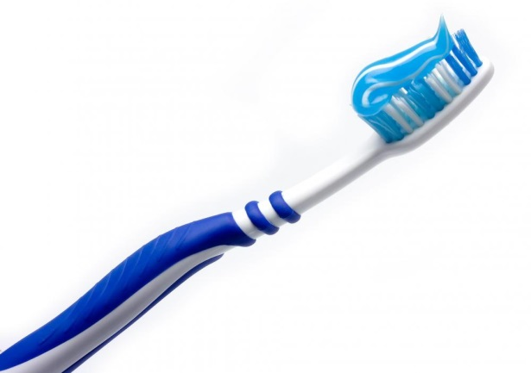
Task 2: Tricky Teeth
Mission: write a set of instructions which will explain to Captain James Blackmouth how to brush and care for his teeth.
Before you write:
Can you clearly explain how to brush your teeth?
How might a set of instructions be organised?
Is there some key language you will need to use?

Slide 3
Task 2: Tricky Teeth
After you have written:
Read your instructions aloud. Are they clear and concise?
Look carefully at the different types of punctuation in your writing. Is it placed and used accurately?
Notice the organisational devices you have used. Do they make your text easy to read and follow?
Identify the key language in your writing. Have you chosen precise words to make your meaning clear?

