Slide 1
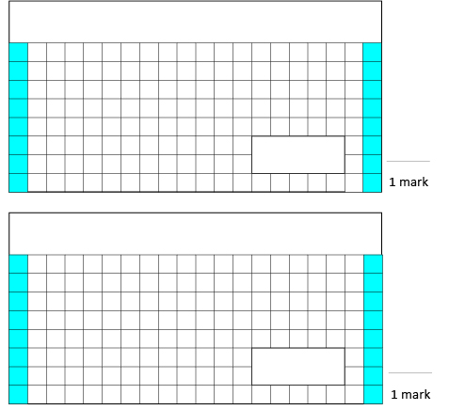
Day 1 – Monday 23rd March 2020
1.
9 + 6 + 12 =
3. Write down a number to make the statement true.
20 = 5 x
2.
86 – 10 =

