Slide 1
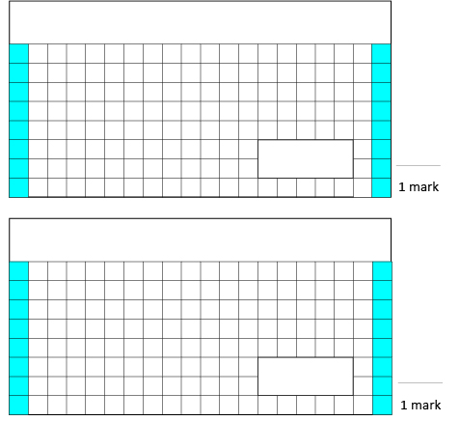
Tuesday 21st April - Maths
3. Write down the letters of the diagrams where the fraction coloured pink is equivalent to $\frac{1}{4}$ .
1.
9 x 6 =
A
B
C
2.
3,456 + 1,233 =

