Slide 1
Year 4 – Summer Block 2 – Properties of Shapes
Year 4: Reasoning about
3D Shapes
© Classroom Secrets Limited 2018

Slide 2
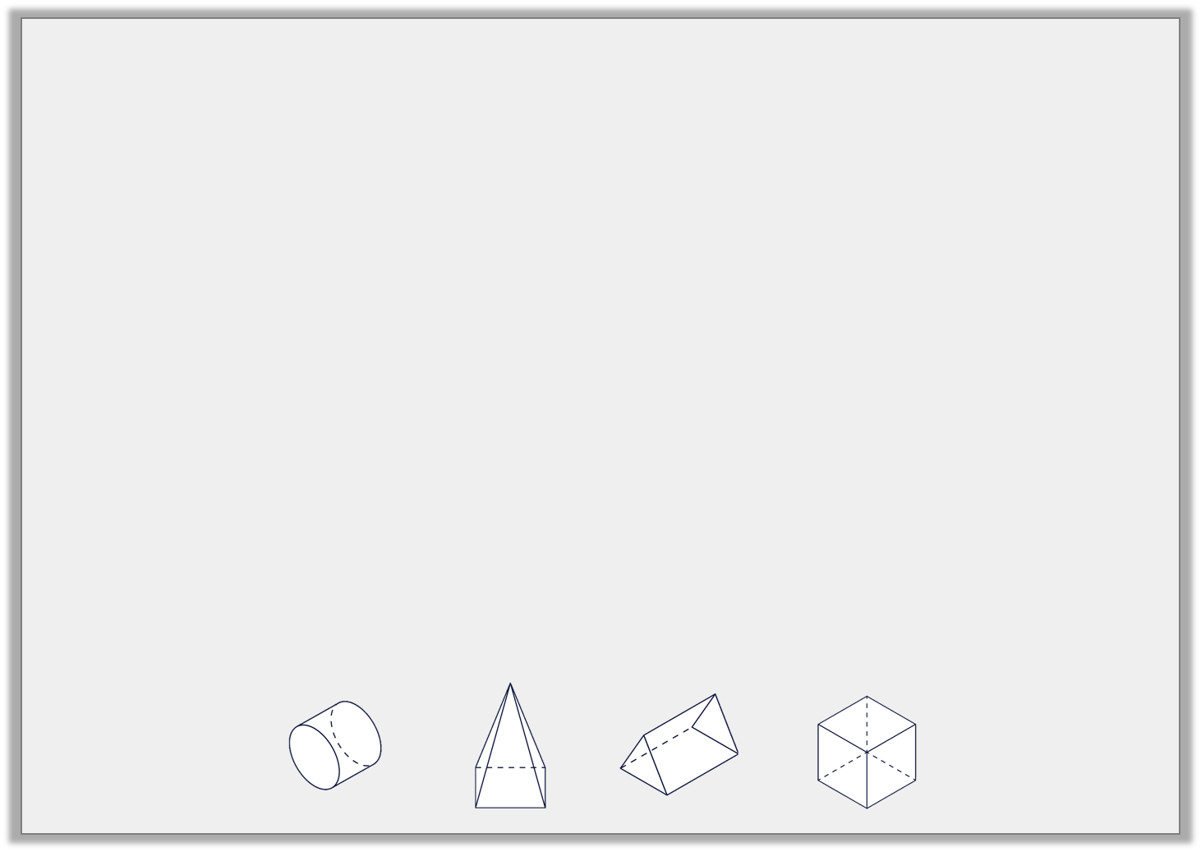
Introduction
Complete the chart using your knowledge of 3D shapes.
Name | Image | Properties
 |  | 6 faces, 12 edges and 8 vertices
 |  | 5 faces, 8 edges and 5 vertices
 |  | 3 faces, 2 edges and 0 vertices
 |  | 5 faces, 9 edges and 6 vertices
Y5
© Classroom Secrets Limited 2018

Slide 3
Varied Fluency 1
Count and name the 2D shapes in this net.
Y5
© Classroom Secrets Limited 2018

Slide 4
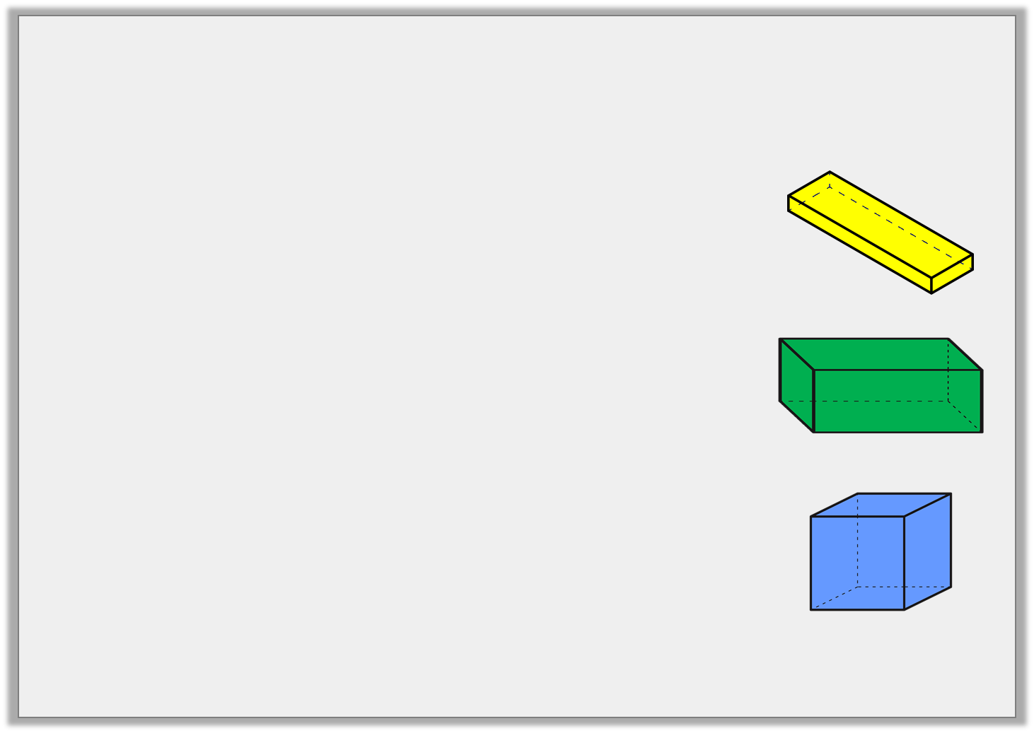
Varied Fluency 2
Match the net to the correct 3D shape.
Y5
© Classroom Secrets Limited 2018

Slide 5
Varied Fluency 3
Which 3D shape does the statement describe?
My base is an octagon. I also have 8 sides which are triangles.
Y5
© Classroom Secrets Limited 2018

Slide 6
Varied Fluency 4
Match the faces to the correct 3D shapes.
5 rectangular faces
hexagonal pyramid
6 triangular faces
cuboid
2 square faces
pentagonal
prism
Y5
© Classroom Secrets Limited 2018

Slide 7
Problem Solving 1
This is one shape from the net of a 3D shape.
Name three 3D shapes you could create.
List the other 2D shapes you would need to complete the shape.
Y5
© Classroom Secrets Limited 2018

Slide 8
Reasoning 1
Which of these 3D shapes could cast this shadow?
Explain your answer.
Square based
pyramid
hexagonal
prism
pentagonal
prism
Y5
© Classroom Secrets Limited 2018

Slide 9
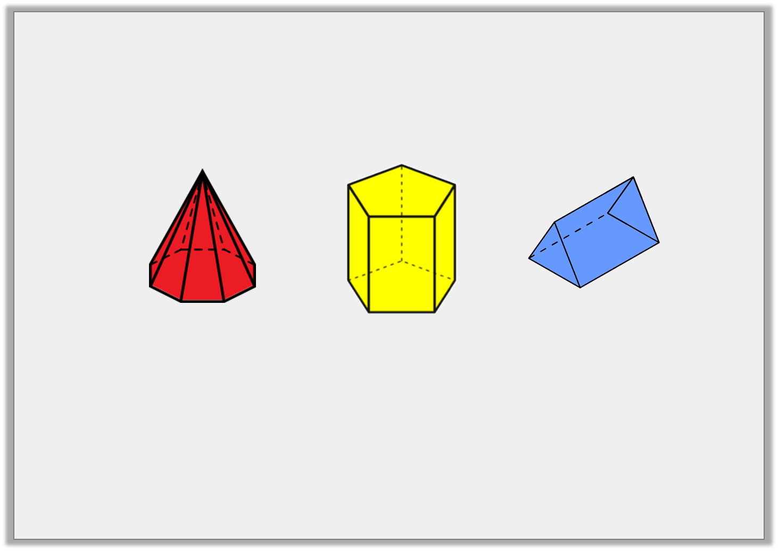
Reasoning 2
Considering the properties of the shapes below, which is the odd one out?
Explain your answer.
Y5
© Classroom Secrets Limited 2018

