Slide 1
Mass and Capacity
Step 5: Measure Capacity 1
© Classroom Secrets Limited 2018

Slide 2
Introduction
Complete the missing numbers in these sequences.
50 |  | 100 |  |  |  | 200
100 |  |  |  | 300 |  |  |  | 500
 |  | 100 |  |  |  | 200
A
B
C
© Classroom Secrets Limited 2018

Slide 3
Varied Fluency 1
Complete the sentence.
The capacity is millilitres.
150ml
50ml
© Classroom Secrets Limited 2018

Slide 4
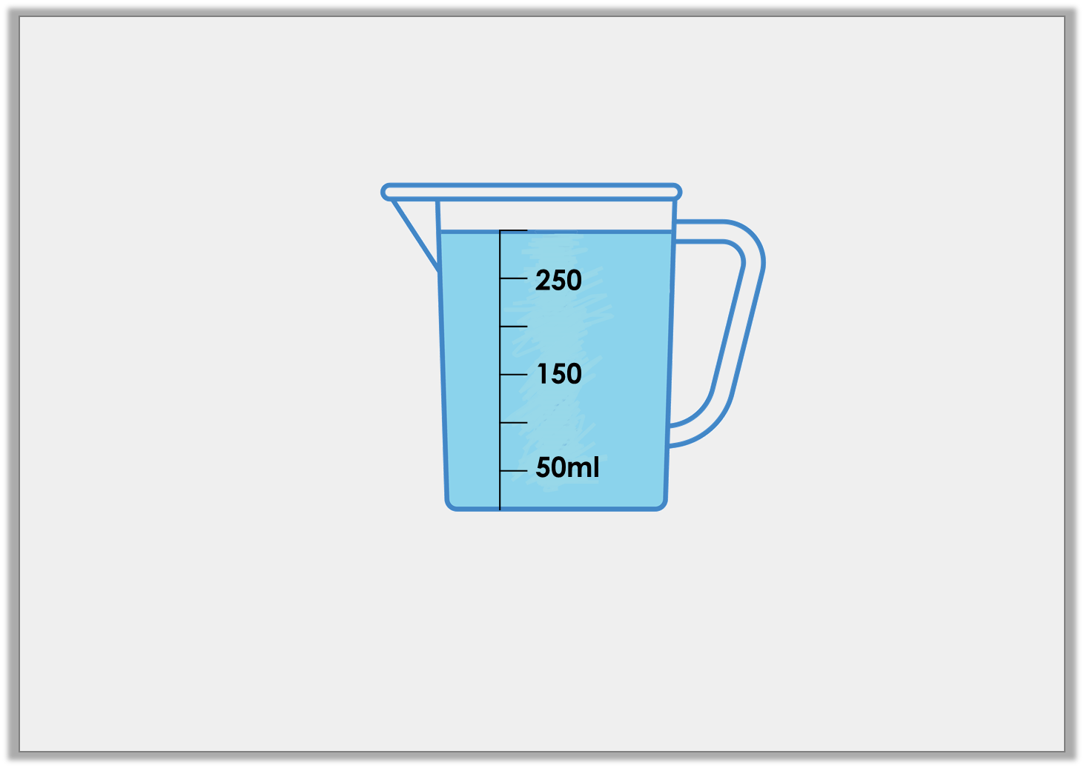
Varied Fluency 2
True or false? There are 300ml of liquid in the jug below.
© Classroom Secrets Limited 2018

Slide 5
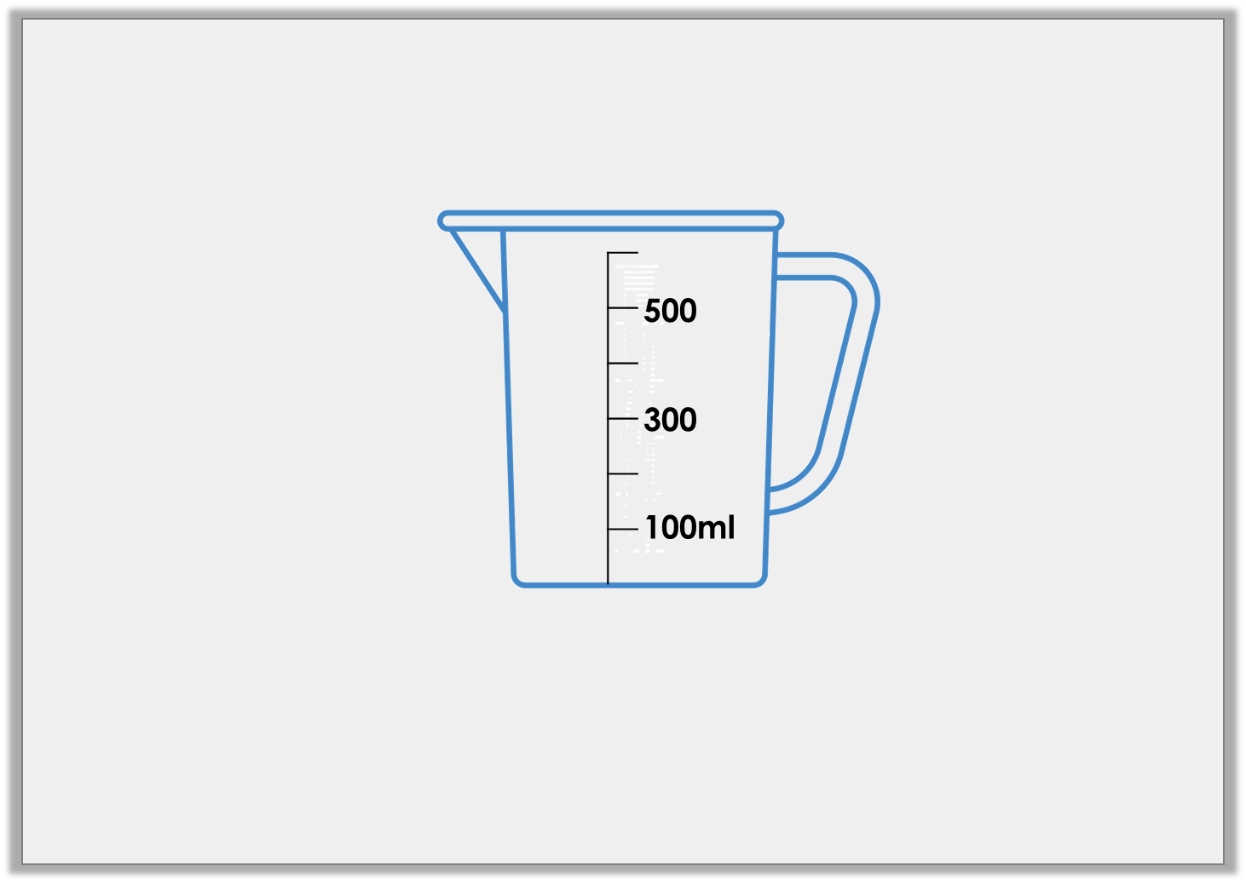
Varied Fluency 3
Draw an arrow to show the water level for a volume of 200ml.
© Classroom Secrets Limited 2018

Slide 6
Varied Fluency 4
Match the volumes to the correct containers.
A
B
C
200ml
100ml
300
100ml
4L
2L
200ml
3LL
150ml
© Classroom Secrets Limited 2018

Slide 7
Reasoning 1
Which is the odd one out? Explain your answer.
A
B
C
150ml
50ml
300
100ml
400ml
200ml
© Classroom Secrets Limited 2018

Slide 8
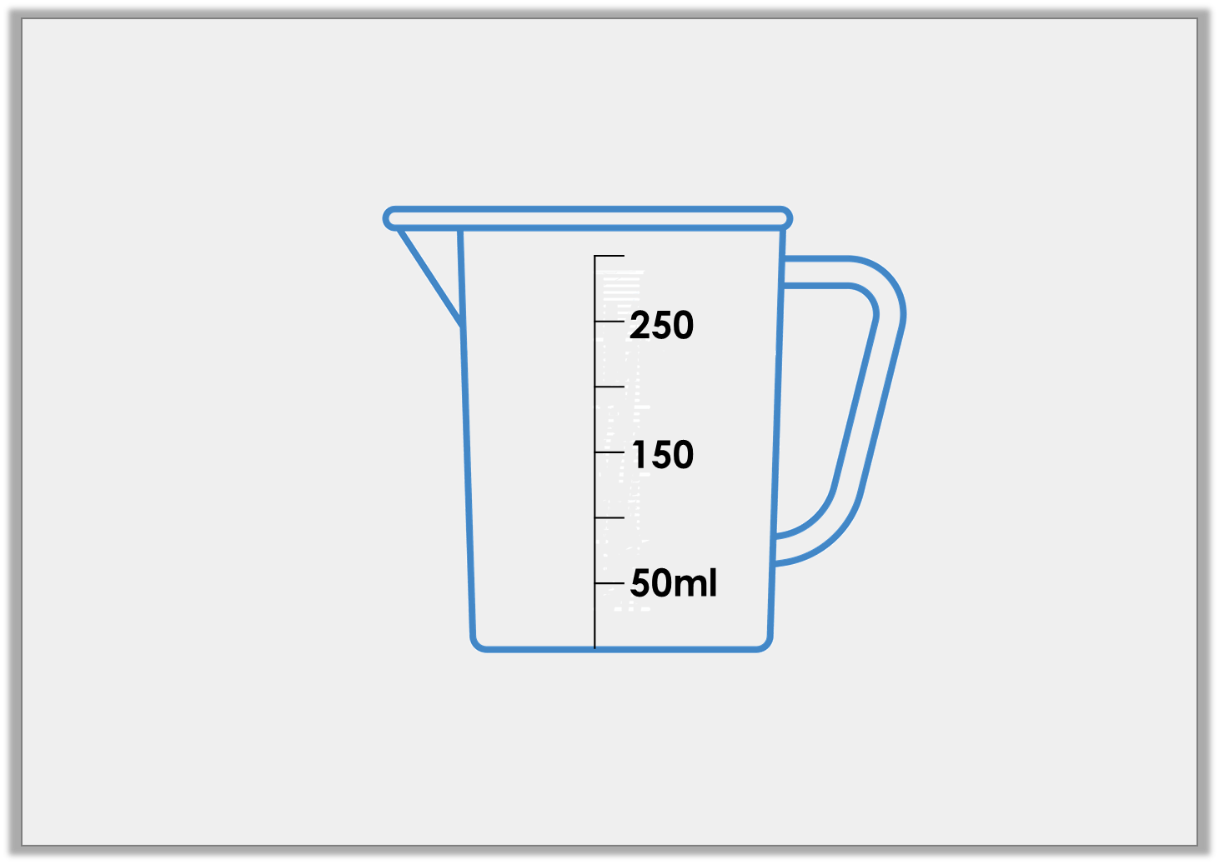
Problem Solving 1
Tom has poured water into the measuring jug below.
The volume is more 50ml than but less than 300ml.
How much water could he have?
Use arrows to label 3 possible answers.
© Classroom Secrets Limited 2018

Slide 9
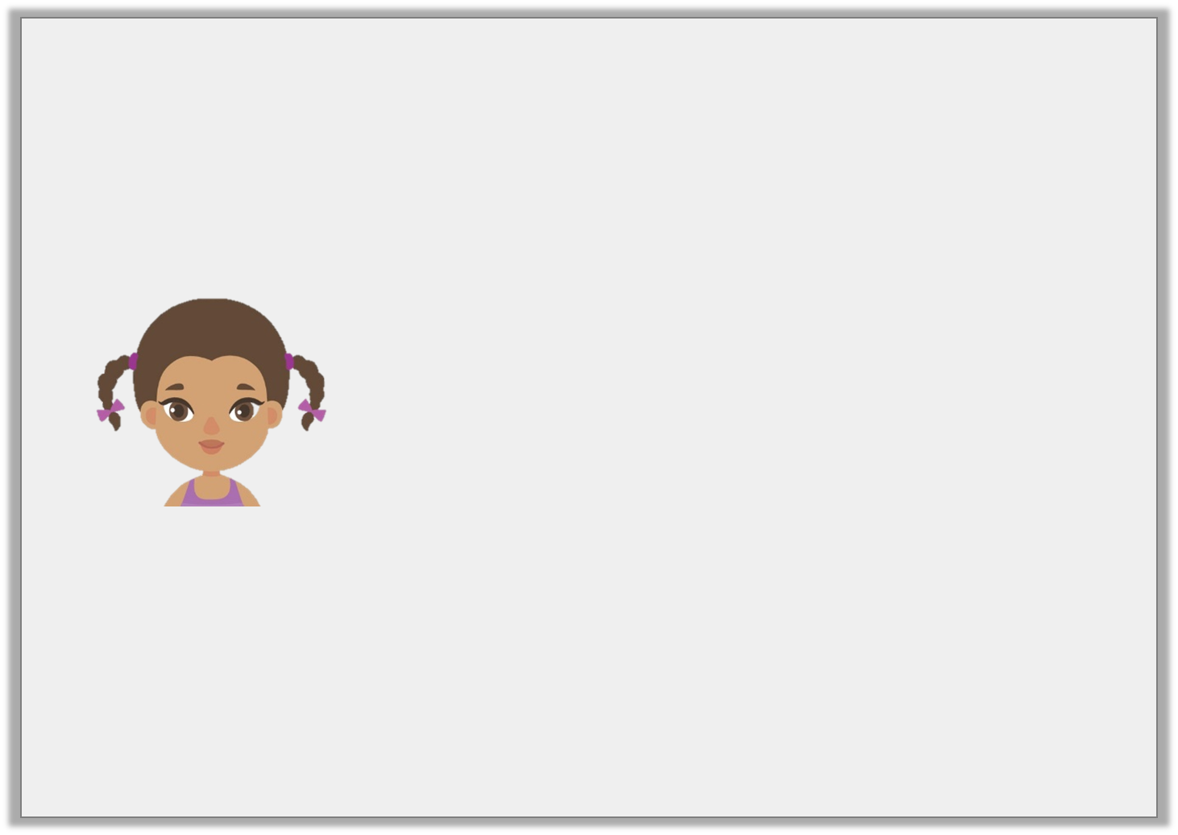
Reasoning 2
Is Aisha correct? Explain your answer.
I have 200ml of liquid in my container.
250
150
50ml
© Classroom Secrets Limited 2018

