Slide 1
W1c. Can generate multiple feasible ideas from a stimulus.
Commissioned by The PiXL Club Ltd.
Example 2017
This resource is strictly for the use of member schools for as long as they remain members of The PiXL Club. It may not be copied, sold nor transferred to a third party or used by the school after membership ceases. Until such time it may be freely used within the member school.
All opinions and contributions are those of the authors. The contents of this resource are not connected with nor endorsed by any other company, organisation or institution.
© Copyright The PiXL Club Limited, 2017

Slide 2
Sometimes the hardest part of writing is coming up with ideas.
The important thing to remember is that the more ideas you come up with, the more likely you are to come up with a brilliant one! We just need to practise creating ideas and then deciding on the ones we will use.
Ideas usually come from a STIMULUS. This is something which makes us think and helps us to form ideas.

Slide 3
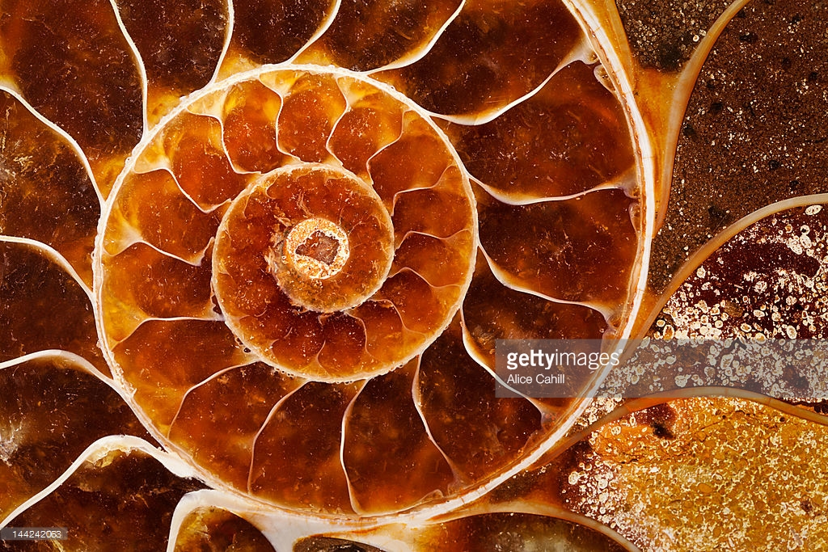
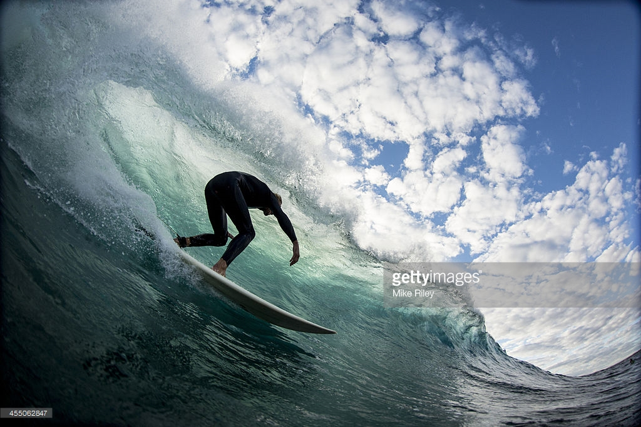
A stimulus could be:
an object
a book or an extract from a book
an experience
a piece of music

Slide 4
Imagine you are told the beginning of a story and you are asked to write what happened next.
Zeton couldn’t believe it! He had finally achieved his lifetime ambition and landed on Planet Zerot. Nervously, he stepped from the shuttle. A cloud of dust puffed up into the silent atmosphere. Looking behind him, he could see Parox, still at the controls, presumably checking everything for their return in two hours’ time. They only had enough power for a short visit.
Deciding he needed to make the most of the limited time, Zeton set off, carrying his bag full of all sorts of special equipment. He needed to take some samples before he left. As he peered ahead, the ground began to shake. His whole body vibrated with the noise. What was it? Suddenly, it dawned on him. The noise was coming from behind him. In horror, he turned just in time to see the shuttle take off and disappear into the distance!

Slide 5
So, our stimulus is the beginning of the story. We need to explore some ideas for how to continue it. If we write a few down (we may not end up using them) it will help us to decide how to continue.
Discussion
Can you and your partner think of two possible story lines for what could happen next?
He could explore the planet and find a character who helps him to return to Earth.
He could explore the planet and find a group of people who live there. He stays on the planet.
He could find a way to communicate with Earth and he is rescued.
He could find some special equipment and he manages to build a vehicle to return to Earth.

Slide 6
Once you have created some ideas, think in more detail about each one. Which one do you think would be most exciting for the reader? You might add a few notes under each one to help you with this. The most important thing is to write rough ideas, as this will guide us to deciding what we are going to write about.
He could explore the planet and find a character who helps him to return to Earth.
He could explore the planet and find a group of people who live there. He stays on the planet.
Character could be unfriendly at first. Perhaps he has been left there for years too and wants to get back to Earth?
I quite like this idea.
I need to make these ‘people’ interesting. Perhaps futuristic/mechanical?
I’m not sure this will be very gripping for my reader.

Slide 7
He could find a way to communicate with Earth and he is rescued.
He could find some special equipment and he manages to build a vehicle to return to Earth.
He is a scientist, so he would have the skill to do this. He has some tools with him and could find some other equipment.
As there are no other characters, I am going off this idea.
I could make this exciting by having some failed attempts to leave. Perhaps he reaches a closer planet but can’t reach Earth?
I think this could be good as I can introduce other planets and other characters.
Now that I have noted down some ideas and given them each a bit more thought, I have decided that I feel most enthusiastic about my first idea. If I am enthusiastic, I am more likely to make this entertaining for my reader!

Slide 8
Your turn: use the start of this story (or another story opening) to write down a few of your own ideas about how it could continue. Follow the steps:
Note down your first thoughts.
Go back to each idea and add a few notes and thoughts.
Decide which idea excites you most, and which you think your reader would find engaging and entertaining.

Slide 9
Imagine that a fossil, or picture of a fossil, is used as a stimulus. How can we use this to create some ideas for a story?
Discussion
What are your first thoughts about how this could be used in a story?

Slide 10
My character finds the fossil, picks it up and he is transported back to the time of the dinosaurs.
My character could find it and take it to the science museum. One of the scientists discovers that it holds the secret to eternal life!
Your turn: decide on two other ideas to go in the empty boxes.

Slide 11
Now you should have four different ideas for a story using the fossil as a stimulus.
Your turn: think about each idea. Write down a few more thoughts about each one. Then decide which one you would use.
Your turn
Explain your story idea to your partner. Do they think it is likely to be a great story line? Perhaps you can help each other with a few more ideas?

Slide 12
Imagine you have been surfing. A real life experience can give us many ideas for our writing.
Discussion
What ideas do you have based on the idea of surfing?

Slide 13
I could write about a world class surfer who is injured but manages to overcome it to win the World Championships.
My character could tumble from the surf board, into a huge wave, and discover an underwater world.
Your turn: decide on two other ideas to go in the empty boxes.

Slide 14
Now you should have four different ideas for a story using surfing as a stimulus.
Your turn: think about each idea. Write down a few more thoughts about each one. Then decide which one you would use.
Your turn
Explain your story idea to your partner. Do they think it is likely to be a great story line? Perhaps you can help each other with a few more ideas?

Slide 15
Your turn: think of something exciting which you have actually done in your life. Write down four ideas for a story based on this activity.
Note down your first thoughts.
Go back to each idea and add a few notes and thoughts.
Decide which idea excites you most, and which you think your reader would find engaging and entertaining.

Slide 16
Why not try creating several ideas using a piece of music as your stimulus?

Slide 17
So, once you are given a stimulus, the important thing is to write down all of your ideas – good or bad. Then go through each idea in more detail. Finally, decide which one you think would work best for your reader.
If you’re not excited by your idea, your reader won’t be either!

