Slide 1
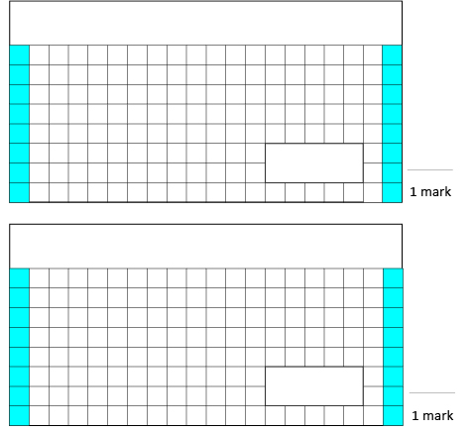
Friday 3rd April
3. Tick the calculation below that is the best estimate for this calculation.
30 + 20 + 20
40 + 15 + 20
40 + 20 + 20
1.
809 + 456 =
35 + 19 + 22
A
B
C
2.
910 – 345 =

